Slide 1
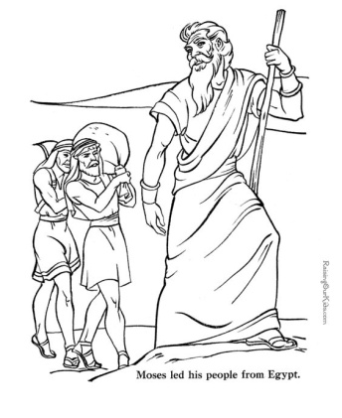
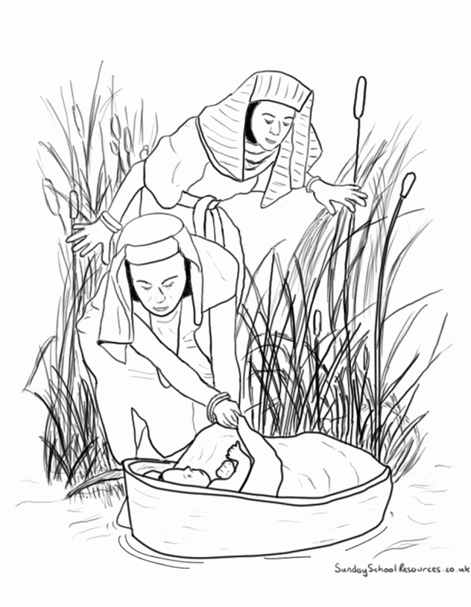
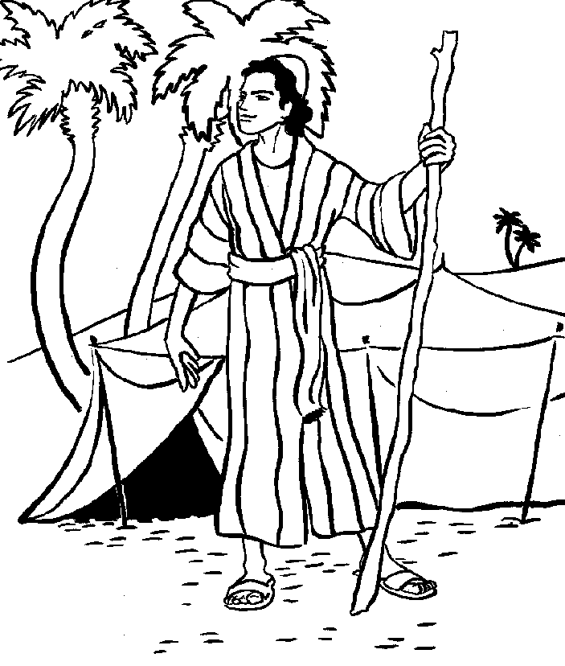
Today’s Lesson - Moses Leaves Egypt Let’s Review what you learned in lesson 2
Tell me…
What do you remember about the story of Moses?
Who was Moses?
When did the story about Moses happen?
Where did the story about Moses happen?
Why did this story happen?
Notes:
It was Jacob and his family who came to Goshen because of Famine in Canaan. Joseph became the governor and as a result Jacob was able to come to Egypt with his entire family. The Israelites had been in Goshen, Egypt for approximately 400 years. The story of Moses took place before the Israelites left Egypt.

Slide 2
Tell me More about Moses …
Where did Moses grow up?
How old was Moses when we first learn about him?
Who rescued him so that he would live?
Where did he grow up for the first 40 years?
Why did he live there?

Slide 3
More Review Questions
Why were the Children of Israel in Goshen, Egypt?
Why the Israelites were in Egypt for over 400 years?
What was God’s purpose for this?
Notes:
They were there for 400 years because life was good and God wanted them to multiply and grow into a nation.

Slide 4
Lesson 3 Memory Verse
Have I not commanded you? Be strong and courageous. Do not be afraid; do not be discouraged, for the Lord your God will be with you wherever you go.
Joshua 1:9

Slide 5
Today’s lesson – Leaving Egypt…
What happened that Moses needed to flee into the desert at the age of 40?
He was here for the next 40 years.
Read: Exodus 2: 11 – 15
3. Moses works as a Sheppard for Jethro his wife’s father tending sheep for 40 years.
4. Then God calls him. What does God have to tell him?

Slide 6
Review your
Memory Verse from lesson 2 :
So the Lord said to Moses, “I will also do this thing that you have spoken; for you have found grace in My sight, and I know you by name.” Exodus 33:17
Lesson 3

Slide 7
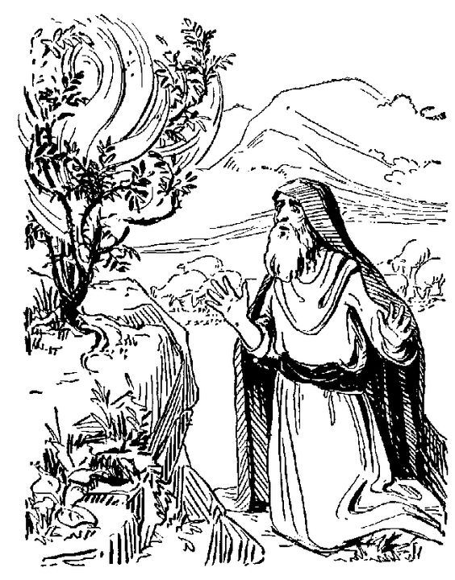
Does Moses want to do what God asks him to do?
God tells Moses what he needs to do
Read Exodus 3:7 – 17
Is this a big job for Moses?
How does Moses feel about it?
What is God’s response?

Slide 8
What did God tell Moses He would do for the Israelites?
The Lord God of the Hebrews has met with us; and now, please, let us go three days’ journey into the wilderness, that we may sacrifice to the Lord our God.’ ¹⁹ But I am sure that the king of Egypt will not let you go, no, not even by a mighty hand. ²⁰ So I will stretch out My hand and strike Egypt with all My wonders which I will do in its midst; and after that he will let you go. ²¹ And I will give this people favor in the sight of the Egyptians; and it shall be, when you go, that you shall not go empty-handed. ²² But every woman shall ask of her neighbor, namely, of her who dwells near her house, articles of silver, articles of gold, and clothing; and you shall put them on your sons and on your daughters. So you shall plunder the Egyptians.”
Exodus 3:18 - 22

Slide 9
Moses is now 80 years old
Moses now returns to Egypt at the age of 80.
What was happening in Egypt now?
Children of Israel were slaves . Why?
What did God do to free the Children of Israel from …. ? (Exodus: 2:23 -25; 4: 1- 17; 12:30 - 42)
How many plagues were there? Can you name them? If you need some help…
If you need some help : https://www.youtube.com/watch?v=LClIy1B8p2M&list=PLYZyz-oG1nTD6ycFu06a8onclawPj7b0e&index=2

Slide 10
What happened next?
What did Moses do to prepare the children of Israel to leave Goshen, Egypt?
What did Pharaoh do when the last plague came? Exodus 29 – 30
What had the children of Israel done in preparation to leave Goshen? Exodus 12:31-42
What does it mean to celebrate the Passover? Exodus 12
Lesson 3

Slide 11
Celebrating the Passover
Preparing:
A lamb without blemish was chosen 10 days before the Passover.
They packed up to get ready to leave right after the Passover – very early in the morning.
The lamb was killed and the blood was put on the doorposts and lintel of each home.
Then the lamb was roasted over a fire. They invited friends to eat with them in a hurry, not leaving anything over? Exodus 12 :42- 51

Slide 12
Leaving Goshen….
The Egyptians gave the Israelites many things to take along as they left: read parts of Exodus 2:1- 4:31
The Israelites took all of, their possessions with them and fled to 3 days journey to Succot where they all gathered.
check your map to see where this might be…

Slide 13
One of the Mysteries of God
We are not sure of the exact journey of the Children of Israel from Goshen through the Sinai Desert to Midian and into the land of Moab. There are a number of theories. However, what we do know is that the Bible says they did not go by the way of the Philistines.
Additionally, the Bible does not say that the children of Israel went along the coastline of Sinai to get to Midian, but through the desert.
https://ancientexodus.com/podcast-interview-the-lost-sea/
Check your Website and Map – see notes below
Notes:
The following website by Dr. Glen Fritz, as well as a podcast interview provides a very good description of a possible route of the Wilderness journey. This is the one used in this journey; although several websites are noted in the teacher’s notes and EndNotes to gather and confirm information for the map. But God is the only one who knows the exact route taken. This is one of God’s mysteries.
https://ancientexodus.com/podcast-interview-the-lost-sea/

Slide 14
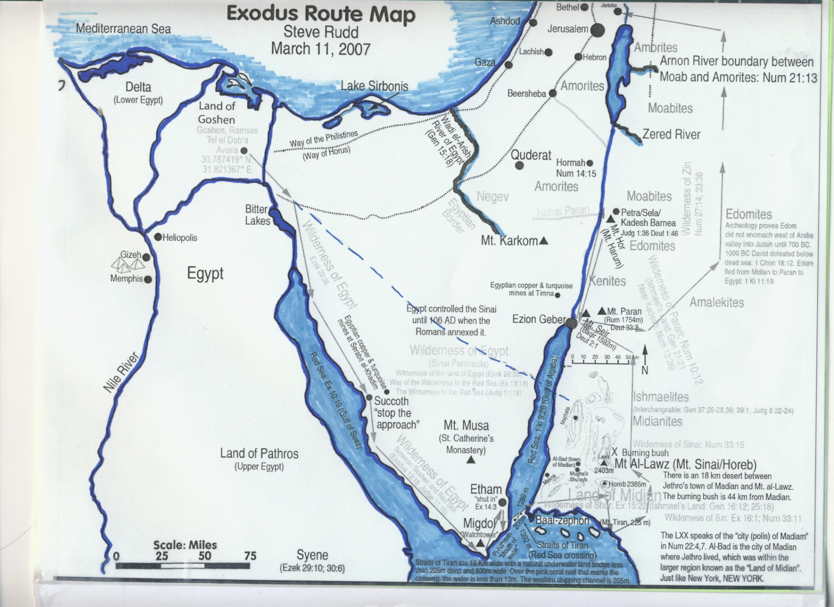
Short cut to Canaan
Notes:
Exodus tells us that the Israelites did not go by the way of the Philistines which followed the Mediterranean Sea and is the green dotted line. We will use the blue dotted line as a possible way for this Holy Land Tour. We will focus on the miracles that God provided to take them to Sinai. Some of these miracles are: they travelled day and night, their clothes did not wear out. God provided a cloud to lead them, a cloud to give comfort in the hot desert; a cloud of fire to lead at night, a cloud to separate the Israelites from the Egyptians on their way to the Red Sea, and God made a way to destroy Pharaoh and his army in the Red Sea.

Slide 15
Miracles that happened as they leave Goshen?
Clothes and supplies were given to the Israelites by
the Egyptians as they were leaving. Exodus 12:35, 36
Who else came with the children of Israel?
Where they travelled: God gave them the strength to flee for three days where they gathered at Succot.
Exodus 13:17 - 22
Find more miracles: Exodus13:20 – 22; Exodus 14
Notes:
The servants of the Israelites who were Egyptian were invited to come with them.

Slide 16
Since God is a God of power and might and wanted to show his amazing power to the nations, we may want to assume that they travelled through the Red Sea – as we know it today. It took the Israelites 1 month to get to and cross to the sea. The Bible says they travelled day and night. Another amazing miracle.
Jethro, Moses, father-in-law lived in Midian, where Moses was a shepherd for 40 years. Jethro came to visit Moses in Midian near what may be thought to be Mount Sinai. See additional notes in the teacher’s lesson book of instructions.

Slide 17
NOTE:
The next two slides show potential route; however, the map we will use illustrates a more detailed possibility.
People have explored and come up with possibilities, but in reality God is the only one who knows the details.
Why the evidence of the journey was lost. Check these websites for research and potential evidence.
https://ancientexodus.com/podcast-interview-the-lost-sea/
https://www.youtube.com/watch?v=uyiWmnVLwMU&list=PLYZyz-oG1nTD6ycFu06a8onclawPj7b0e&index=8

Slide 18
Examine the next map and answer the following questions.
Examine the map and look to see where Goshen is in Egypt.
What do you think the land was near the delta of the Nile River?
Dry and desert like? Why or Why Not?
or
Green and easy to grow plants? Why

Slide 19
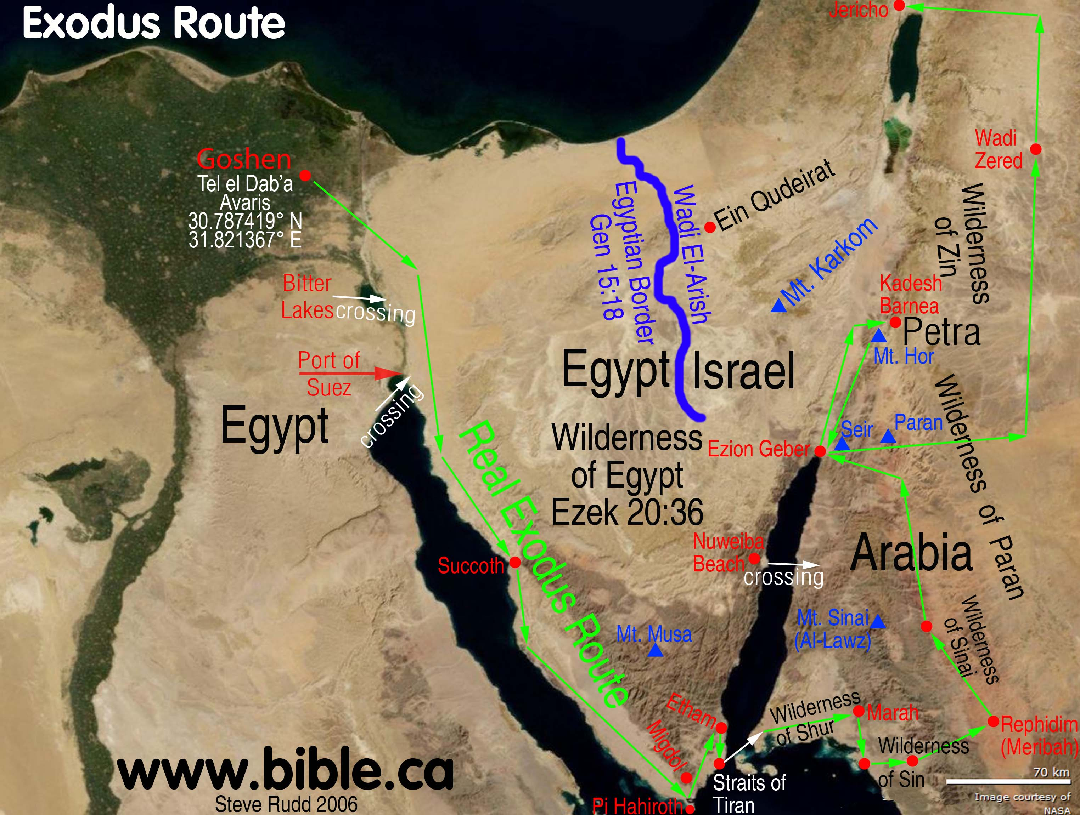
Possible routes to Midian and Mt Sinai
Notes:
These are routes that researchers have thought about. But, look to see what the Bible says or does not say. Exodus tells us the they did not go by the way of the Philistines. The Bible does not say they followed the coastline of Sinai, but that they went through the wilderness. Mt. Musa is a place that Constantine’s (300 AD) designated as Mt. Sinai. Exodus tells us that the Israelites confused the Egyptian Army and changed their route slightly; then crossed the Red Sea. The names of many places including some of the wilderness areas have been lost or the name has been changed.

Slide 20
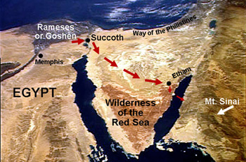
Notes:
This is another potential way that was taken to Mount Sinai. There is an area of land next to the coast that could hold over a million people before they crossed the Red Sea.

Slide 21
Short cut to Canaan
Notes:
Exodus tells us that the Israelites did not go by the way of the Philistines which followed the Mediterranean Sea and is the green dotted line. We will use the blue dotted line as a possible way for this Holy Land Tour. We will focus on the miracles that God provided to take them to Sinai. Some of these miracles are: they travelled day and night, their clothes did not wear out. God provided a cloud to lead them, a cloud to give comfort in the hot desert; a cloud of fire to lead at night, a cloud to separate the Israelites from the Egyptians on their way to the Red Sea, and God made a way to destroy Pharaoh and his army in the Red Sea.

Slide 22
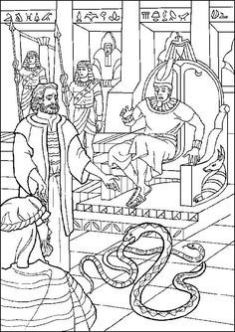
Let’s see what you remember!
However, the Pharaoh was unhappy and felt threatened by the large number of Israelites.
https://www.youtube.com/watch?v=1oU97fSl3pQ&list=PLYZyz-oG1nTD6ycFu06a8onclawPj7b0e&index=7
https://www.youtube.com/watch?v=3bLlpy0MW08&list=PLYZyz-oG1nTD6ycFu06a8onclawPj7b0e&index=9
2. According to the Bible name the 10:
https://www.youtube.com/watch?v=LClIy1B8p2M&list=PLYZyz-oG1nTD6ycFu06a8onclawPj7b0e&index=2
3. What was the last plague?
And what happened after that?

Slide 23
Lesson 3 Memory Verse
Have I not commanded you? Be strong and courageous. Do not be afraid; do not be discouraged, for the Lord your God will be with you wherever you go.
Joshua 1:9

Slide 24
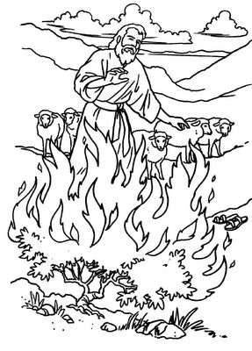
Lesson 3: Pictures to add to your Passport

Slide 25
Challenge
Lesson 3 Memory Verse:
And they sang the song of Moses, the bond-servant of God, and the song of the Lamb, saying, "Great and marvelous are Your works, O Lord God, the Almighty; Righteous and true are Your ways, King of the nations! "Who will not fear, O Lord, and glorify Your name? For You alone are holy; for all the nations will come and worship before you, for your righteous acts have been revealed.“Revelation 15: 3-4

