Slide 1
Lesson 11
Crossing the Jordan, settling in Gilgal, celebrating Passover
.
Opening Prayer
Sing:
Father Abraham or another song
Memory Verses
Review where we did we travel during the last lesson?
Lesson #11
NOTE: This lesson is very lengthy and can easily be presented as 2 or 3 lessons.

Slide 2
From Gilgal, Jericho – claiming back the land in Canaan.
Review:
The journey
Verses and Commandments…
Crossing the Jordan River
The Ark of the Covenant
12 stones piled in the Jordan River
12 stones taken from the river to build an altar

Slide 3
And God spoke all these words: The 10 Commandments and
Exodus 20: 3 – 17
"I am ADONAI your God, who brought you out of the land of Egypt, out of the abode of slavery."
You are to have no other gods before me.
You are not to make for yourselves a carved image or any kind

Slide 4
You are not to use God’s name in vain.
Remember the Shabbat (Sabbath) and keep it holy.
Honor your father and mother.
Do not murder.
Do not commit adultery.
Do not steal.
Do not lie.
Do not covet.

Slide 5
What does it mean to repent?
To truly be sorry
Ask for forgiveness
Thank God for forgiving you
And not making the same mistake again…
Examples of doing wrong/sin…

Slide 6
Review Bible Memory Verses
Joshua 1:16 –
Then they answered Joshua, “Whatever you have commanded us we will do, and wherever you send us we will go.
Joshua 24:15
“Choose for yourselves this day whom you will serve…but as for me and my household, we will serve the Lord”

Slide 7
Learning Obedience to God
The story of Balaam
Camping at Gilgal
Achan’s Sin at Ai
Joshua’s Legacy

Slide 8
Learning Obedience to God
The story of Balaam
Students can act out this story as a mime as a narrator reads the Scripture.
The actors needed include:
Balaam, Balak (the king), the donkey, the angel of God and reader to read what God says.

Slide 9
Obeying God
1. Story of Balaam and his talking donkey…
Numbers 22 -24 (NKJ)
Balak Sends for Balaam
22 Then the children of Israel moved, and camped in the plains of Moab on the side of the Jordan across from Jericho.
² Now Balak the son of Zippor saw all that Israel had done to the Amorites. ³ And Moab was exceedingly afraid of the people because they were many, and Moab was sick with dread because of the children of Israel. ⁴ So Moab said to the elders of Midian, “Now this company will lick up everything around us, as an ox licks up the grass of the field.” And Balak the son of Zippor was king of the Moabites at that time.
Notes:
Students can act out this story as a mime as a narrator reads from Scripture. The actors needed are: Balaam, Balak, the donkey, the angel of God. In this story God has several lessons to teach the reader: do not let others convince you that something is right, when they have other motives for their own motives for gain in mind. Do not let others manipulate you when God has given you insights into what is the right thing to do.

Slide 10
King Balak’s fear
⁵ Then he sent messengers to Balaam the son of Beor at Pethor, which is near the River in the land of the sons of his people, to call him, saying: “Look, a people has come from Egypt. See, they cover the face of the earth, and are settling next to me!
⁶Therefore please come at once, curse this people for me, for they are too mighty for me. Perhaps I shall be able to defeat them and drive them out of the land, for I know that he whom you bless is blessed, and he whom you curse is cursed.”
Notes:
Students can act out this story as a mime as a narrator reads from Scripture. The actors needed are: Balaam, Balak, the donkey, the angel of God. In this story God has several lessons to teach the reader: do not let others convince you that something is right, when they have other motives for their own motives for gain in mind. Do not let others manipulate you when God has given you insights into what is the right thing to do.

Slide 11
King Balak trying to convince Balaam
⁷ So the elders of Moab and the elders of Midian departed with the diviner’s fee in their hand, and they came to Balaam and spoke to him the words of Balak. ⁸ And he said to them, “Lodge here tonight, and I will bring back word to you, as the Lord speaks to me.” So the princes of Moab stayed with Balaam.
⁹ Then God came to Balaam and said, “Who are these men with you?”
¹⁰ So Balaam said to God, “Balak the son of Zippor, king of Moab, has sent to me, saying,
Notes:
Students can act out this story as a mime as a narrator reads from Scripture. The actors needed are: Balaam, Balak, the donkey, the angel of God. In this story God has several lessons to teach the reader: do not let others convince you that something is right, when they have other motives for their own motives for gain in mind. Do not let others manipulate you when God has given you insights into what is the right thing to do.

Slide 12
King Balak’s fear… and what he wanted Balaam to do…
¹¹ ‘Look, a people has come out of Egypt, and they cover the face of the earth. Come now, curse them for me; perhaps I shall be able to overpower them and drive them out.’ ”
¹² And God said to Balaam, “You shall not go with them; you shall not curse the people, for they are blessed.”
¹³ So Balaam rose in the morning and said to the princes of Balak, “Go back to your land, for the Lord has refused to give me permission to go with you.”
Notes:
Students can act out this story as a mime as a narrator reads from Scripture. The actors needed are: Balaam, Balak, the donkey, the angel of God. In this story God has several lessons to teach the reader: do not let others convince you that something is right, when they have other motives for their own motives for gain in mind. Do not let others manipulate you when God has given you insights into what is the right thing to do.

Slide 13
What are we to learn from this part of the Story of Balaam and Balak?
Numbers 22: 10 -11
¹⁰ Then Balak’s (Moabite King, leader) anger was aroused against Balaam (whom God was speaking to and through), and he struck his hands together (clapped); and Balak said to Balaam, “I called you to curse my enemies (the Israelites), and look, you have bountifully blessed them these three times! ¹¹ Now therefore, flee to your place. I said I would greatly honor you, but in fact, the Lord has kept you back from honor.”
Whose honor is greater and more important?
What man can give or what God can give you?
Why?
Notes:
We do not need to follow the orders of others when they are being forceful or deceptive, or go against what you know is the right thing to do.

Slide 14
Balak trying to entice Balaam…
¹⁴ And the princes of Moab rose and went to Balak, and said, “Balaam refuses to come with us.” ¹⁵ Then Balak again sent princes, more numerous and more honorable than they. ¹⁶ And they came to Balaam and said to him, “Thus says Balak the son of Zippor: ‘Please let nothing hinder you from coming to me; ¹⁷ for I will certainly honor you greatly, and I will do whatever you say to me. Therefore please come, curse this people for me.’ ”
Notes:
Students can act out this story as a mime as a narrator reads from Scripture. The actors needed are: Balaam, Balak, the donkey, the angel of God. In this story God has several lessons to teach the reader: do not let others convince you that something is right, when they have other motives for their own motives for gain in mind. Do not let others manipulate you when God has given you insights into what is the right thing to do.

Slide 15
God speaks to Balaam
¹⁸ Then Balaam answered and said to the servants of Balak, “Though Balak were to give me his house full of silver and gold, I could not go beyond the word of the Lord my God, to do less or more. ¹⁹ Now therefore, please, you also stay here tonight, that I may know what more the Lord will say to me.”
²⁰ And God came to Balaam at night and said to him, “If the men come to call you, rise and go with them; but only the word which I speak to you—that you shall do.” ²¹ So Balaam rose in the morning, saddled his donkey, and went with the princes of Moab.
Notes:
Students can act out this story as a mime as a narrator reads from Scripture. The actors needed are: Balaam, Balak, the donkey, the angel of God. In this story God has several lessons to teach the reader: do not let others convince you that something is right, when they have other motives for their own motives for gain in mind. Do not let others manipulate you when God has given you insights into what is the right thing to do.

Slide 16
Balaam, his Donkey, and the Angel
²² Then God’s anger was aroused because he went, and the Angel of the Lord took His stand in the way as an adversary against him. And he was riding on his donkey, and his two servants were with him. ²³ Now the donkey saw the Angel of the Lord standing in the way with His drawn sword in His hand, and the donkey turned aside out of the way and went into the field. So Balaam struck the donkey to turn her back onto the road. ²⁴ Then the Angel of the Lord stood in a narrow path between the vineyards, with a wall on this side and a wall on that side. ²⁵ And when the donkey saw the Angel of the Lord, she pushed herself against the wall and crushed Balaam’s foot against the wall; so he struck her again.
Notes:
God used a painful physical lesson to communicate with Balaam to follow his instructions.

Slide 17
²⁶ Then the Angel of the Lord went further, and stood in a narrow place where there was no way to turn either to the right hand or to the left. ²⁷ And when the donkey saw the Angel of the Lord, she lay down under Balaam; so Balaam’s anger was aroused, and he struck the donkey with his staff.
²⁸ Then the Lord opened the mouth of the donkey, and she said to Balaam, “What have I done to you, that you have struck me these three times?”
²⁹ And Balaam said to the donkey, “Because you have abused me. I wish there were a sword in my hand, for now I would kill you!”

Slide 18
³⁰ So the donkey said to Balaam, “Am I not your donkey on which you have ridden, ever since I became yours, to this day? Was I ever disposed to do this to you?”
And he said, “No.”
³¹ Then the Lord opened Balaam’s eyes, and he saw the Angel of the Lord standing in the way with His drawn sword in His hand; and he bowed his head and fell flat on his face. ³² And the Angel of the Lord said to him, “Why have you struck your donkey these three times? Behold, I have come out to stand against you, because your way is perverse before Me. ³³ The donkey saw Me and turned aside from Me these three times. If she had not turned aside from Me, surely I would also have killed you by now, and let her live.”
Notes:
God has the power to open our eyes to understand what is happening in real life situations. This event can become a powerful life-time lesson. Have you had any experiences where your eyes have been opened and you have learned a lesson that you will never forget? Or has turned you to understanding God better and the plan he has for your life?

Slide 19
³⁴ And Balaam said to the Angel of the Lord, “I have sinned, for I did not know You stood in the way against me. Now therefore, if it displeases You, I will turn back.”
³⁵ Then the Angel of the Lord said to Balaam, “Go with the men, but only the word that I speak to you, that you shall speak.” So Balaam went with the princes of Balak.
³⁶ Now when Balak heard that Balaam was coming, he went out to meet him at the city of Moab, which is on the border at the Arnon, the boundary of the territory. ³⁷ Then Balak said to Balaam, “Did I not earnestly send to you, calling for you? Why did you not come to me? Am I not able to honor you?”
Notes:
Is God calling us to do certain things? If we are in tune with the Holy Spirit/God; he will instruct or direct us. He gives us instructions in many different ways; maybe not like Balaam, but in ways that we will understand. .

Slide 20
³⁸ And Balaam said to Balak, “Look, I have come to you! Now, have I any power at all to say anything? The word that God puts in my mouth, that I must speak.”
Numbers 24
Balaam Foretells the Happiness of Israel
24 Now when Balaam saw that it pleased the Lord to bless Israel, he did not go as at other times, to seek to use sorcery, but he set his face toward the wilderness. ² And Balaam raised his eyes, and saw Israel encamped according to their tribes; and the Spirit of God came upon him…
Notes:
Balaam is very honest with Balak, but Balak still wants to manipulate Balaam and convince him to do what Balak wants. Balak feels he can buy Balaam with material goods.

Slide 21
Numbers 23 - Balaam obeys God …
Then the Lord put a word in Balaam’s mouth, and said, “Return to Balak, and thus you shall speak.” ⁶ So he returned to him, and there he was, standing by his burnt offering, he and all the princes of Moab.
⁷ And he took up his oracle [spoke his message] and said:
“Balak the king of Moab has brought me from Aram, From the mountains of the east. ‘Come, curse Jacob for me, And come, denounce Israel!’
Is to speak a curse over Israel a dilemma for Balaam?
(Hint: see the note beneath the slide for the answer.)
Notes:
God has several lessons to teach the reader: do not let others convince you that something is right, when they have other motives for their own motives for gain in mind. Do not let others manipulate you when God word has given you insights into what is the right thing to do.

Slide 22
Balaam blesses Israel …
Numbers 23
⁸ “How shall I curse whom God has not cursed? And how shall I denounce whom the Lord has not denounced? ⁹ For from the top of the rocks I see him, And from the hills I behold him; There! A people dwelling alone, Not reckoning itself among the nations.
¹⁰ “Who can count the dust of Jacob, Or number one-fourth of Israel? Let me die the death of the righteous, And let my end be like his!”
Notes:
God has several lessons to teach the reader: it is better to bless than to curse people, especially God’s chosen people. Do not let others manipulate you when God has given you instructions to do the right thing to do. When Balak sees the vast multitudes of Israelites, he feels threatened that they will conquer him and his people. He has probably heard about the might and power of the God of Israel and the miraculous crossing of the Red Sea. Balak is very afraid that the Israelites will destroy them and does everything to have Balaam curse who God has blessed and taken care of. Verse 9 tells us that they are a people dwelling alond

Slide 23
What are we to learn from this part of the Story of Balaam and Balak?
Numbers 24: 12 - 14
¹² So Balaam said to Balak, “Did I not also speak to your messengers whom you sent to me, saying, ¹³ ‘If Balak were to give me his house full of silver and gold, I could not go beyond the word of the Lord, to do good or bad of my own will. What the Lord says, that I must speak’? ¹⁴ And now, indeed, I am going to my people. Come, I will advise you what this people will do to your people in the latter days.”
What can we learn from this story of Balak and Balaam ?
What can we learn about God from this story?
Notes:
The Bible says we are to bless Israel, not curse Israel.
Following the word of the Lord and doing what is right in God’s sight is much more important than material gain or what others want us to do for their gain.

Slide 24
Obeying God
Who do we obey?
Others OR GOD?
Why?
Discuss the positive and negative consequences of obeying
People
God

Slide 25
Deuteronomy 34
¹ Then Moses went up to Mount Nebo from the plains of Moab and climbed Pisgah Peak, which is across from Jericho. And the Lord showed him the whole land, from Gilead as far as Dan; ² all the land of Naphtali; the land of Ephraim and Manasseh; all the land of Judah, extending to the Mediterranean Sea^{[a]}; ³ the Negev; the Jordan Valley with Jericho—the city of palms—as far as Zoar. ⁴ Then the Lord said to Moses, “This is the land I promised on oath to Abraham, Isaac, and Jacob when I said, ‘I will give it to your descendants.’ I have now allowed you to see it with your own eyes, but you will not enter the land.”
Why would Moses not enter Canaan,
The Promised Land?

Slide 26
Although at this time, Moses did not go into Canaan, he did appear on the Mt of Transfiguration with Elijah.
Jesus Transfigured on the Mount
Matthew 17
¹ Now after six days Jesus took Peter, James, and John his brother, led them up on a high mountain by themselves; ² and He was transfigured before them. His face shone like the sun, and His clothes became as white as the light. ³ And behold, Moses and Elijah appeared to them, talking with Him. …

Slide 27
Matthew 17 New King James Version (NKJV)
⁴ Then Peter answered and said to Jesus, “Lord, it is good for us to be here; if You wish, let us make here three tabernacles: one for You, one for Moses, and one for Elijah.”
⁵ While he was still speaking, behold, a bright cloud overshadowed them; and suddenly a voice came out of the cloud, saying, “This is My beloved Son, in whom I am well pleased. Hear Him!” ⁶ And when the disciples heard it, they fell on their faces and were greatly afraid. ⁷ But Jesus came and touched them and said, “Arise, and do not be afraid.” ⁸ When they had lifted up their eyes, they saw no one but Jesus only.

Slide 29
https://http://filesfromtoni.blogspot.ca/2009/01/how-much-land-did-god-give-israel-in.html

Slide 30
https://www.google.ca/search?q=land+God+promised+to+Israel&tbm=isch&imgil=HfndXl79GsSFnM%253A%253BVEDrHmfrN3_uyM%
253Bhttp%25253A%25252F%25252Ffilesfromtoni.blogspot.com%25252F2009%25252F01%25252Fhow-much-land-did-god-give-israel- in.html&source=iu&pf=m&fir=HfndXl79GsSFnM%253A%252CVEDrHmfrN3_uyM%252C_&usg= 8jimV_E0lKGBSggkNSN_6rqJcMk%3D&bi w=1333&bih=637&ved=0ahUKEwiLwJyf2OTOAhUDHGMKHRTBAXwQyjcIKw&ei=nCbDV4uCFYO4jAOUgofgBw#imgrc=N9IjRigs61DW6M%3A

Slide 31
1. Hand out map of where the tribes would have land.

Slide 32
Moses had died at Mount Nebo.
Deuteronomy 34:
⁵ So Moses, the servant of the Lord, died there in the land of Moab, just as the Lord had said. ⁶ The Lord buried him^{[b]} in a valley near Beth-peor in Moab, but to this day no one knows the exact place. ⁷ Moses was 120 years old when he died, yet his eyesight was clear, and he was as strong as ever. ⁸ The people of Israel mourned for Moses on the plains of Moab for thirty days, until the customary period of mourning was over.
NOTE: Moses appeared with Elijah on the Mt. of Transfiguration in Canaan .
Matthew 17 Now after six days Jesus took Peter, James, and John his brother, led them up on a high mountain by themselves; ² and He was transfigured before them. His face shone like the sun, and His clothes became as white as the light. ³ And behold, Moses and Elijah appeared to them, talking with Him.

Slide 33
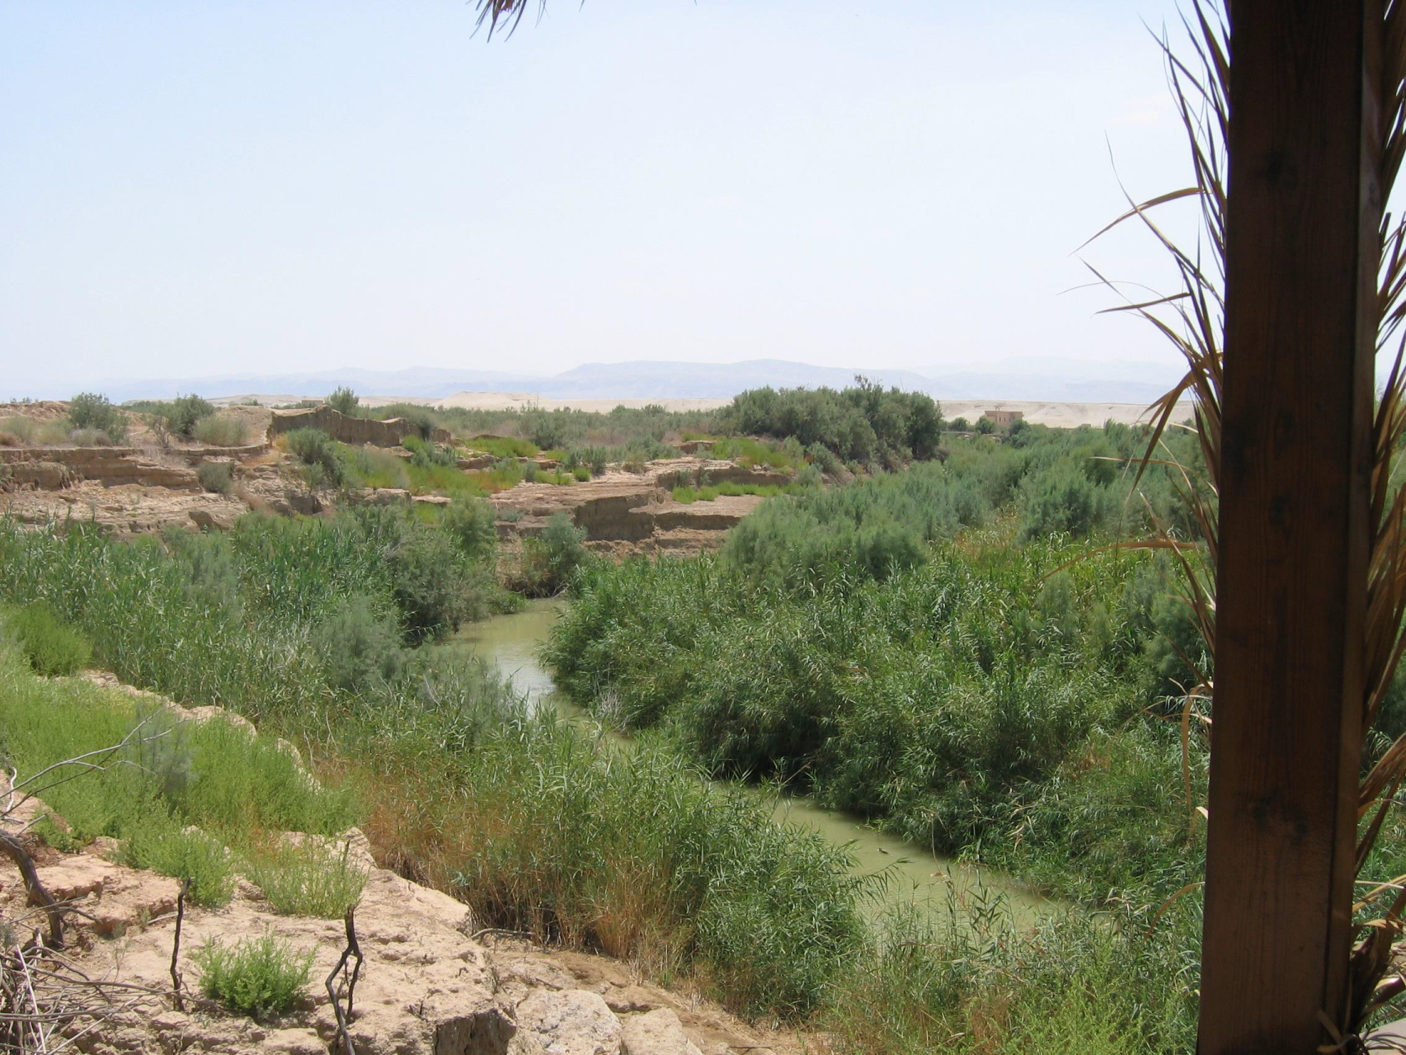
The Jordan River in the month of July. The Israelites passed over the river in the spring before Passover.

Slide 34
Stones piled up in the middle of the Jordan
River and 12 stones for an altar.

Slide 35
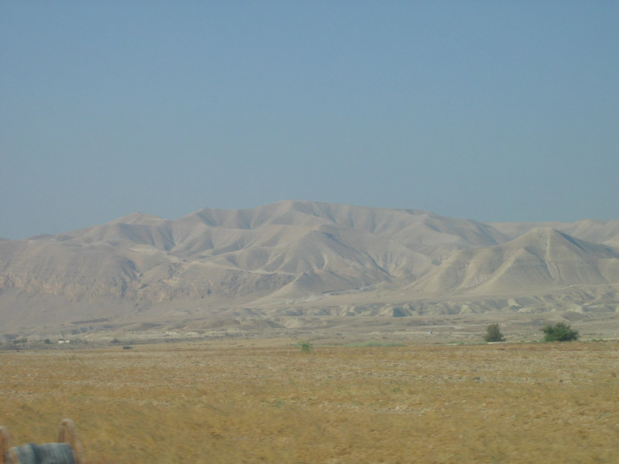
Looking towards the mountains by the Dead Sea from the Gilgal area, Canaan

Slide 36
Joshua now leads the Israelite into Canaan – The Promised Land
⁹ Now Joshua son of Nun was full of the spirit of wisdom, for Moses had laid his hands on him. So the people of Israel obeyed him, doing just as the Lord had commanded Moses.
¹⁰ There has never been another prophet in Israel like Moses, whom the Lord knew face to face. ¹¹ The Lord sent him to perform all the miraculous signs and wonders in the land of Egypt against Pharaoh, and all his servants, and his entire land. ¹² With mighty power, Moses performed terrifying acts in the sight of all Israel.

Slide 37
2. Camping at Gilgal west of the Jordan River and into the Promised Land.
The first thing that Joshua did when the Israelites arrived across the river was to build an altar and thank God.
The other important task was to read the Torah and Instructions to the Israelites.
READ:

Slide 38
Obedience to God…
Life in Canaan – learning to obey God
What happens if we do not listen or obey God?
Balaam’s donkey who spoke to warn …
Defeating kings of the cities and settling in the land of Canaan -
Achan’s Sin and Ai Destroyed
The Gibeonites deceive the Israelites
Miracles: the Sun & Moon stood still at Gibeon
Large hail stones during a battle

Slide 39
Learning to Continue Obeying God
3. The city of Ai is conquered:
Achan’s Sin
(READ - Joshua 7:1-26)
What sin had Achan committed.
Why was it such a serious sin?
Notes:
Joshua had reminded them that they were not to take certain things.
After the defeat of Ai; what did Joshua do?
Joshua 8: 34, 35 ³⁴ And afterward he read all the words of the law, the blessings and the cursings, according to all that is written in the Book of the Law. ³⁵ There was not a word of all that Moses had commanded which Joshua did not read before all the assembly of Israel, with the women, the little ones, and the strangers who were living among them.

Slide 40
After the capture of Ai what did Joshua do?
READ - Joshua 8:34, 35
Why was this decision made?

Slide 41
Learning to Continue Obeying God
Joshua’s Legacy as a leader (accomplishments/contributions of the Israelites and Israel)
Taking over the land by conquering the Canaanites
Continually reading and reminding the Israelites of God’s laws and instructions (Honoring God and the Torah)
The result was the Israelites worshiping God and finding his favour for 2 generations.

Slide 42
Pictures to paste into your passport. For Lesson 11

Slide 43
NOTE:
The following is a Picture Gallery of Israel today, July 2004, that illustrate some of the areas that the Children of Israel may have seen or lived in on their journey.

Slide 44
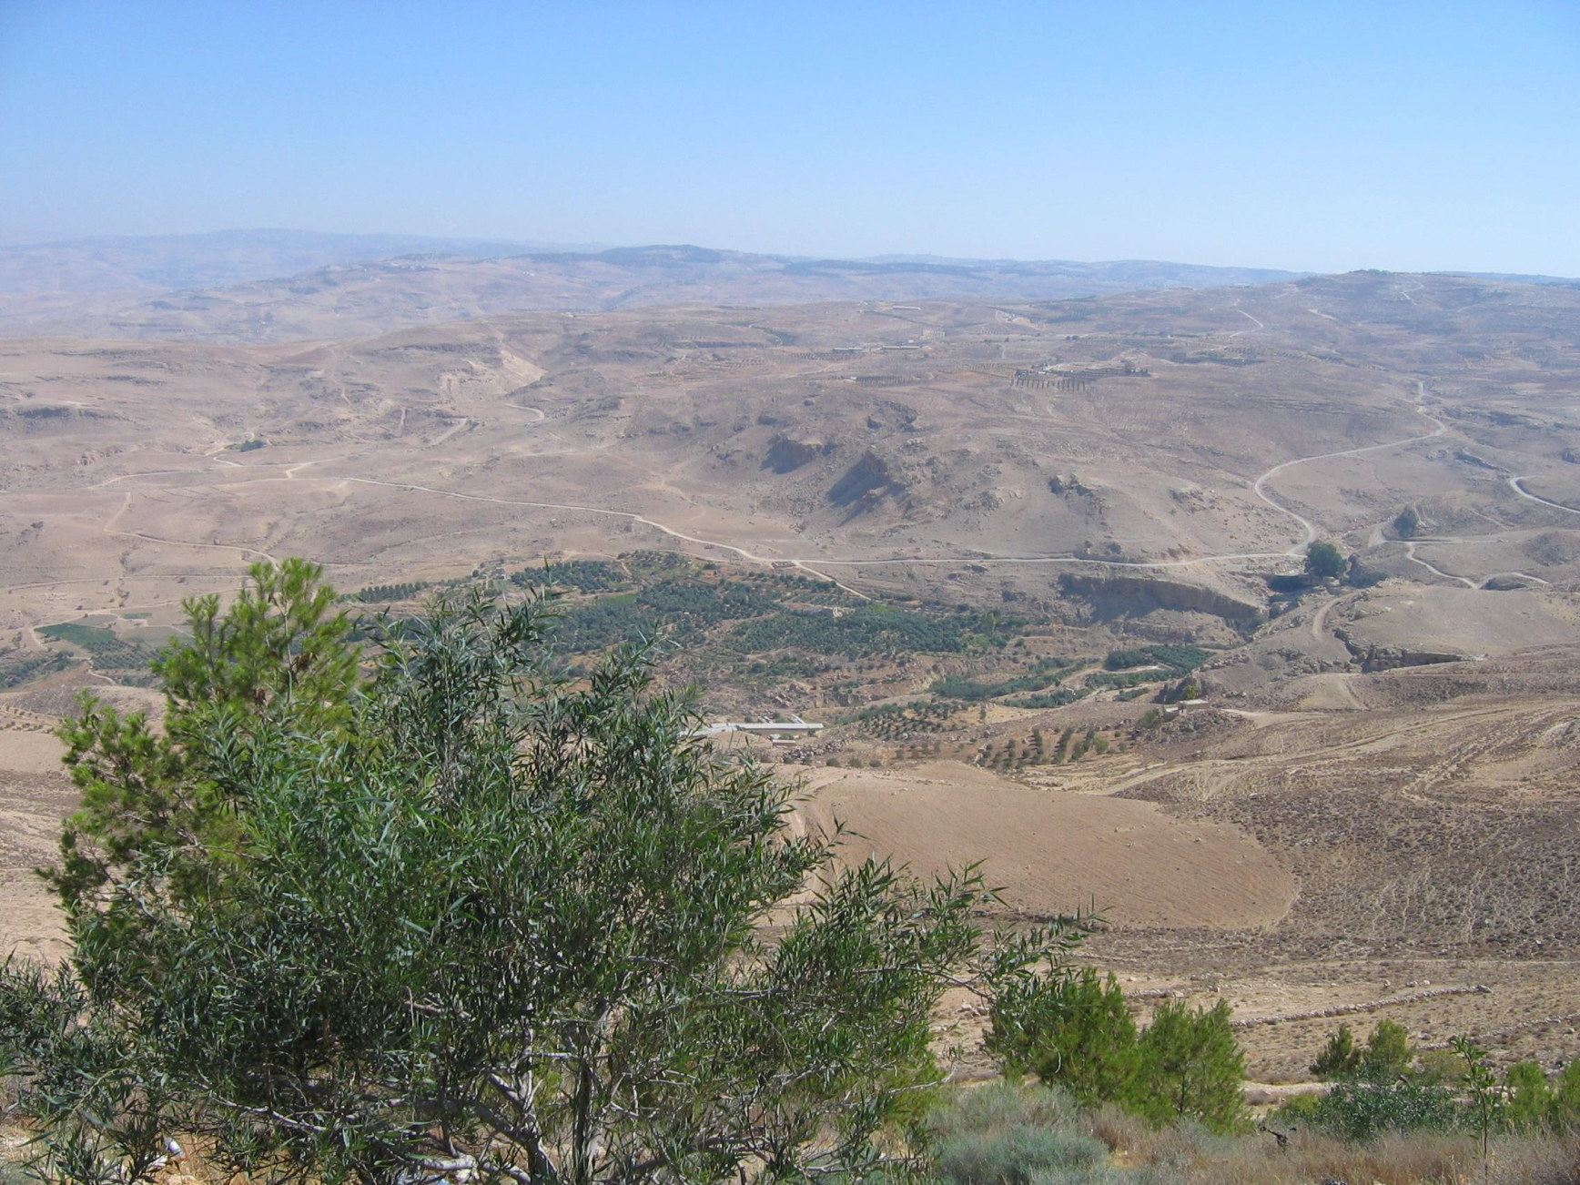
Looking into the valley from Mt. Nebo in Jordan.

Slide 45
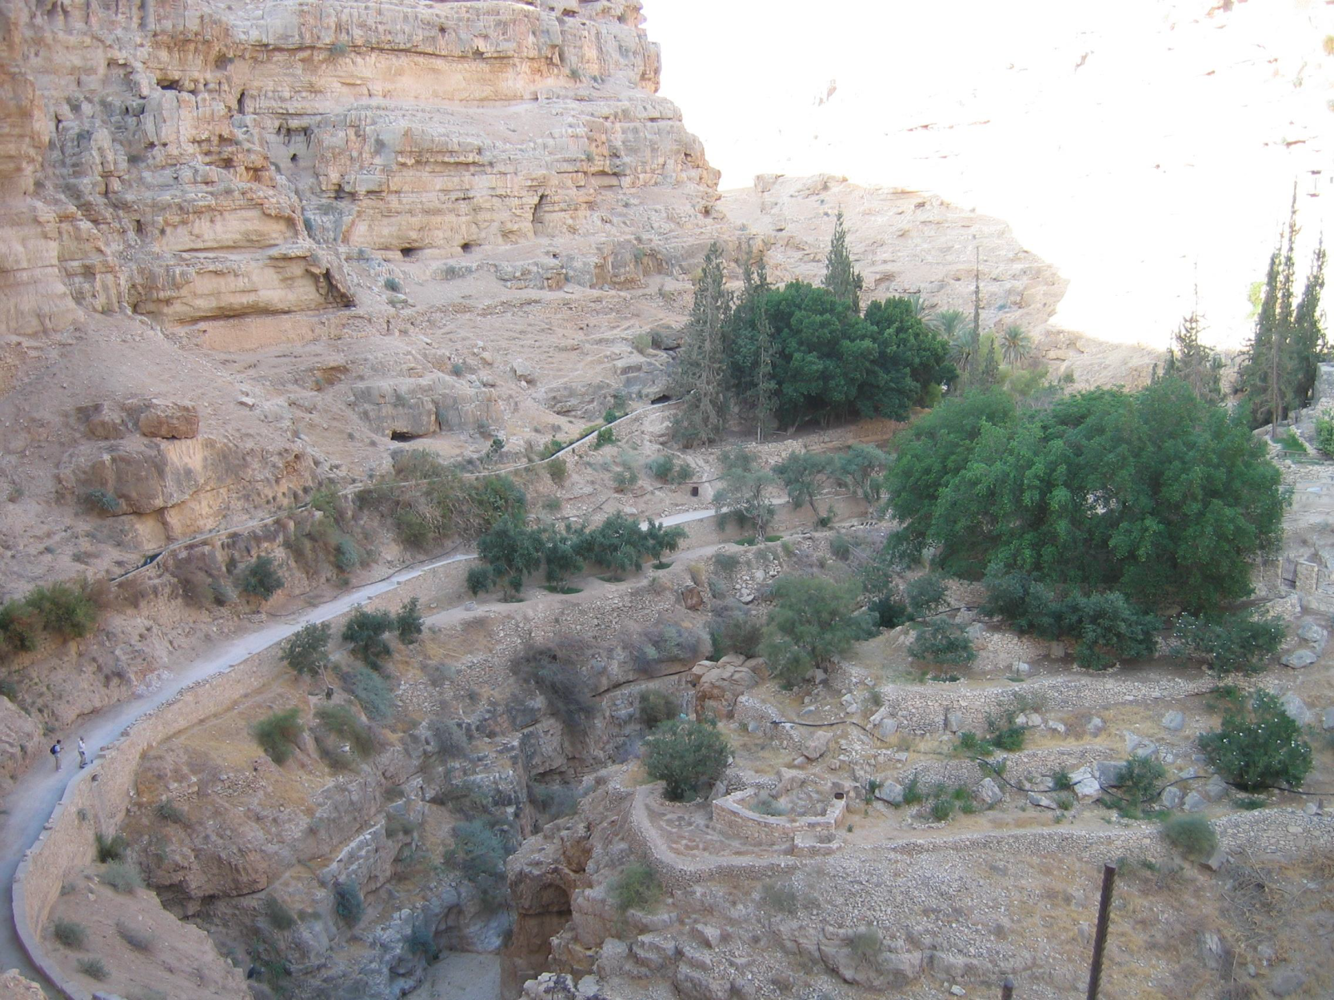
Walking Path to Jericho from outside Jerusalem

Slide 46
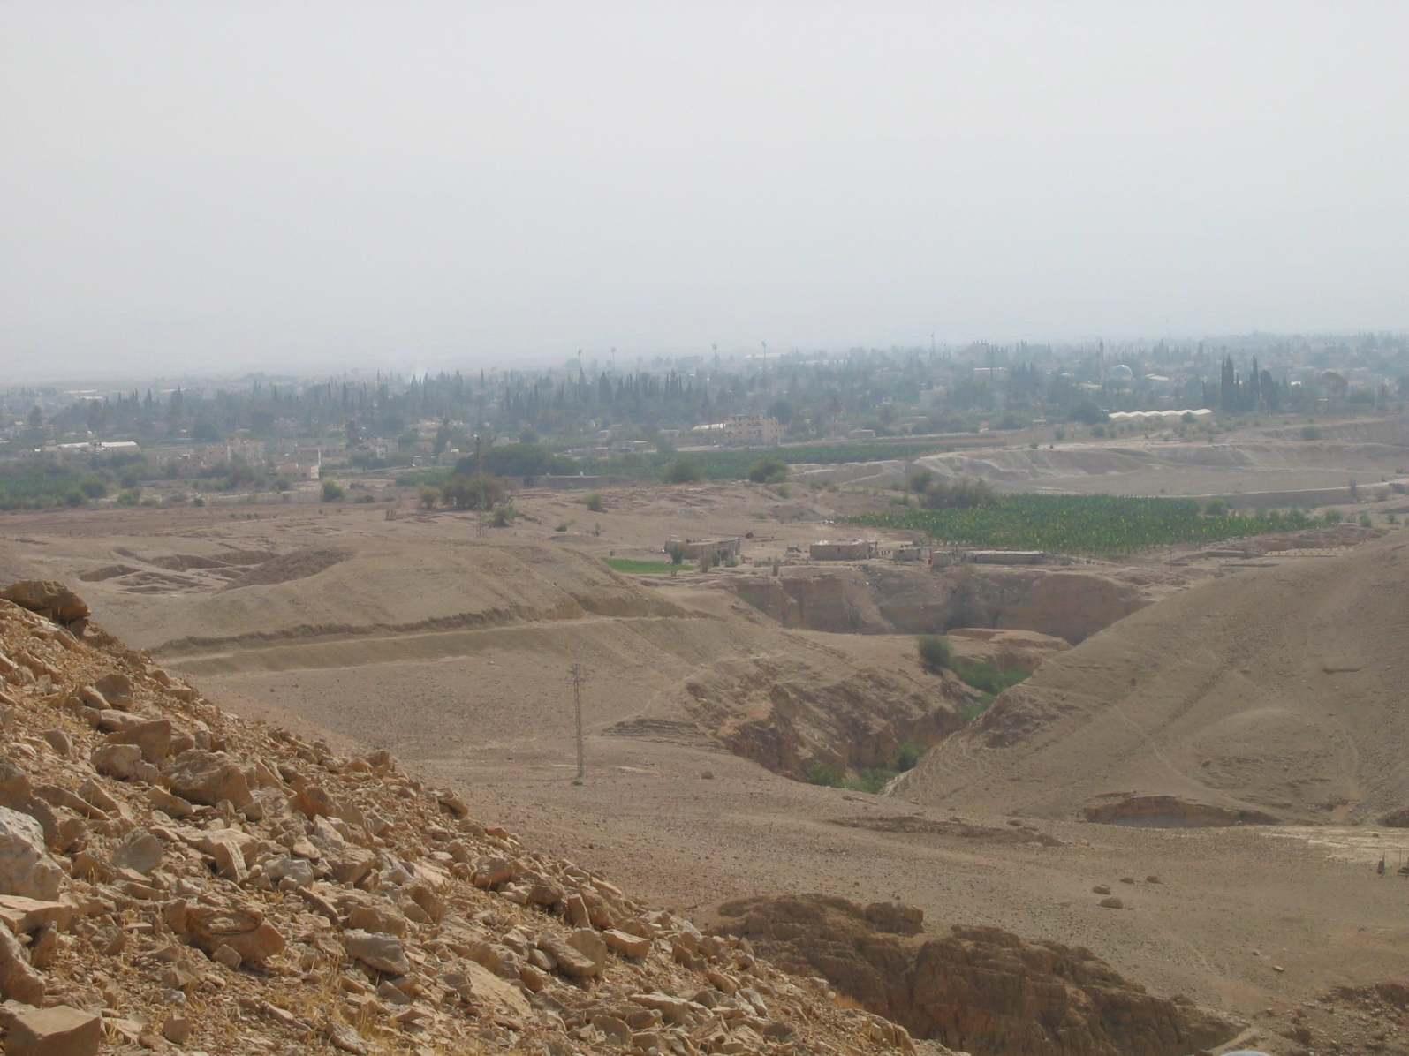
Foreground: Archeological Research in ancient Jericho with the modern city in the background.

Slide 47
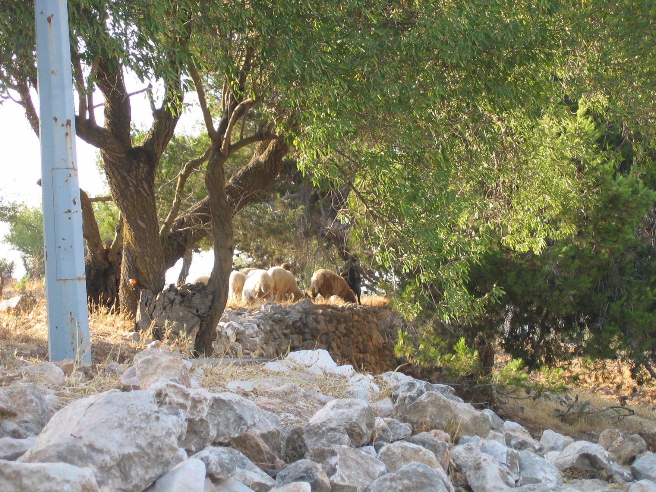
Sheep feeding in the pastures near Bethlehem.

Slide 48
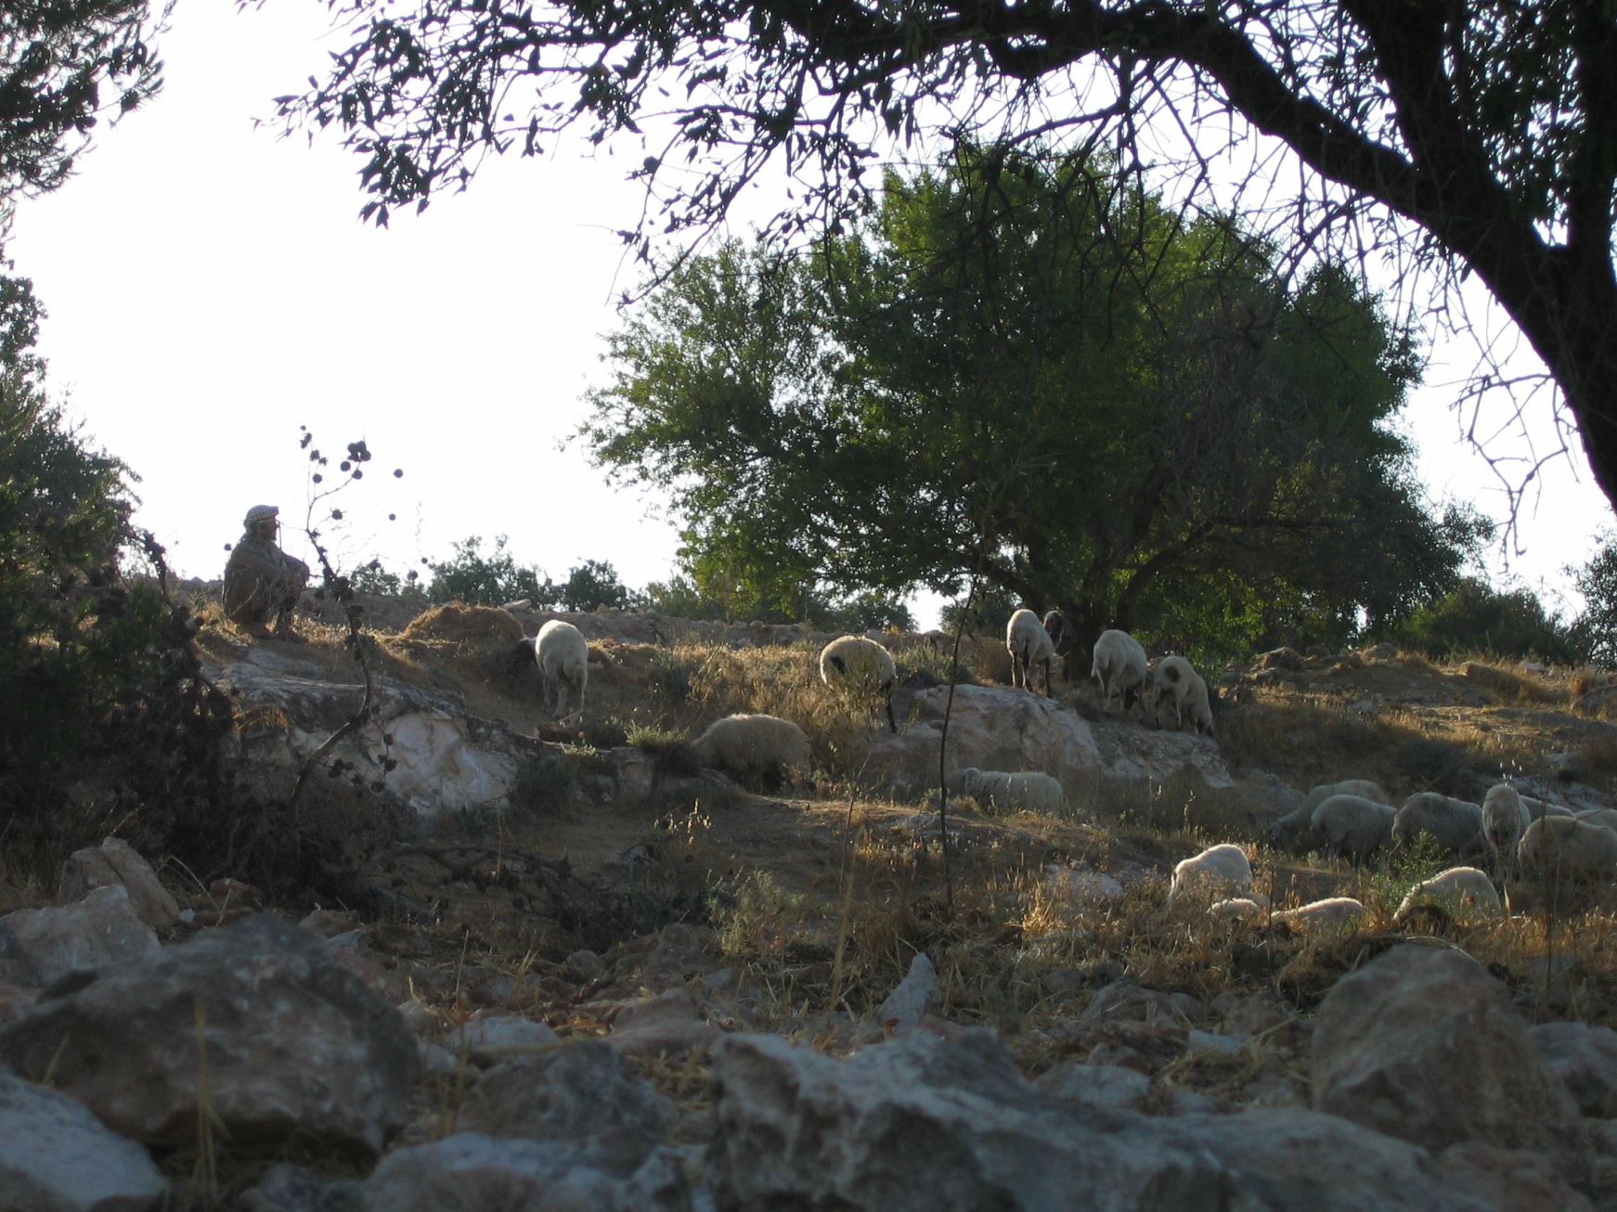
Shepherd with his Sheep

Slide 49
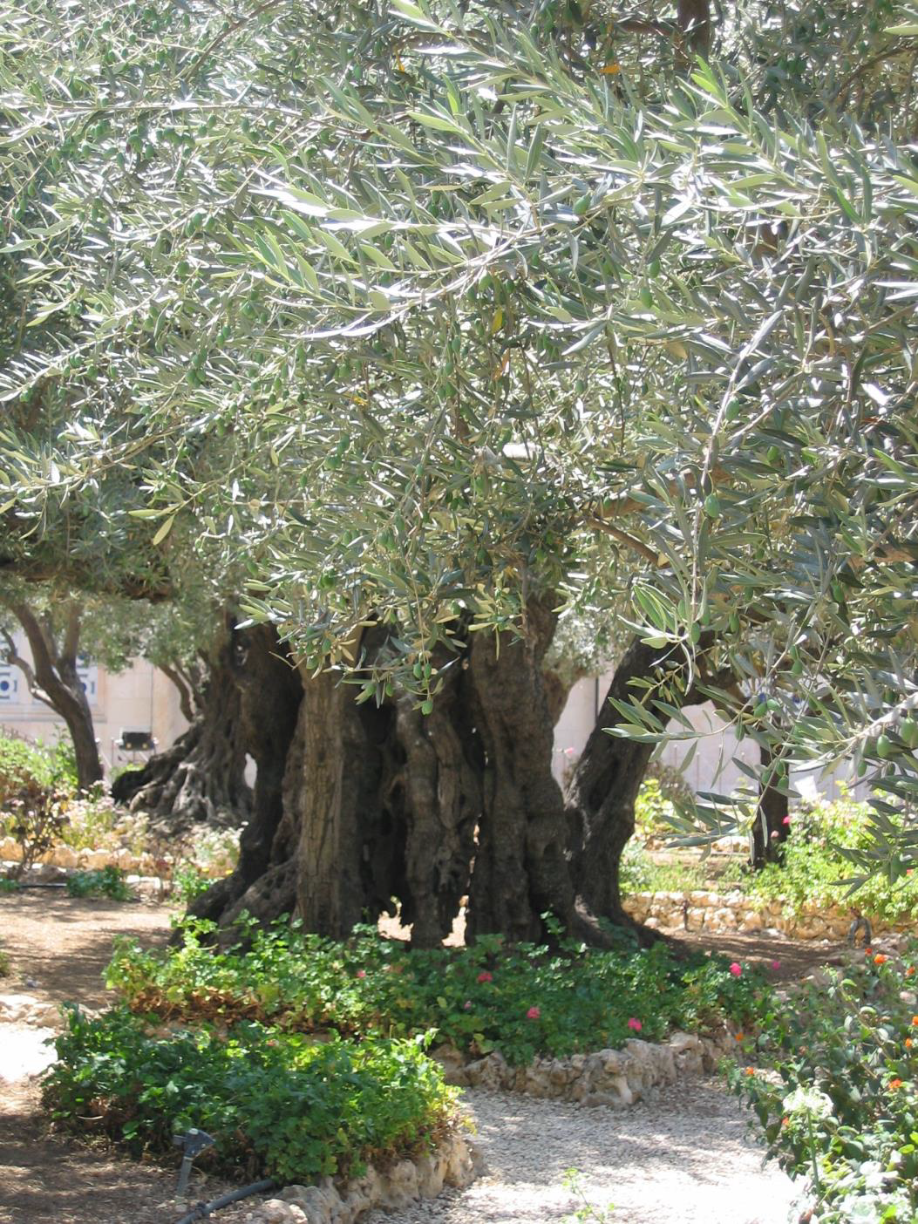
Ancient olive trees

Slide 50
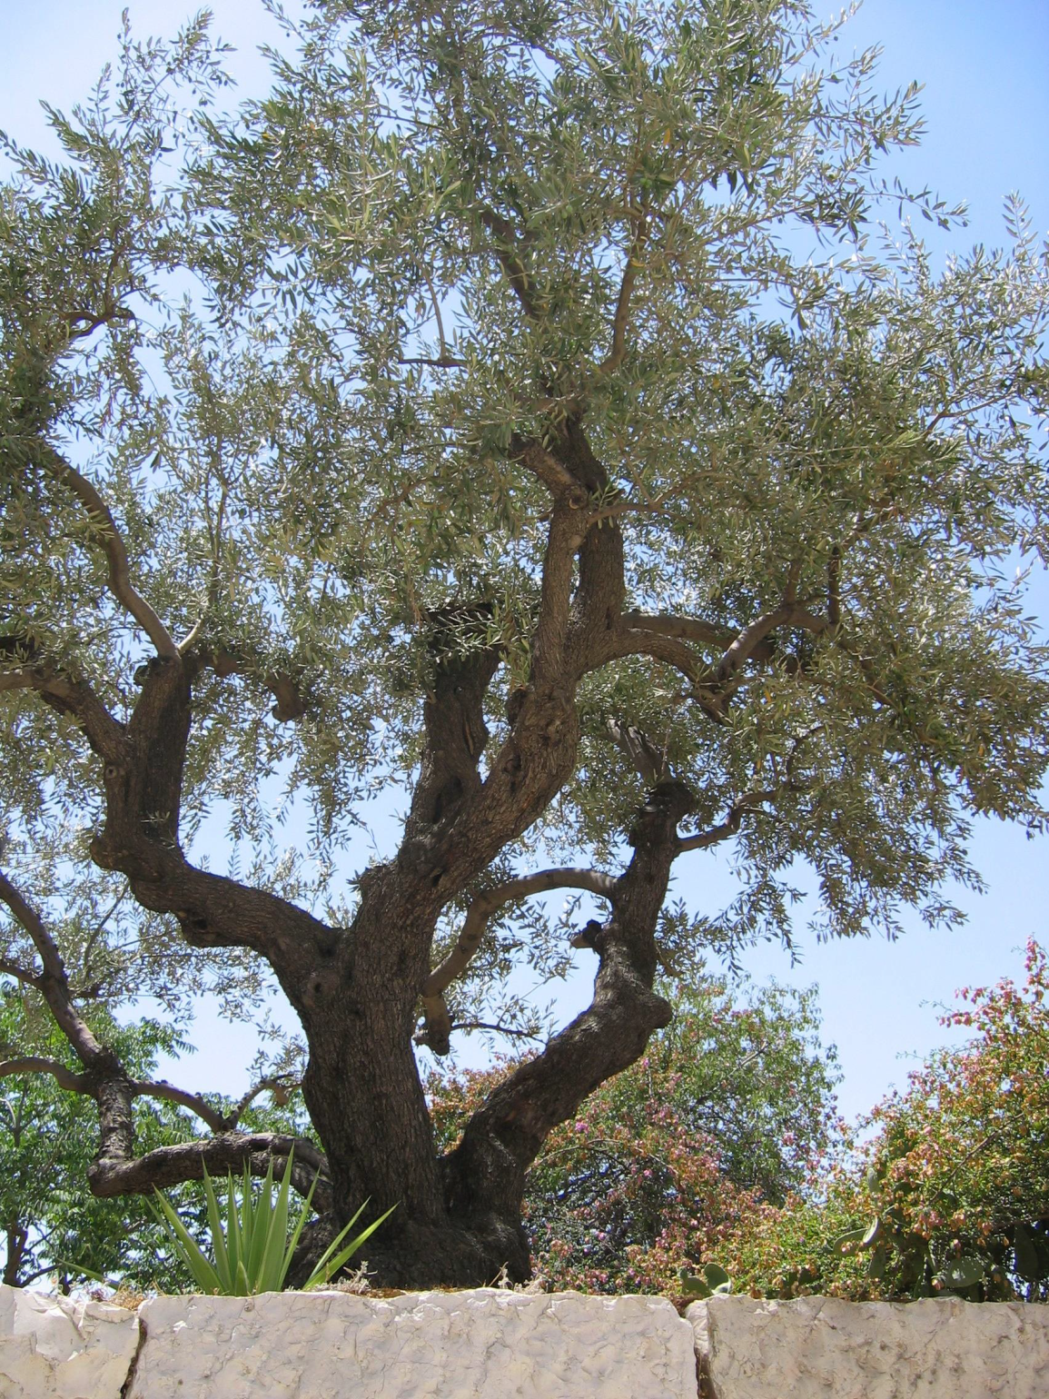

Slide 51
Gnarled ancient olive trees

Slide 52
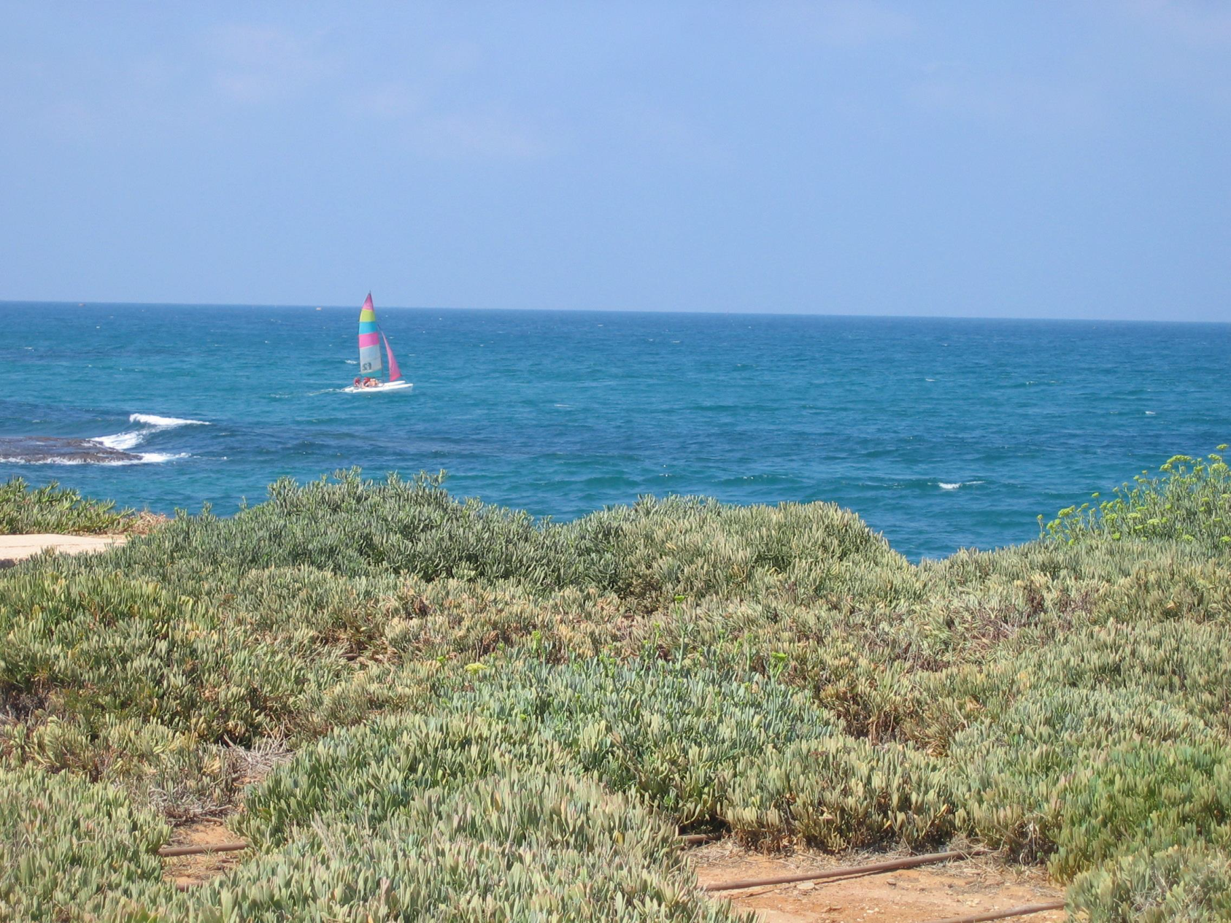
Israel’s coast on the Mediterranean Sea

Slide 53
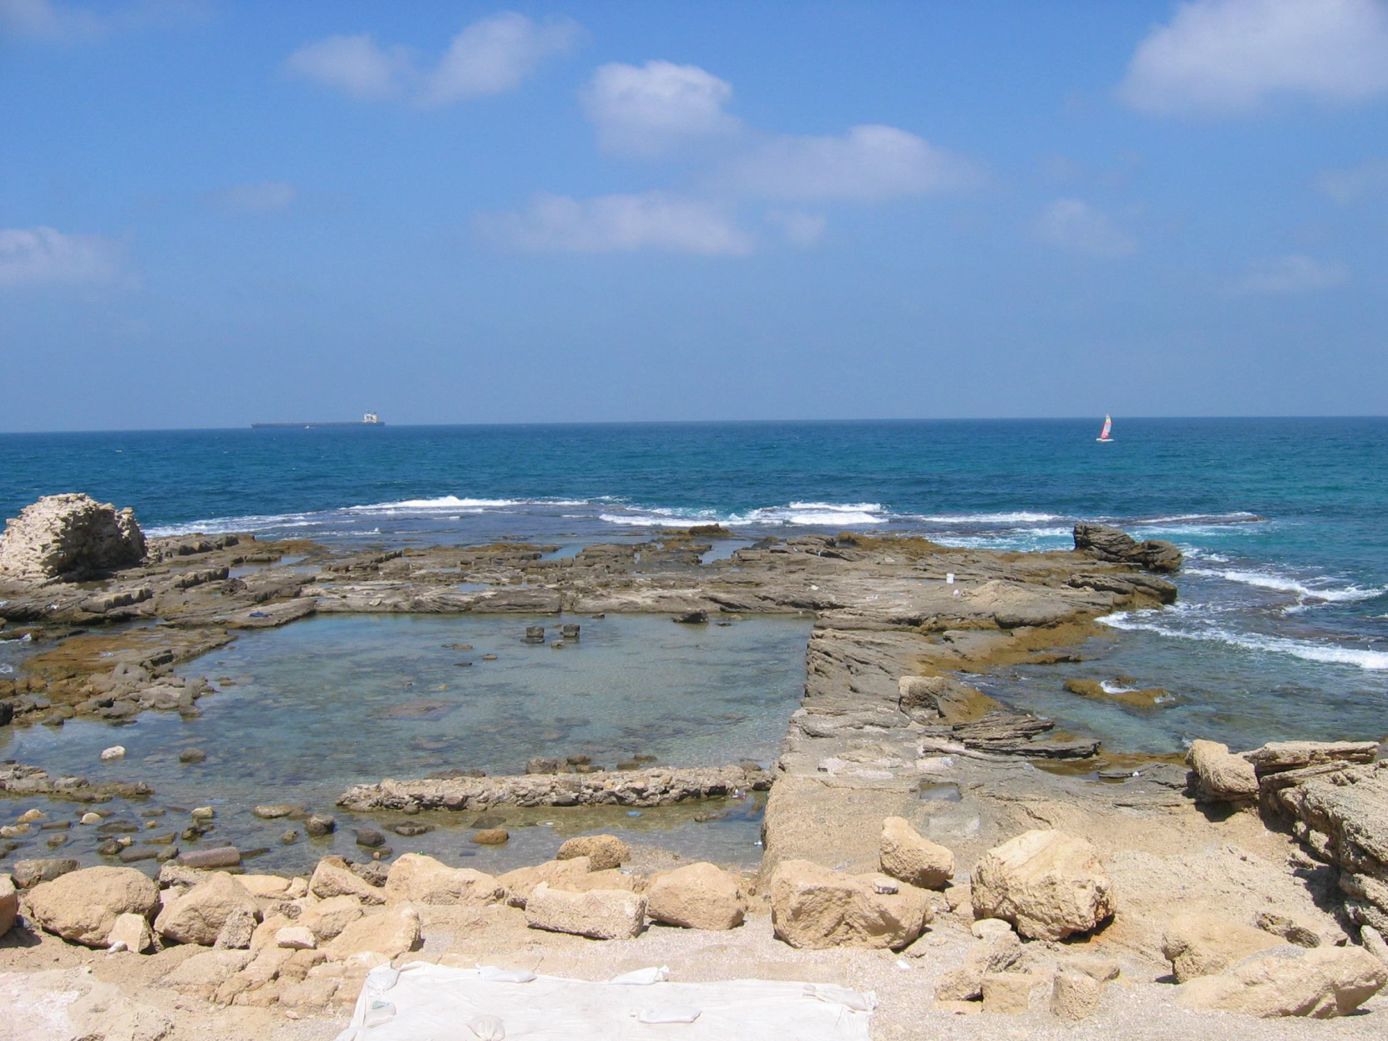
The Promised Land on the Mediterranean Sea

Slide 54
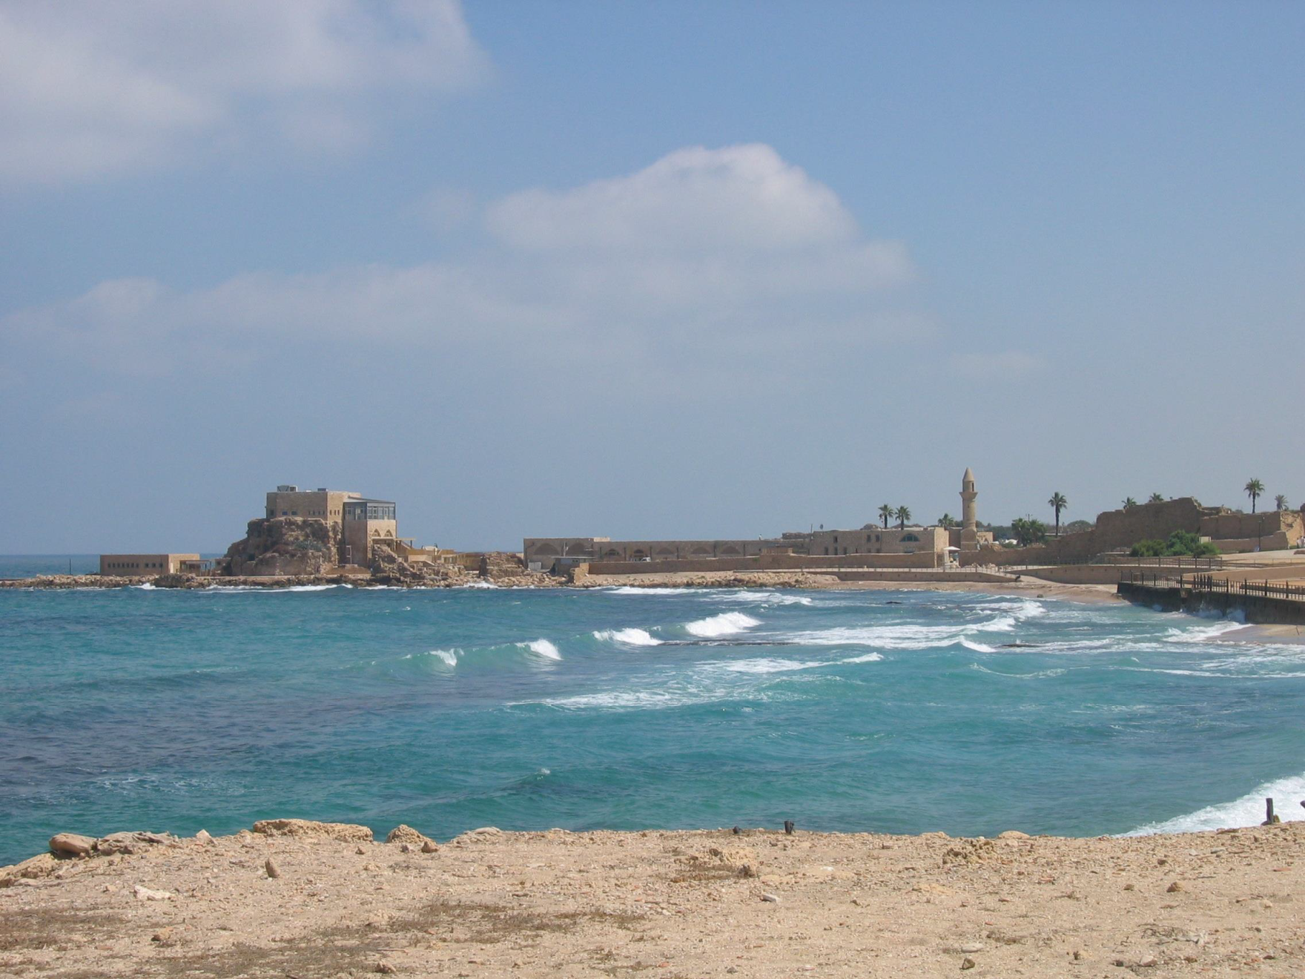
Caesarea Maritima on the Mediterranean Sea

Slide 55
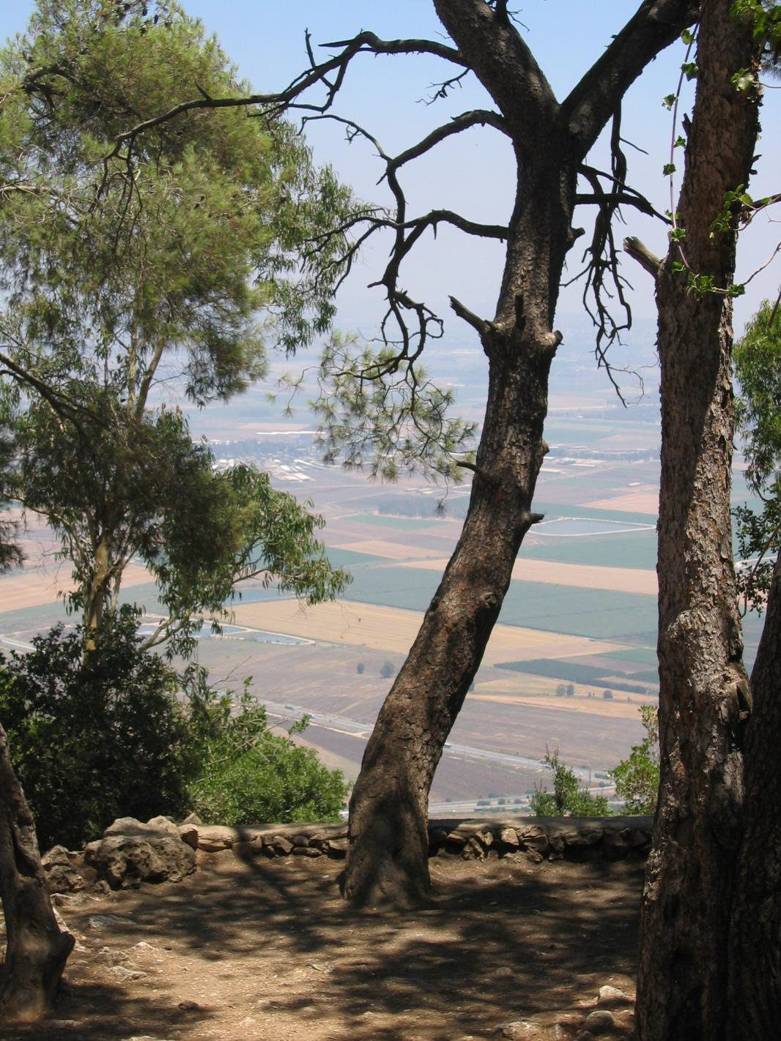
Looking down into the Jezreel Valley in Israel

Slide 56
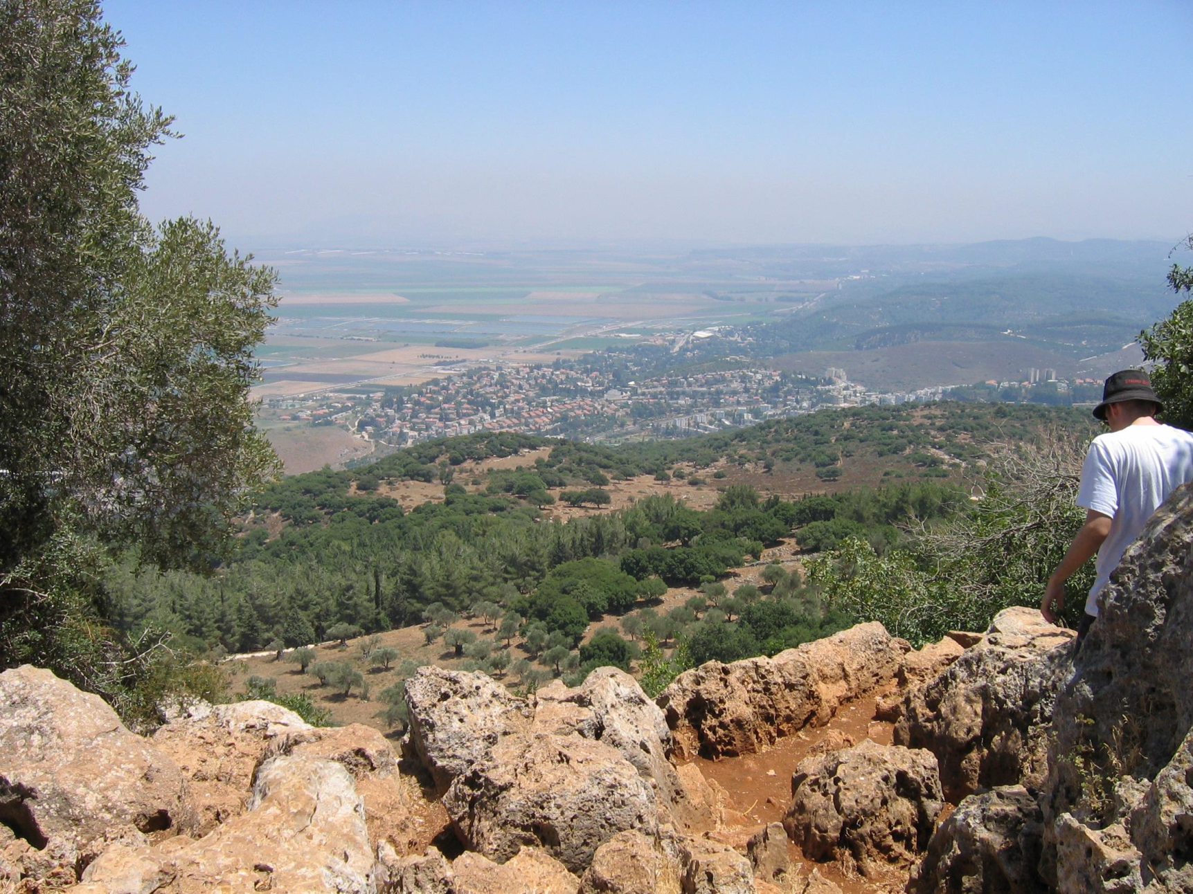
Countryside surrounding the Sea of Galilee

Slide 57
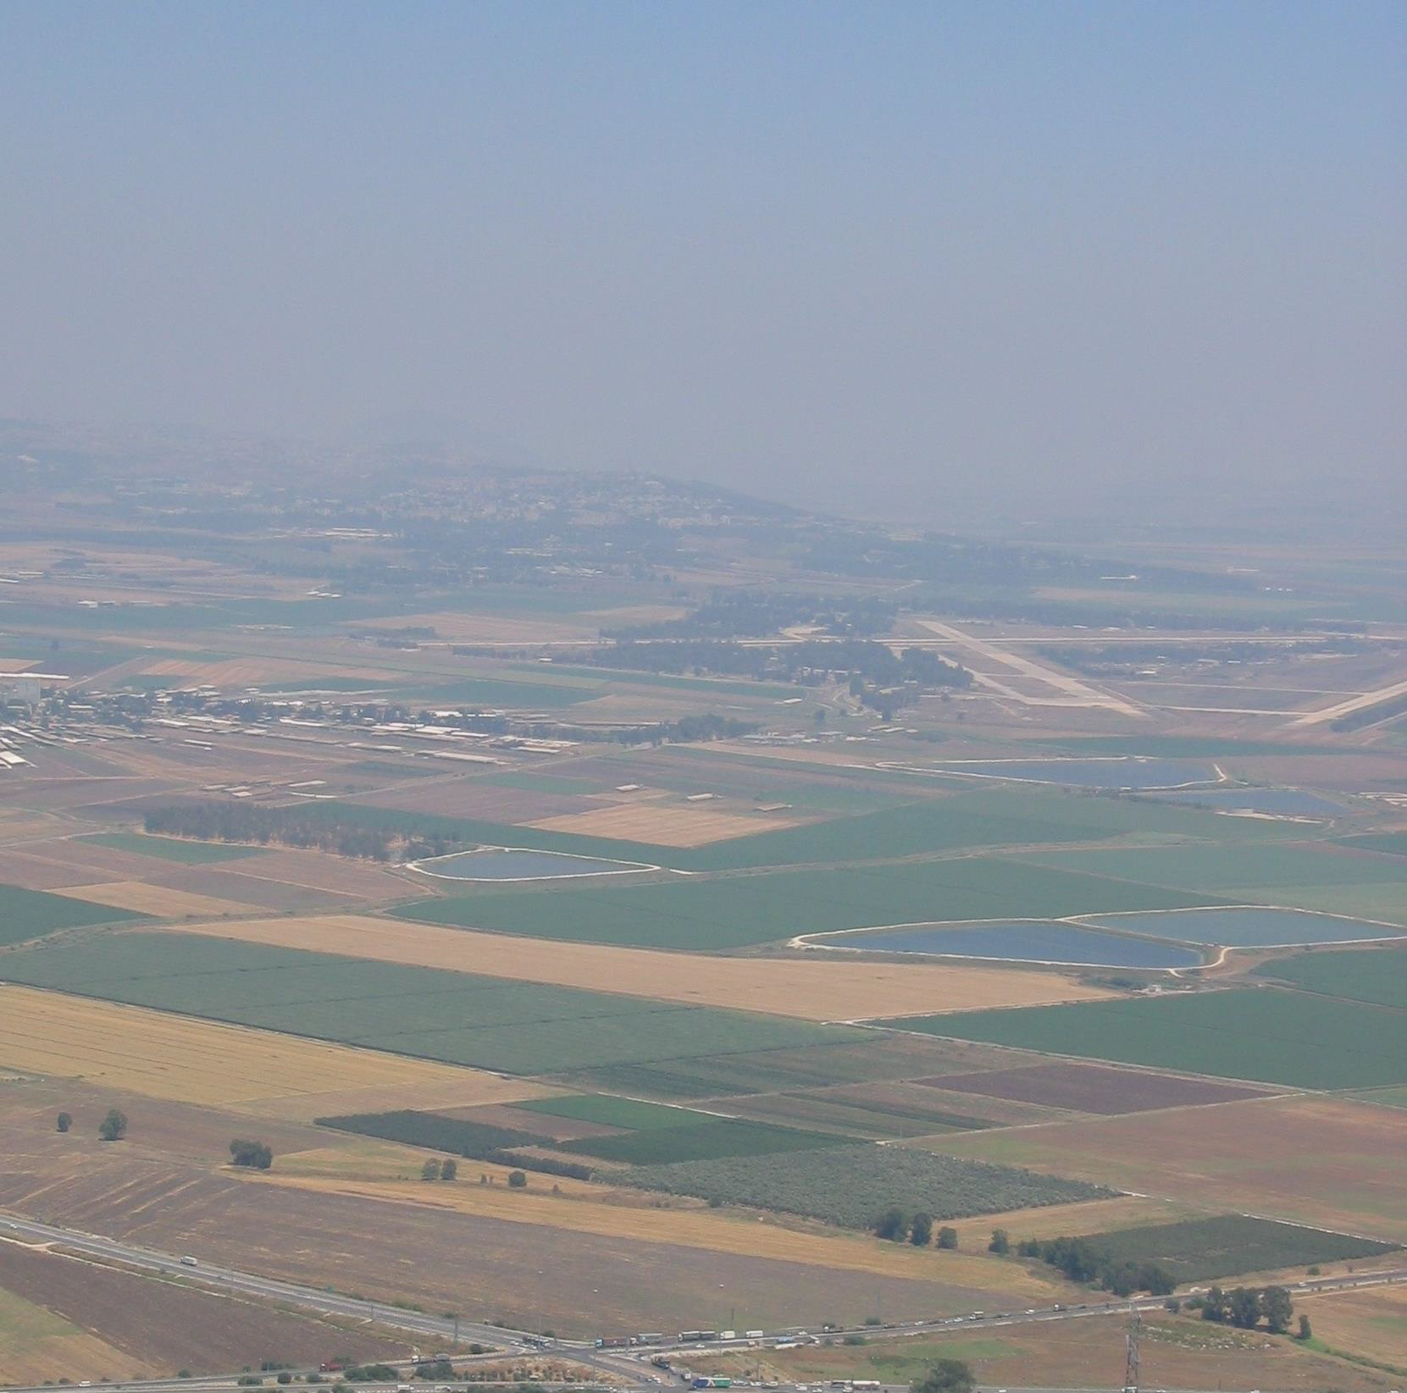
The Jezreel Valley in Galilee

Slide 58
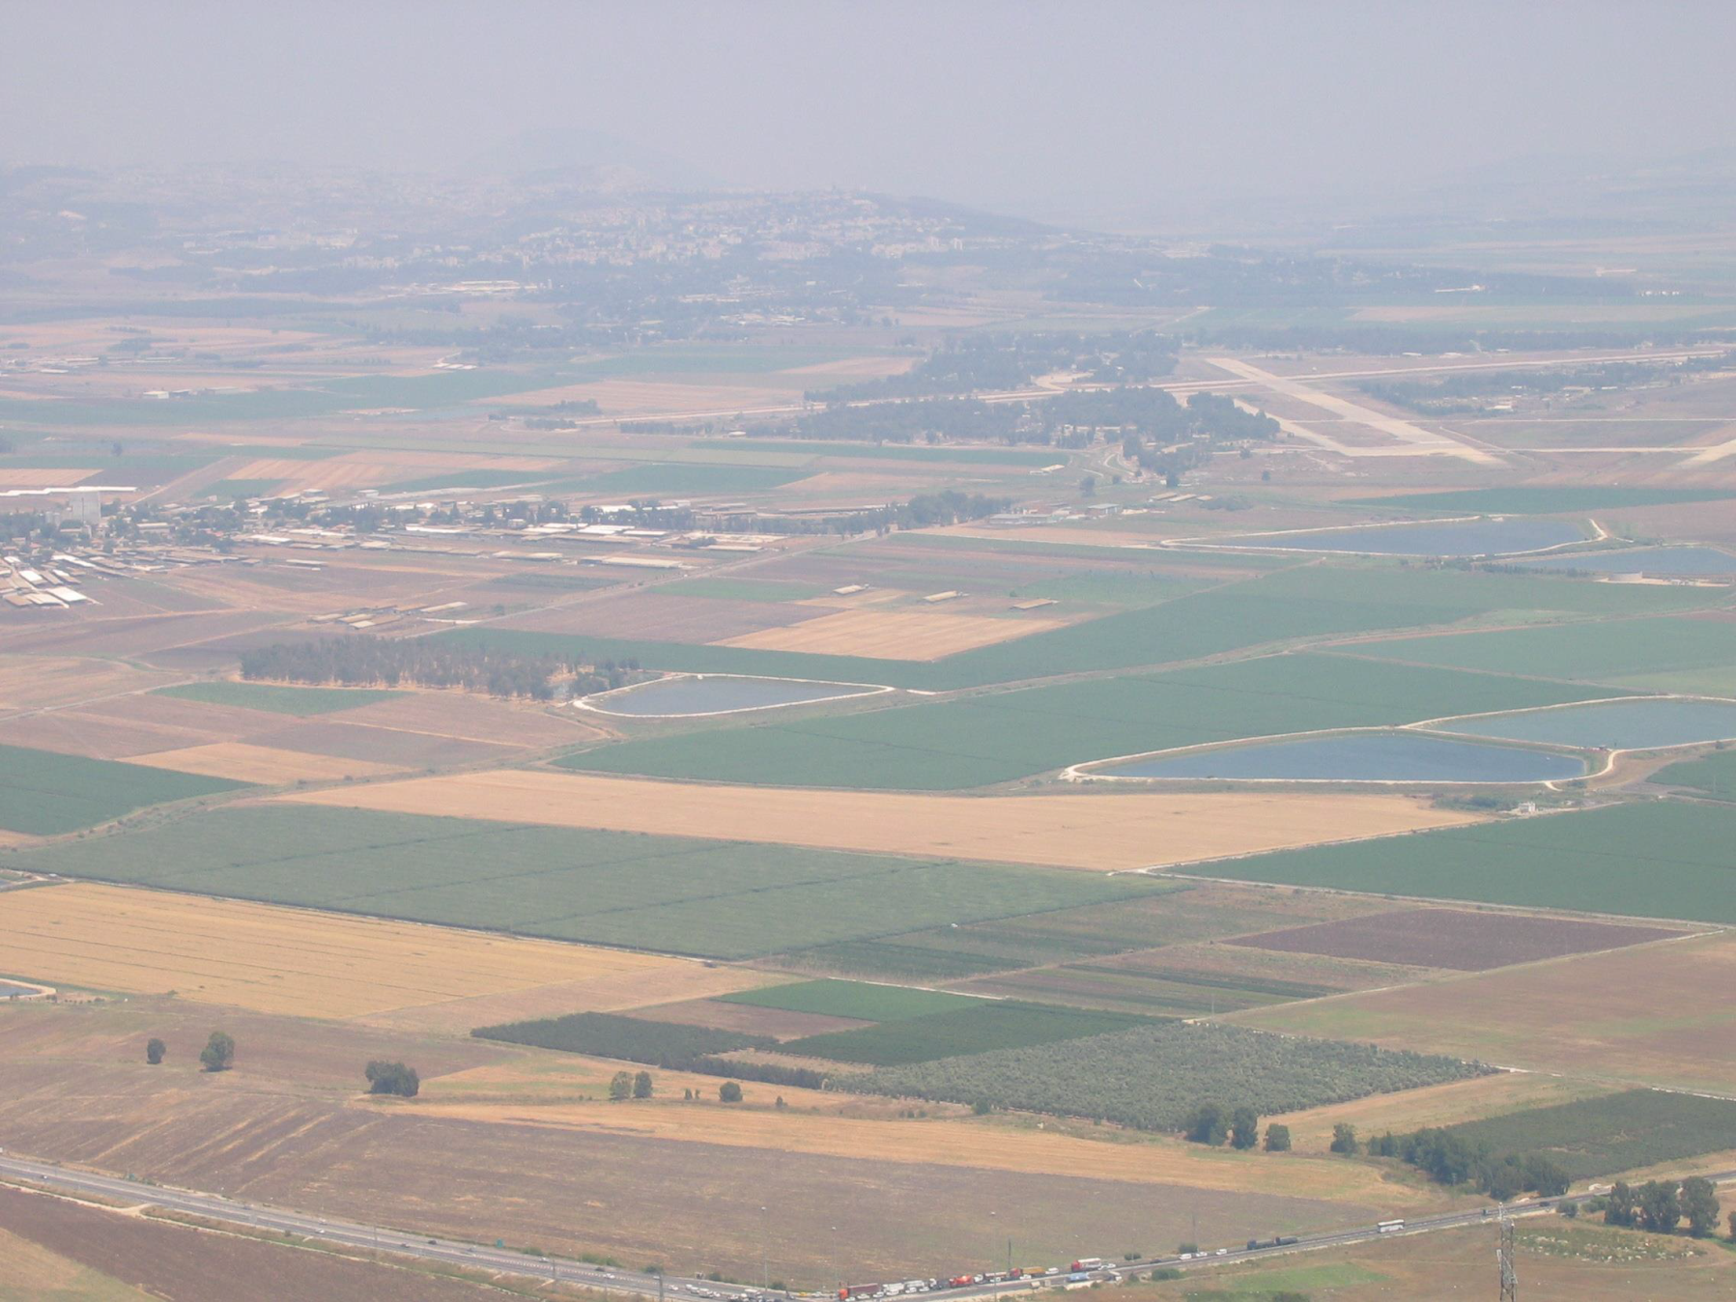
Jezreel Valley

Slide 59
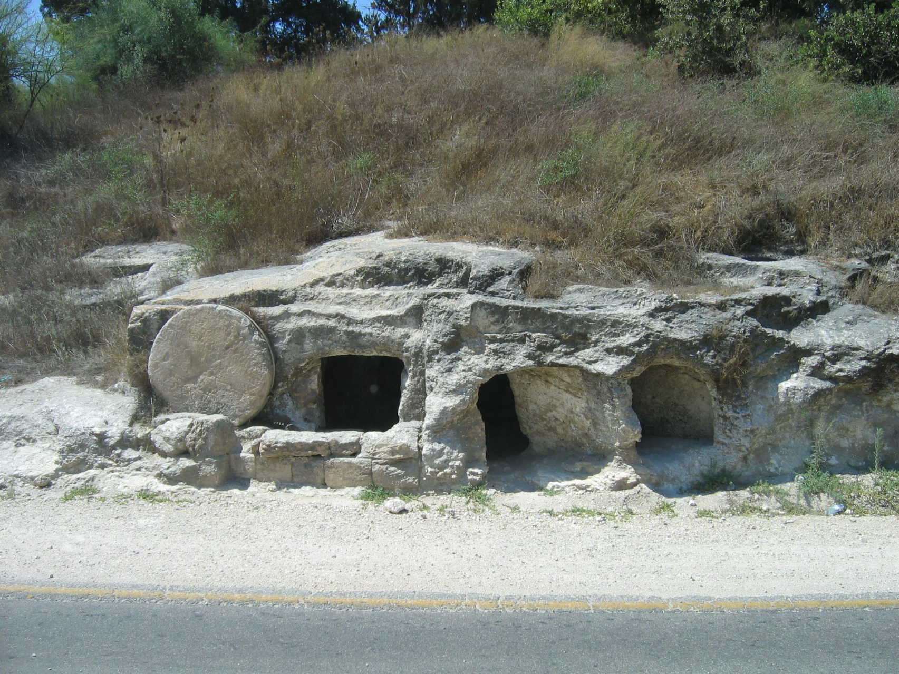
Ancient burial areas in Israel.

Slide 60
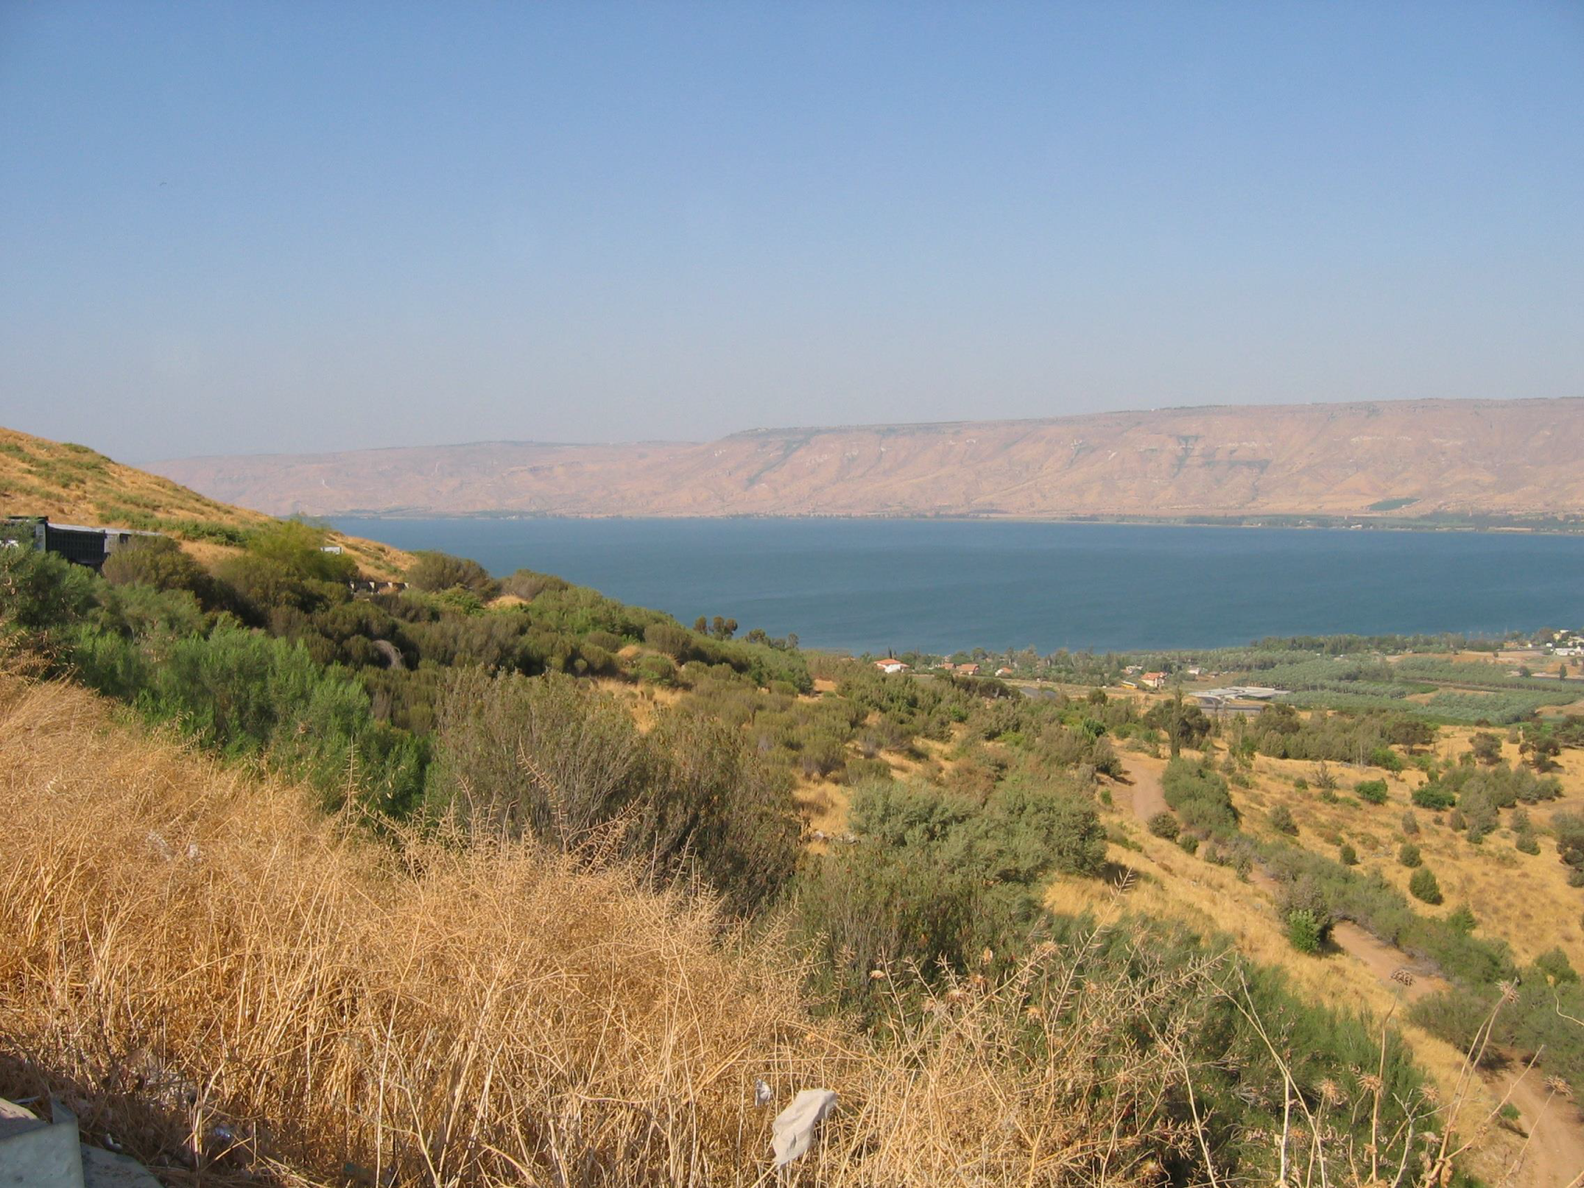
Looking toward the Sea of Galilee and Golan Heights.

Slide 61
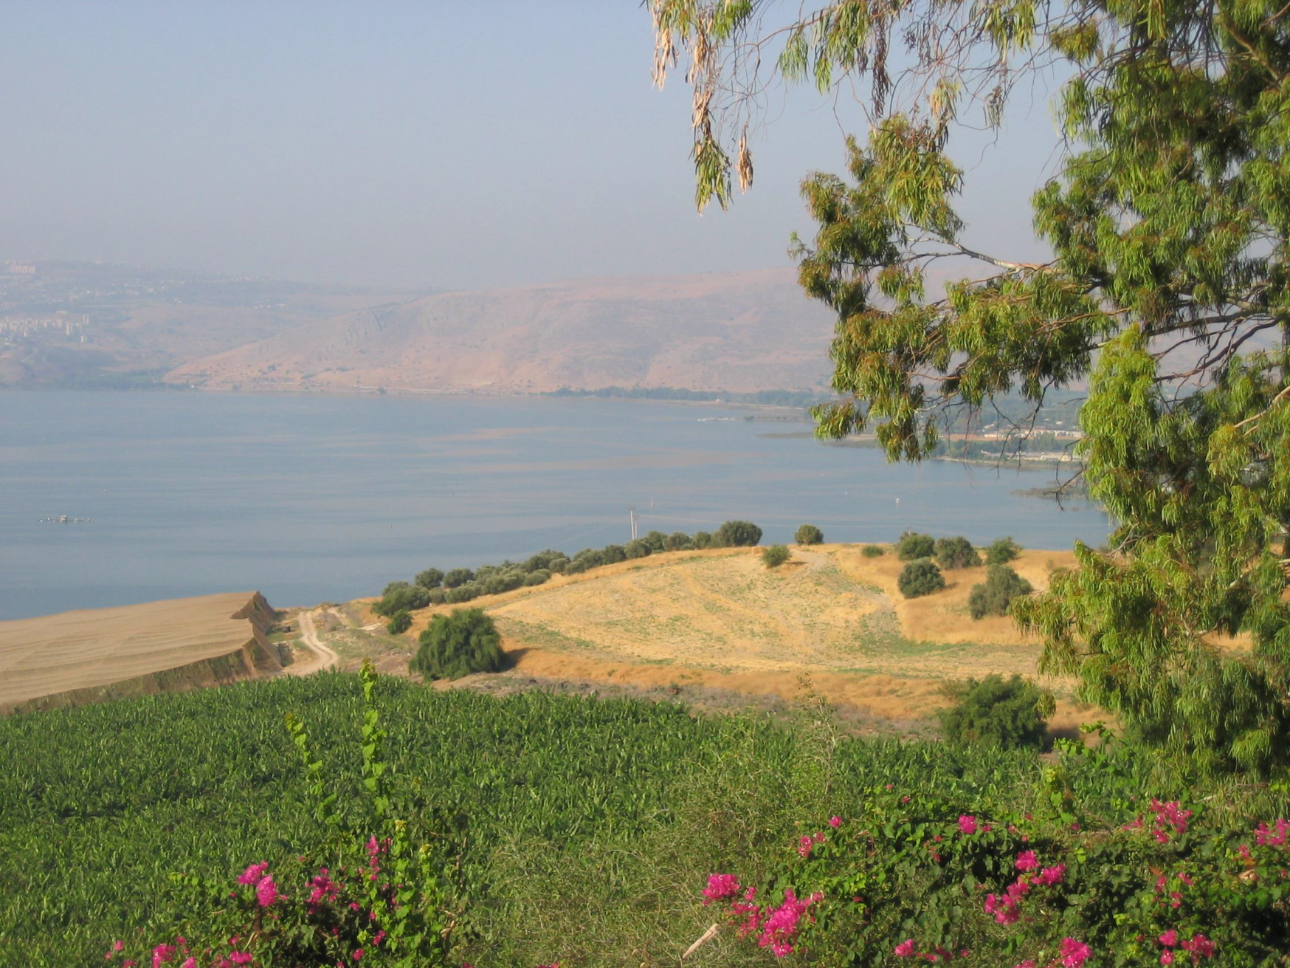
Looking toward the North and west of the Sea of Galilee

Slide 62
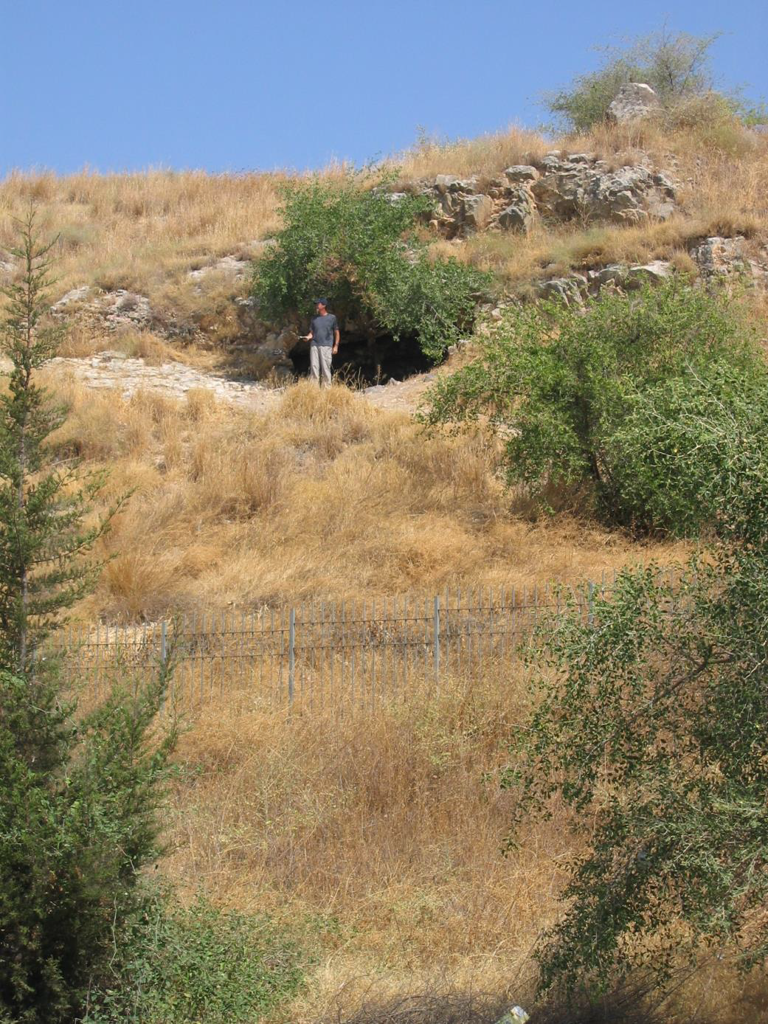
Mountain of the Beatitudes where Jesus taught..

Slide 63
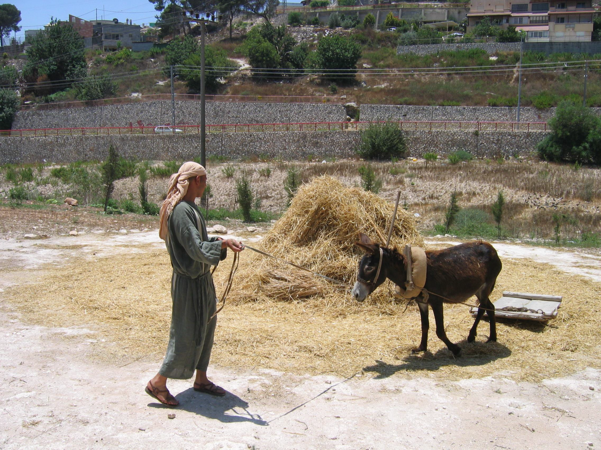
Milling grain with a donkey.

Slide 64
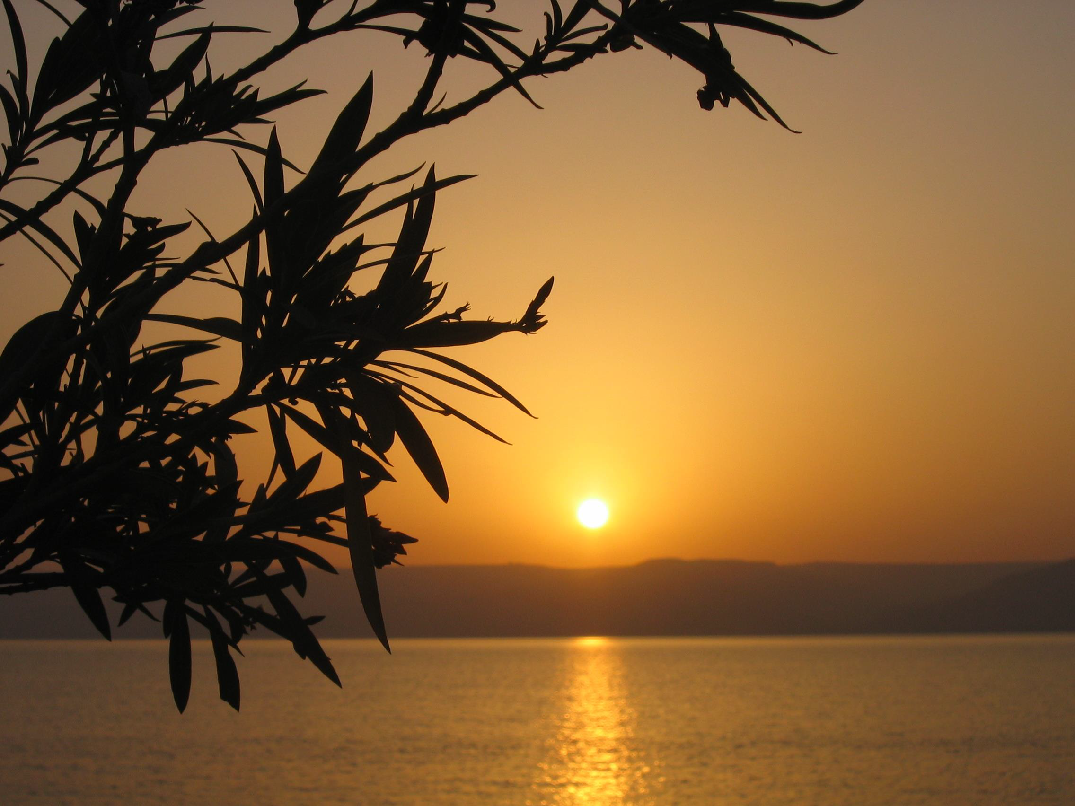
Sunrise over the Sea of Galilee.

Slide 65
The Aaronic Blessing
Numbers 6:24 – 26
²⁴ “The Lord bless you and keep you; ²⁵ The Lord make His face shine upon you,
And be gracious to you; ²⁶ The Lord lift up His countenance upon you, And give you peace.

Slide 66
Dear Student/ Teacher of the Holy Scriptures:
I trust that you have found this “Simulated Holy Land Tour through the eyes of Moses and Joshua” interesting, intriguing and inspiring.
I hope that you and your students have developed deeper knowledge and a greater curiosity for searching the scriptures as an in-depth study of the scriptures, namely the Old Covenant/Old Testament. When understanding the Old Testament, the New Covenant/Testament is better understood.
Abundant blessings
Helen Wall PhD

