Slide 1
Lesson 10
Crossing the Jordan, settling in Gilgal, celebrating Passover
.
Opening Prayer
Sing:
  Father Abraham
Memory Verses
Review where we did we travel last lesson?

Slide 2
Today’s Journey over the
Jordan River
    Miracle of crossing the Jordan River
    and the amazing details (Deuteronomy 34,
    Joshua 1)
After crossing the Jordan River and arriving at Gilgal, Joshua reads God’s commandments and instructions for living.
Israelites honour and obey God for 2 generations after Joshua dies.
Lesson #10

Slide 3
Let’s Review:
Where have we been and where are we going today on our tour?
Hint: check your maps…
Check the map - 40 years of wandering …
Name many of God’s miracles ….
Describe some of the mysteries of God…
List the lessons you learned from last
week?

Slide 4
Review Bible Memory Verses:
Joshua 1:16 - Then they answered Joshua, “Whatever you have commanded us we will do, and wherever you send us we will go.
Joshua 24:15
“Choose for yourselves this day whom
you will serve…but as for me and my household, we will serve the Lord”

Slide 5
And God spoke all these words:
The 10 Commandments and
Exodus 20: 3 – 17
“I am ADONAI your God, who brought you out of the land of Egypt, out of the abode of slavery..
You are to have no other gods before me.
You are not to make for yourselves a carved image or any kind

Slide 6
You are not to use God’s name in vain.
Remember the Shabbat (Sabbath) and keep it holy.
Honor your father and mother.
Do not murder.
Do not commit adultery.
Do not steal.
Do not lie.
Do not covet.

Slide 7
Review what is true repentance?
What does it mean to repent?
  To truly be sorry
  Ask for forgiveness
  Thank God for forgiving you
  And not do it again…

Slide 8
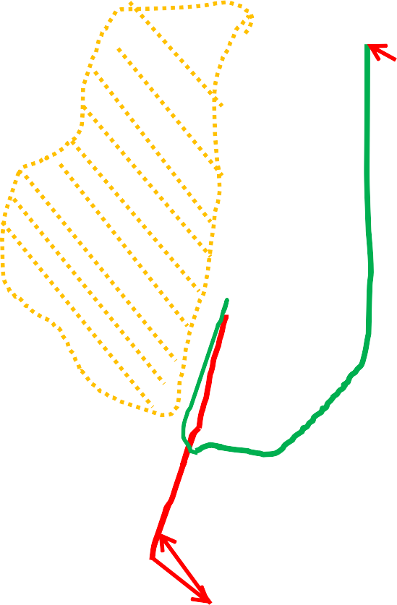
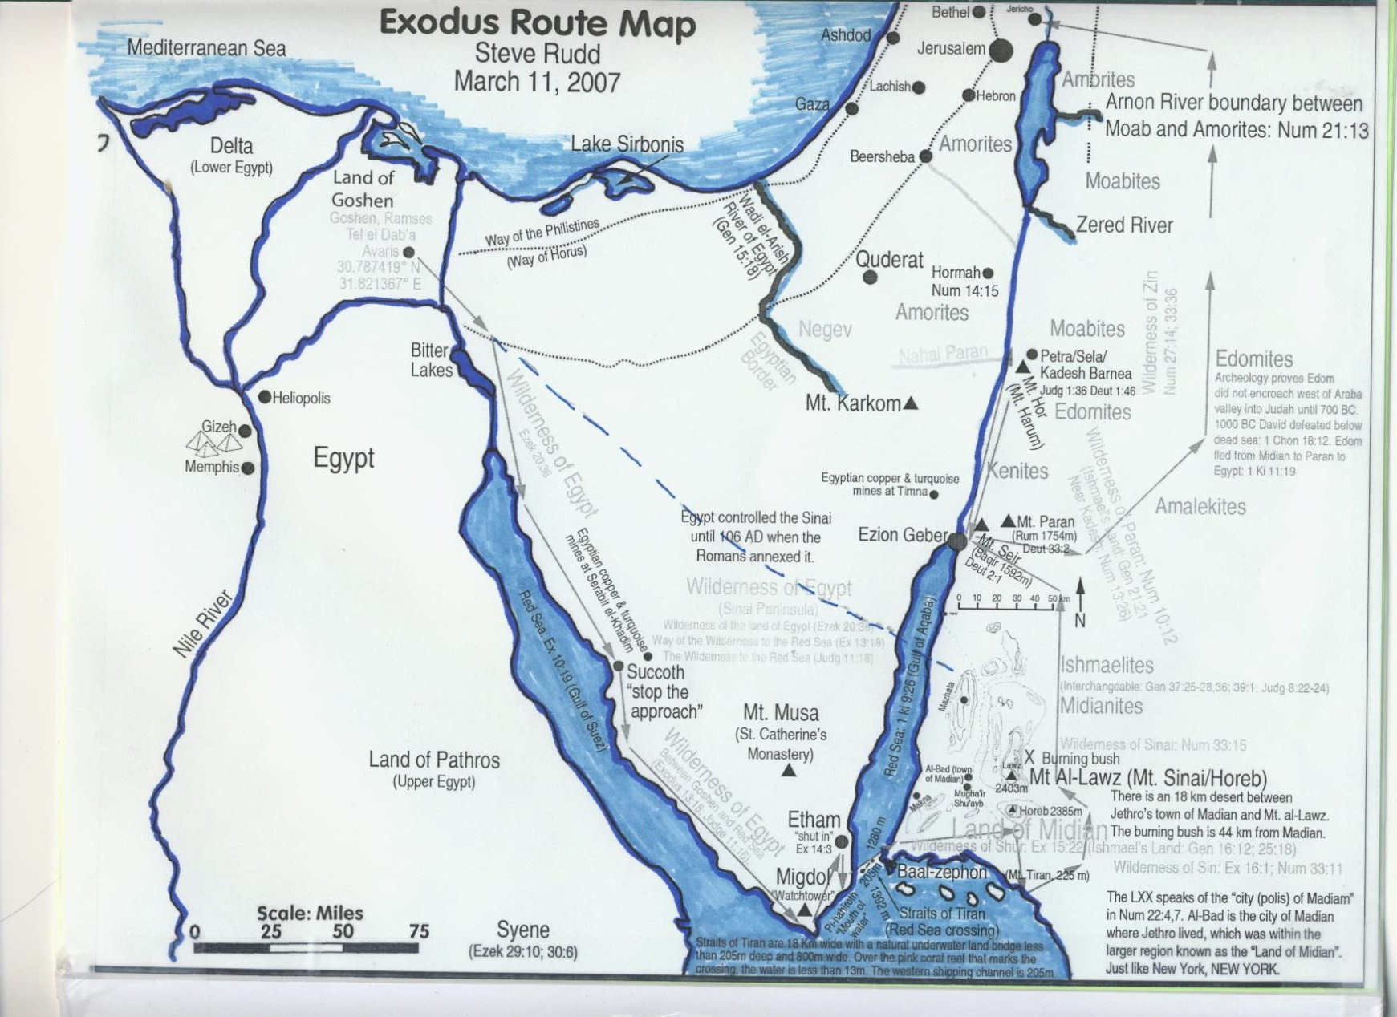
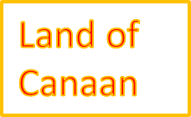
Mt. Nebo
Aaron dies at Mt. Sinai
Travel from Mt. Nebo across the Jordan to Gilgal …
Notes:
Today’s lesson will be travelling from the east side of the Jordan River, over the Jordan River and to Gilgal where they will celebrate Passover. Joshua will again read the Israelites what it is they need to do to prepare themselves.

Slide 9
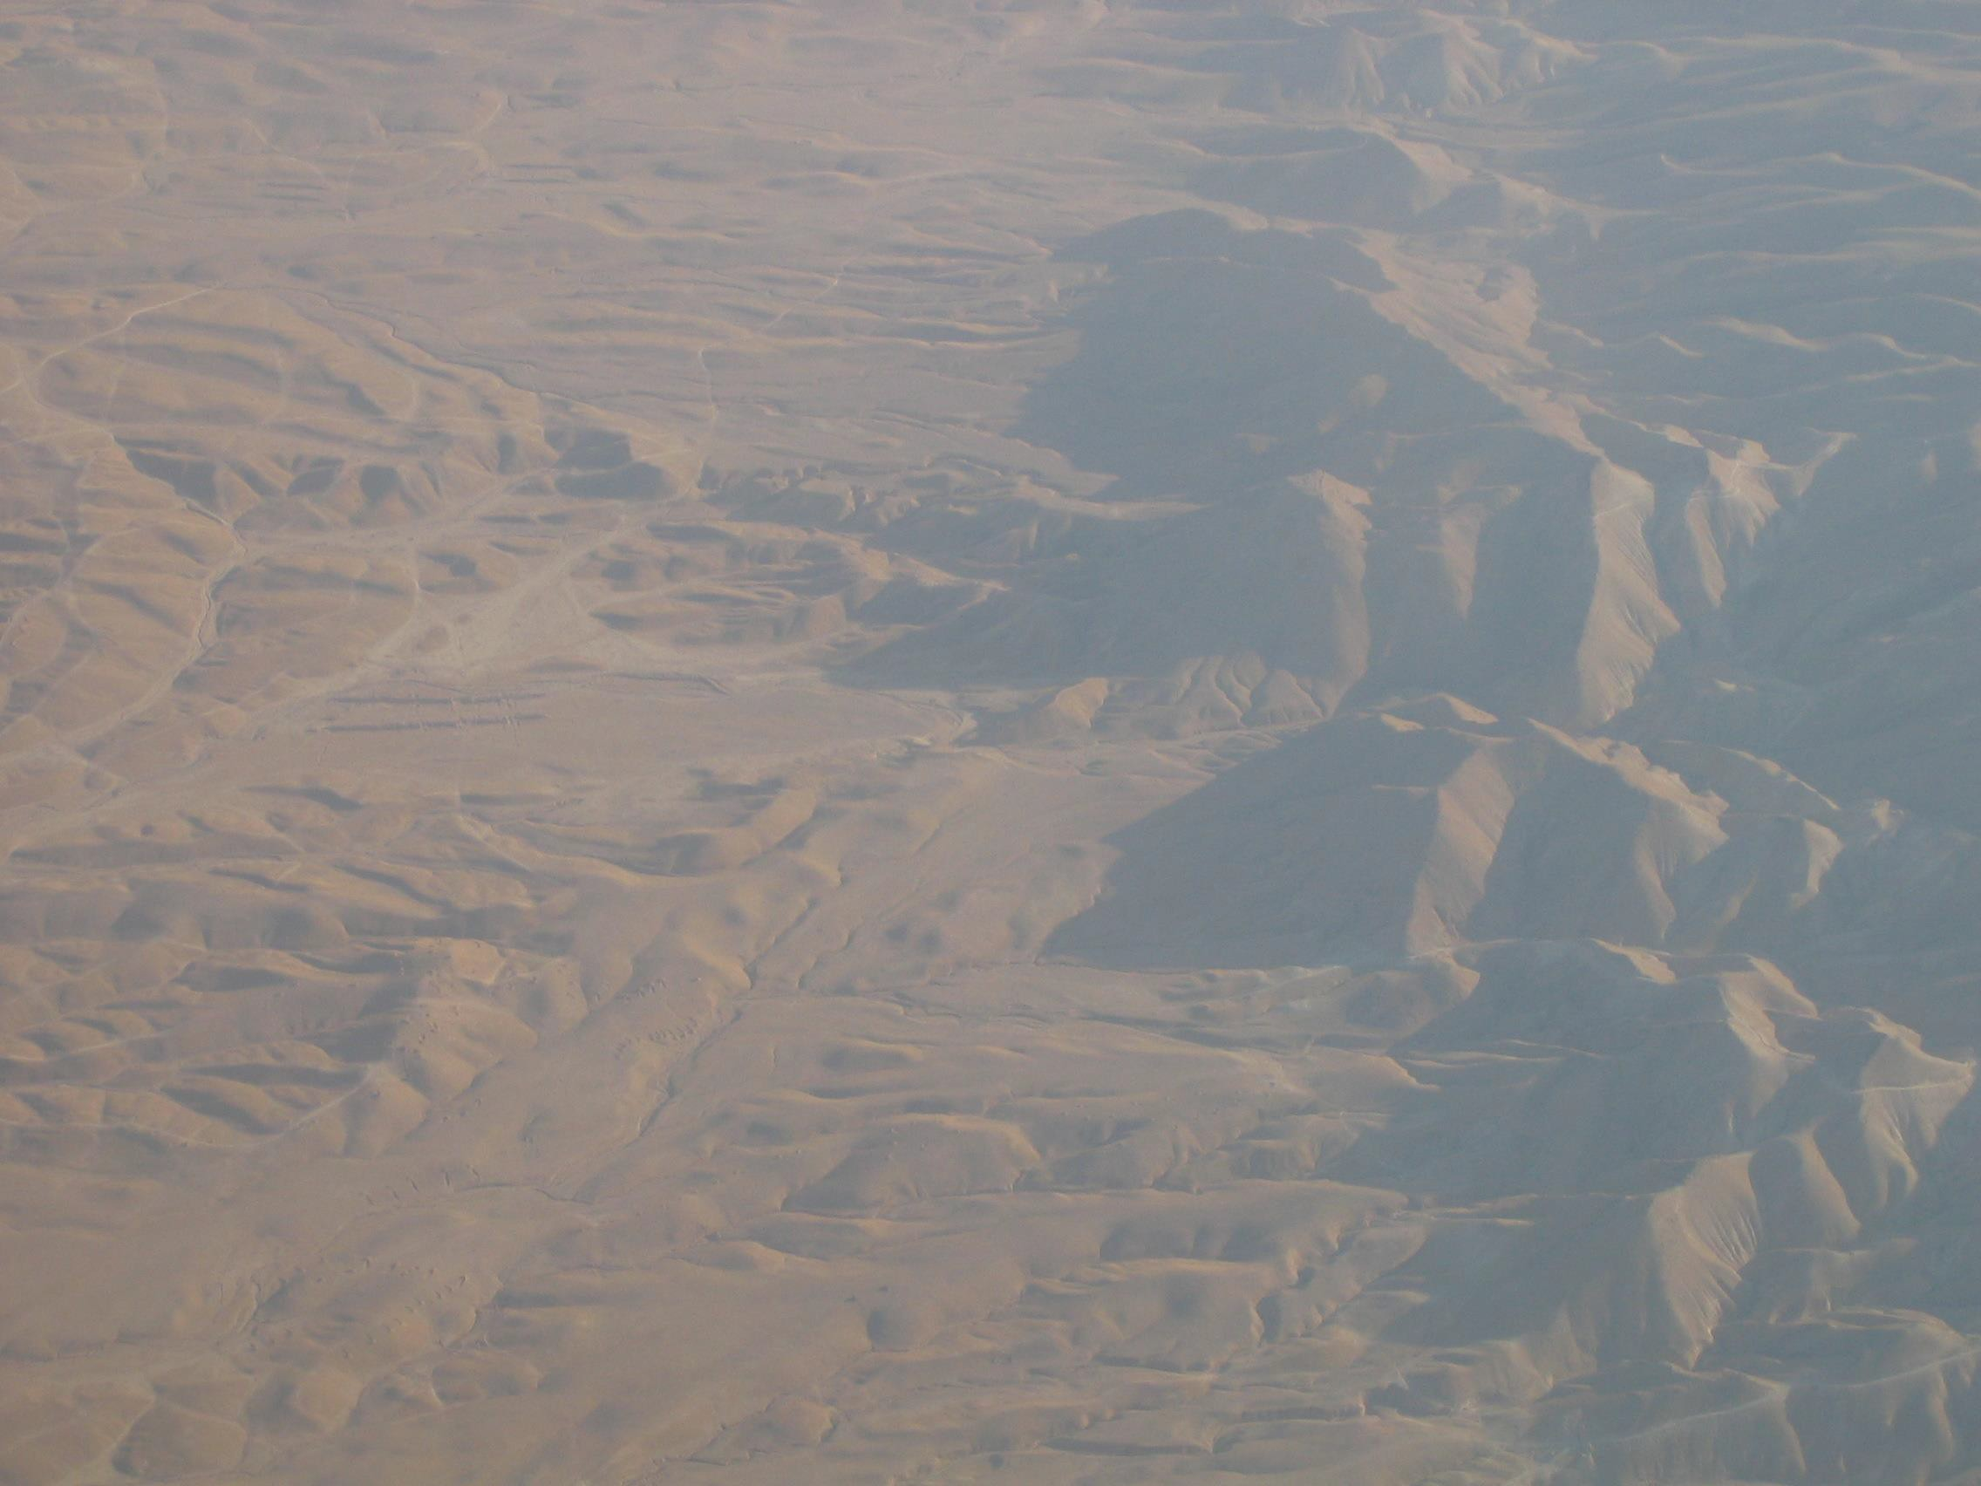
Where will we travel today?
Desert and mountains in Israel
Notes:
This is the range of Mountains from the Northern tip of the Red Sea to the northern part of the Dead Sea.

Slide 10
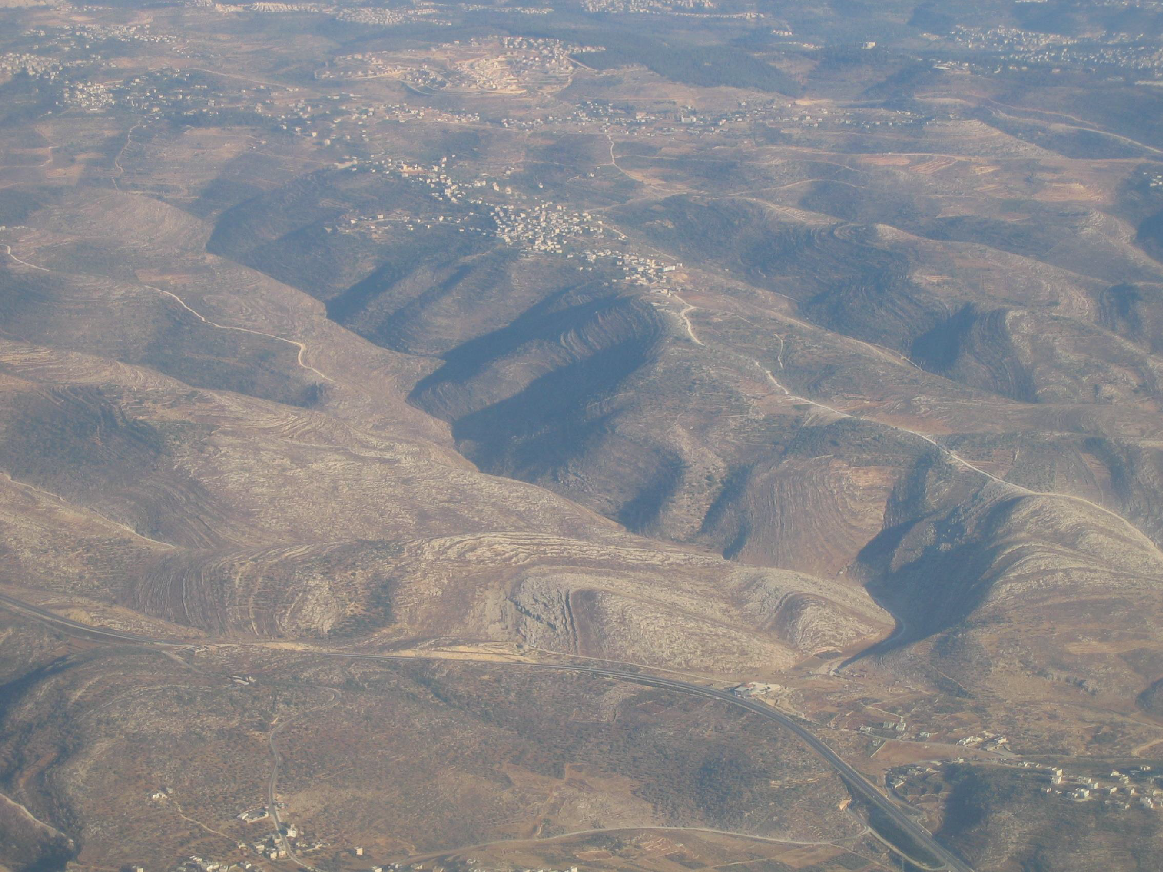
Look for the cities and towns of today that are scattered in the valleys and mountains..
Notes:
Mountains, deserts and valleys on the west side of the Dead Sea towards Jerusalem.

Slide 11
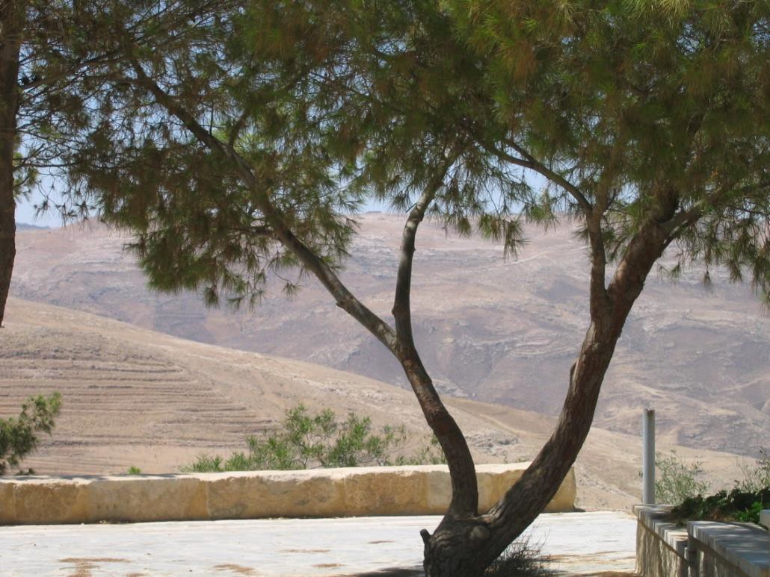
At Mt. Nebo
Moses gives land to 2 ½ tribes
Moses reviews the commandments and God’s
instructions.
Moses Dies at age 120
Joshua becomes the leader
Notes:
Looking West toward the valley below Mount Nebo.

Slide 12
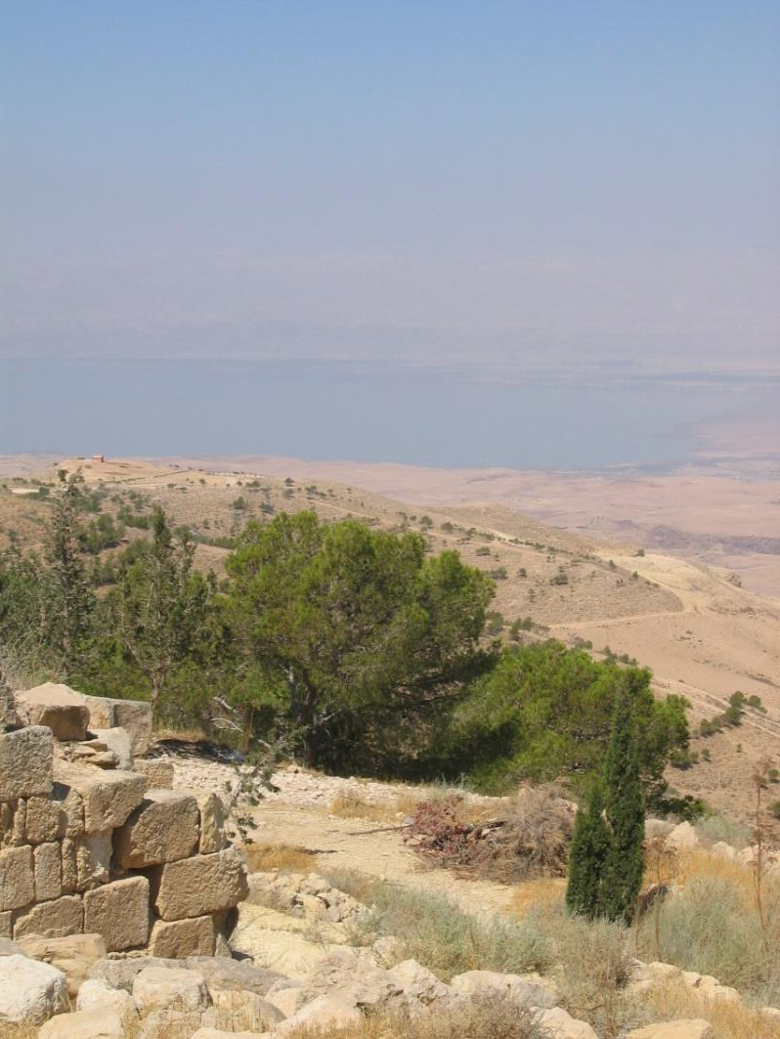
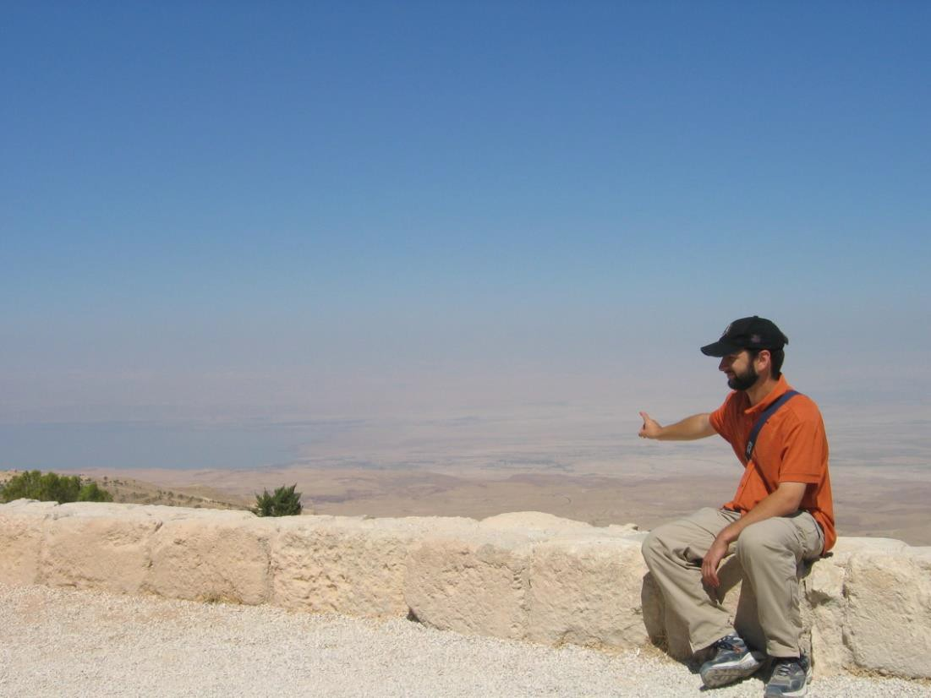
Looking west from Mt. Nebo in Jordan to the Dead Sea.
Jericho can be seen from Mt.
Nebo.
On a clear day Jerusalem
can be seen from here.
Notes:
The man in the picture is pointing towards Jerusalem which is west of the Dead Sea and can be seen on a clear day.

Slide 13
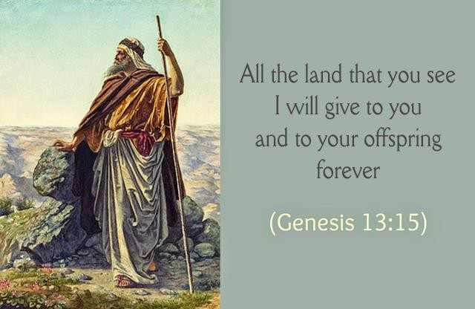
The promise God made to Abraham and the land that Moses and Joshua described to the tribes.
Notes:
The promise God made to Abraham.

Slide 14
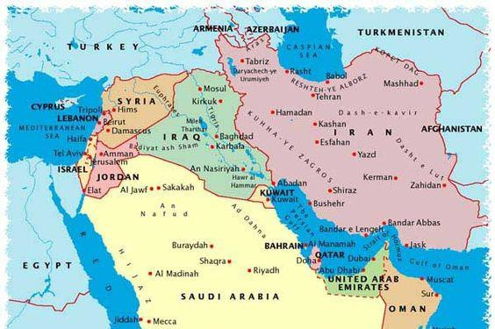
Moses describes the Land God gave to Abraham and his descendents. Joshua describes the land for the tribes.
TODAY this land is in the countries of
Iraq, Jordan, Saudi Arabia, Syria and Israel.

Slide 15

Look for the Dead Sea in the distance.
Note the desert with some shrubs – in the month of July.

Slide 16
Joshua is the leader of
the Israelites travelling into Canaan
Joshua has secretly sent out spies into
Canaan to check out Jericho
Who are the spies?
Who do they talk to?
  Read Joshua 2:1-24

Slide 17
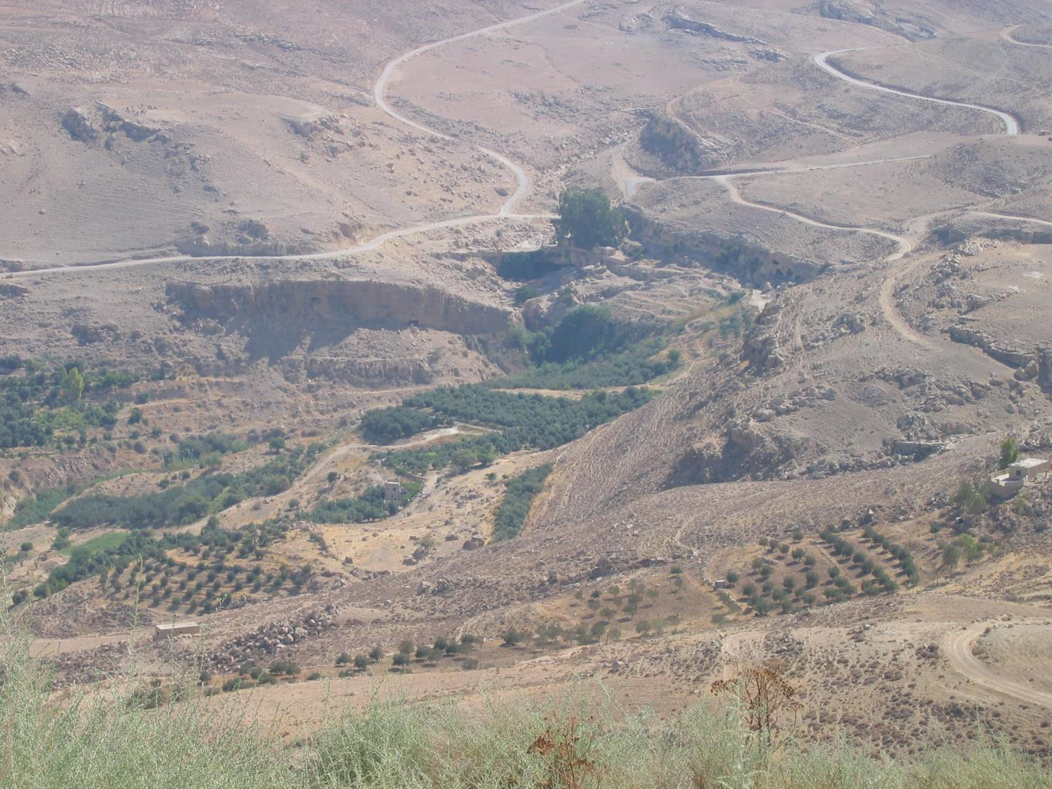
The valley below Mt. Nebo where the 2 spies will cross the Jordan River to check out Jericho.

Slide 18
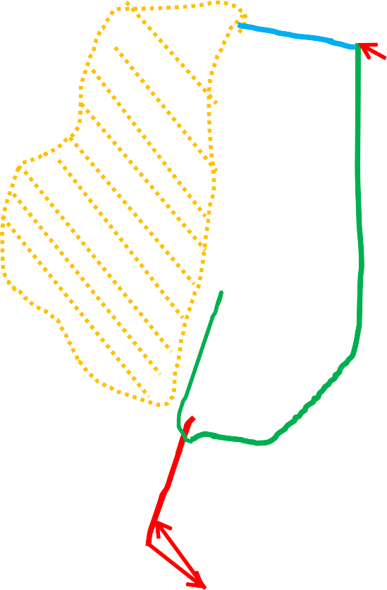
Check the Map --- Where are we traveling next?
Mt. Nebo
Aaron died at Mt. Hor
Travel from Mount Nebo and camp east of the Jordan … Joshua reviews the Commandments and God’s instructions. They consecrate themselves.
Notes:
Let students look at their map and then provide instructions on the next 2 slides.

Slide 19
Check your maps for where we are now camped in Gilgal.
We are now camped East of the Jordan River,
We will be travelling west to cross the Jordan River.
What events and miracle happens at the Jordan River?
We settle in Gilgal.
An alter is built to worship God
The army is sent to conquer Jericho
Notes:
The river parts (the water stands up on the north side of the river. The water on the other side of the dry land flows down to the Dead Sea) as the ark of the covenant is taken into the river. Rocks are piled in the Jordan to mark the place where they crossed.

Slide 20
– The miracle of the crossing
A wall of water and we walk across the river
– 12 stones are picked up to build an alter to worship God on the west side of the Jordan.
– 12 stones are placed in the Jordan river where they crossed
Notes:
Answers to the previous slide.

Slide 21
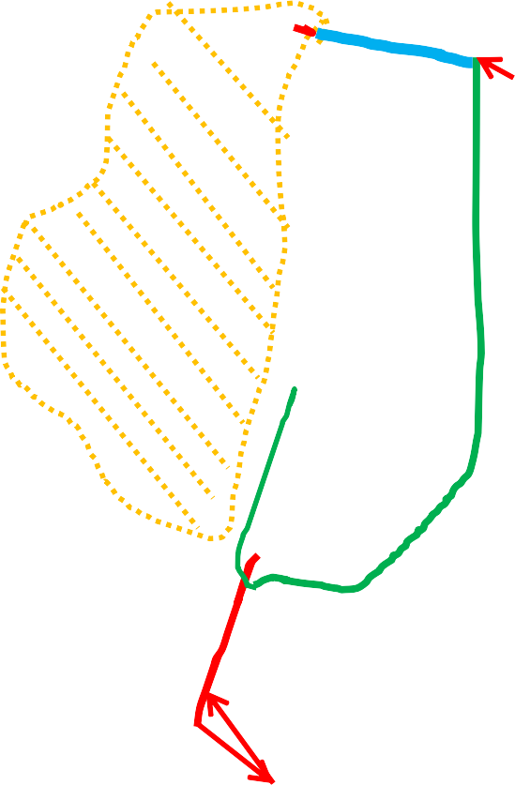
Mt. Nebo
Aaron dies at Mt. Hor
Miracles of crossing Jordan, settle in Gilgal, conquer Jericho …
Notes:
Students draw the line from Mount Nebo across the Jordan River and settle at Gilgal while they conquer Jericho and other cities.

Slide 22
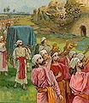
The Ark of the covenant would lead the children of Israel. When the cloud moved, they would move as well.
https://en.wikipedia.org/wiki/File:The_Fall_of_Jericho.jpg

Slide 23
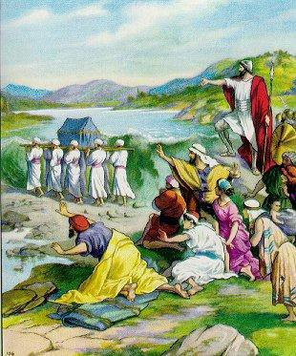
The Ark of the Covenant crossing the Jordan River.
Note: the water to the north appears like a wall of water.
Notes:
They celebrate Passover when they arrive at Gilgal. This is in the spring and as a result the Jordan river is very wide.

Slide 24
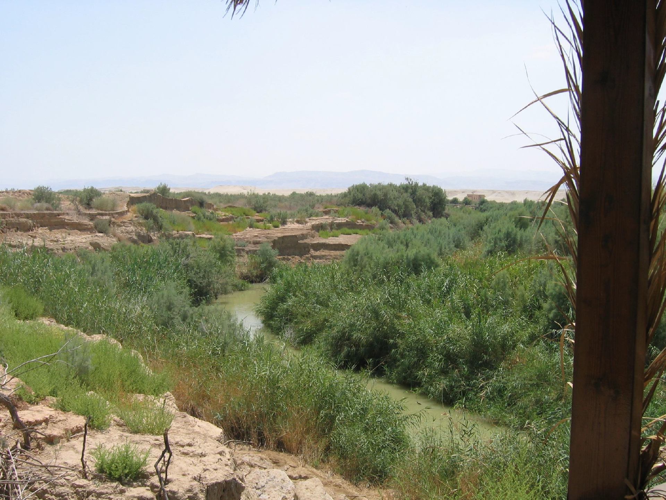
In the Spring the Jordan River floods.
This is the Jordan River in the summer.

Slide 25
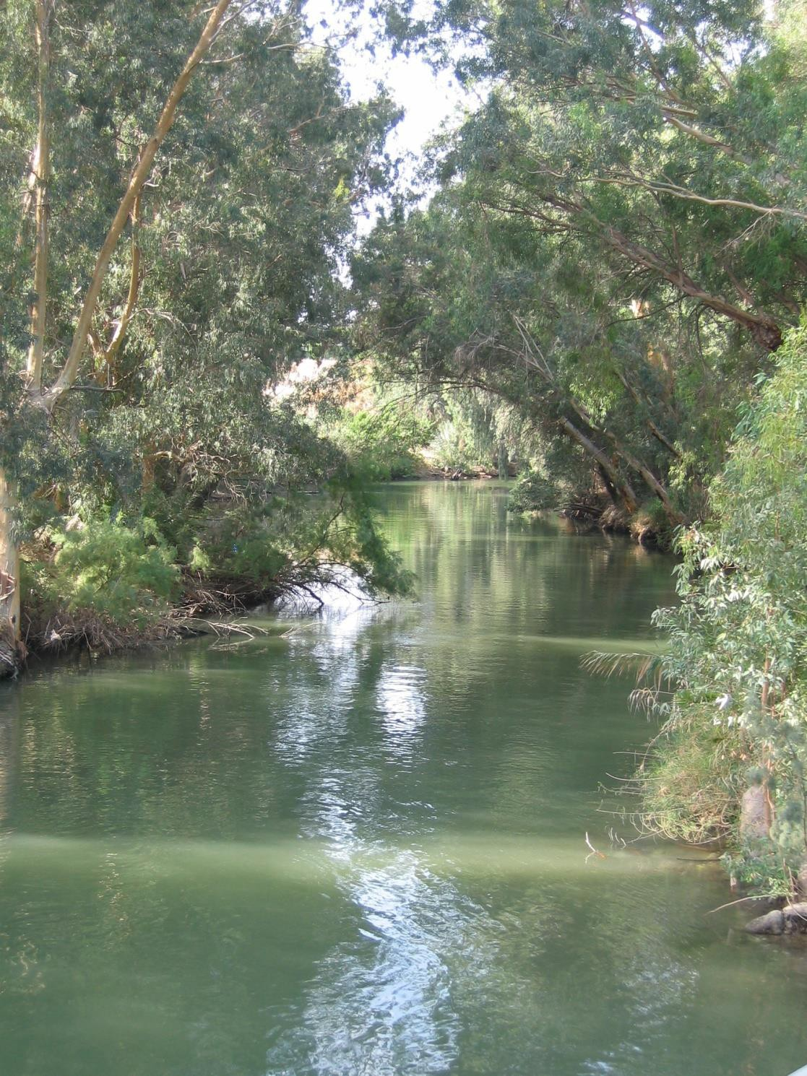
The northern part of the Jordan River

Slide 26
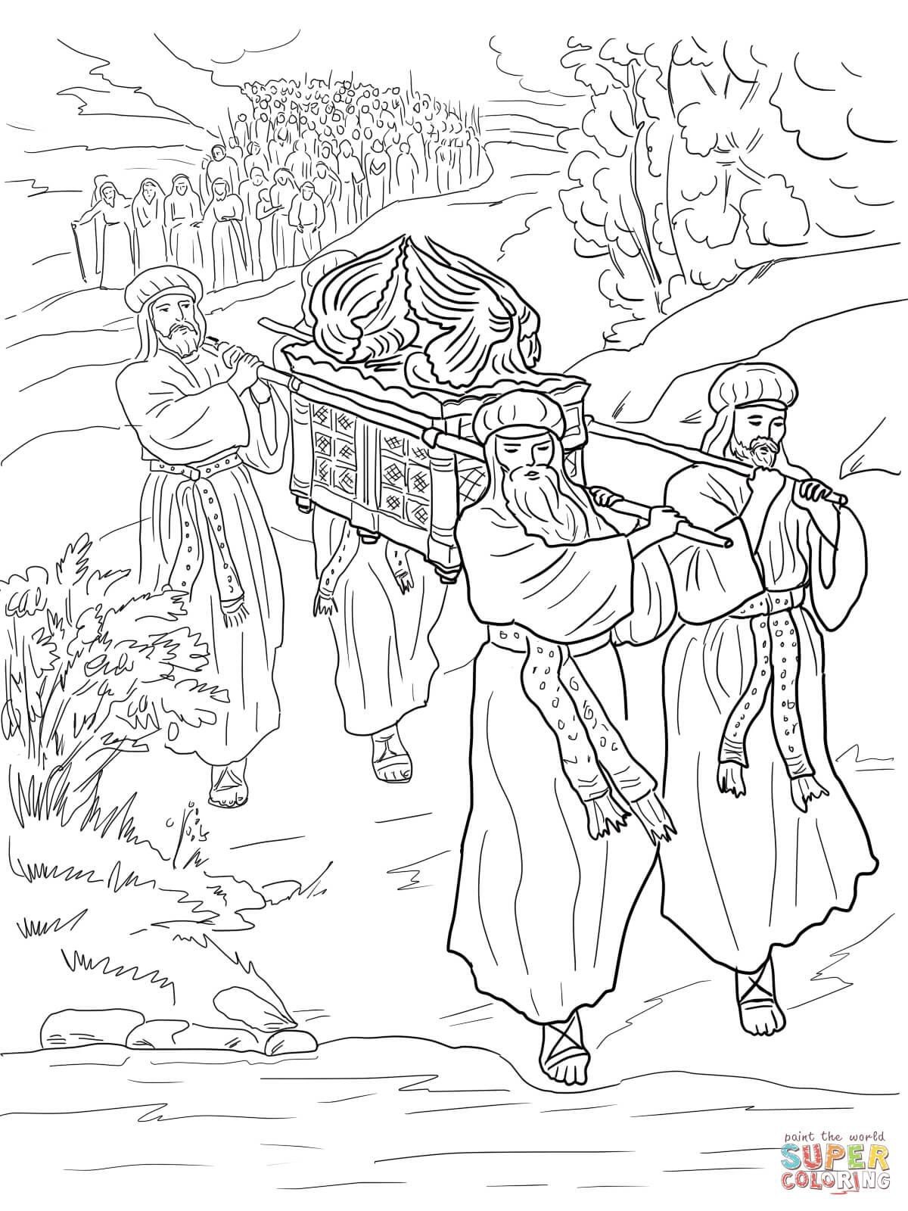
Travelling with the Ark of the Covenant. When the ark
would move, the cloud and the people would move.

Slide 27
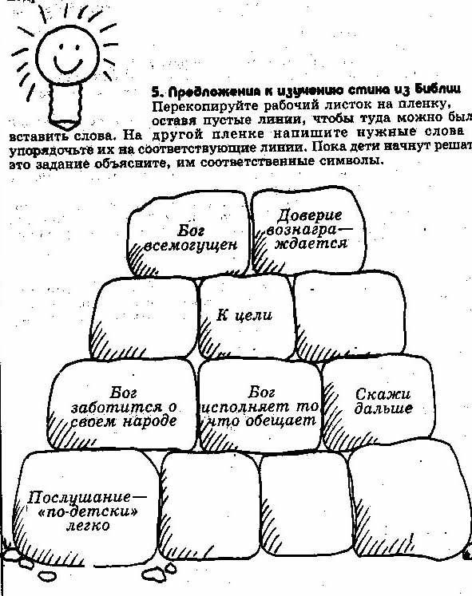
12 Stones piled up in the middle of the Jordan River and 12 stones for building
an altar.

Slide 28
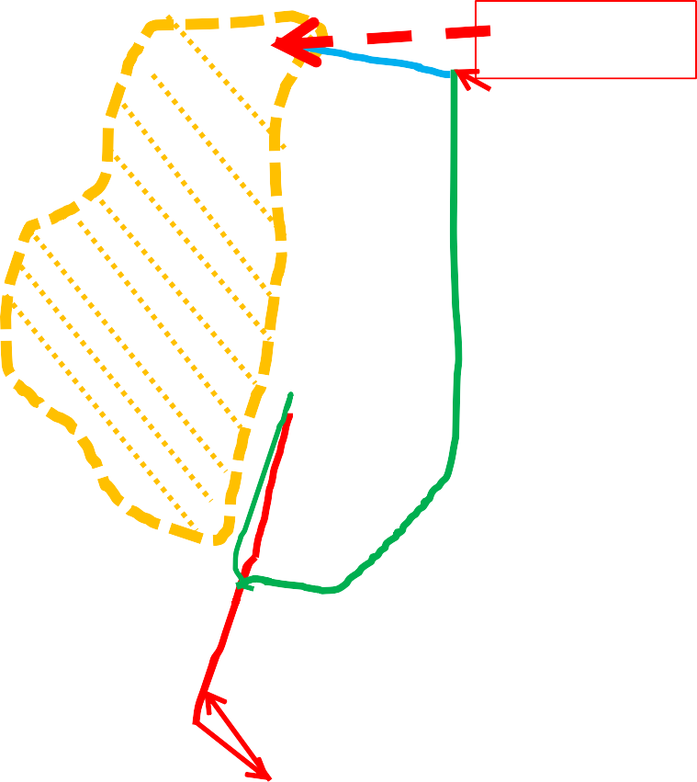


Mt. Nebo
Miracles of crossing Jordan, settle in Gilgal, conquer Jericho …

Slide 29
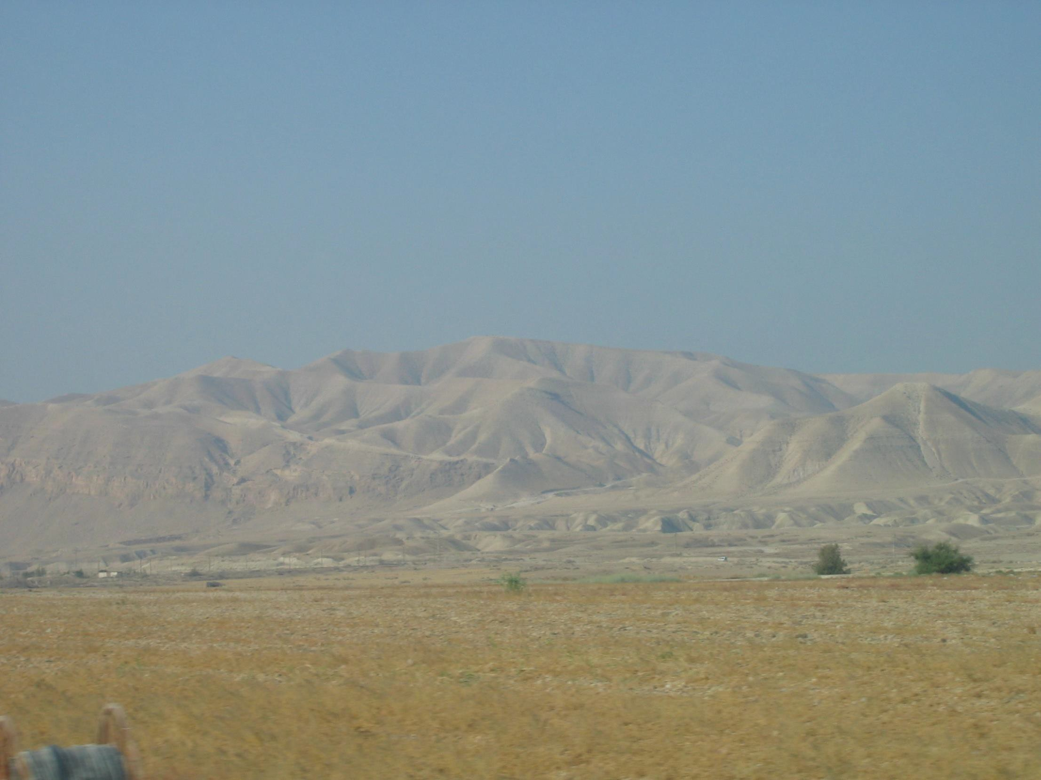
Looking towards the mountains by the Dead Sea from Gilgal area.
Notes:
The Dead Sea is to the left of the picture.

Slide 30
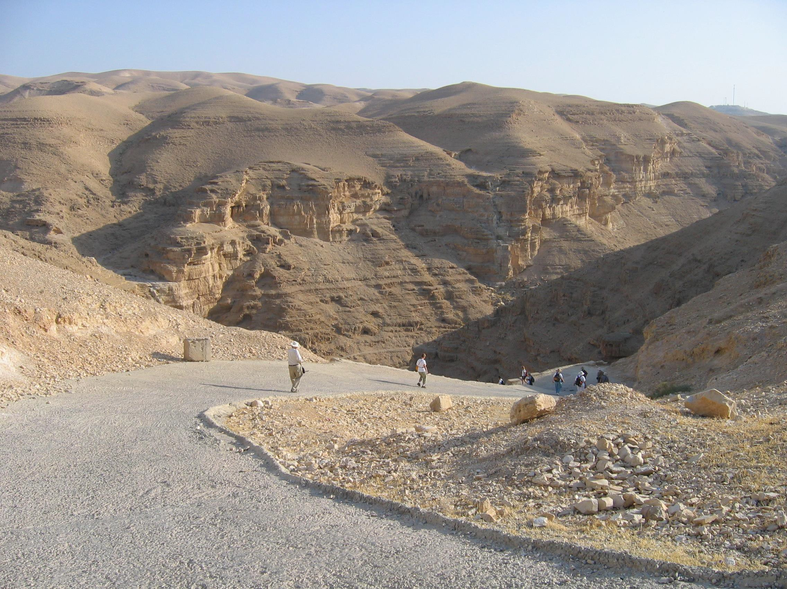
A possible way that the army may have marched through the Judean Hills to conquer Jericho. Observe the dry desert conditions..

Slide 31
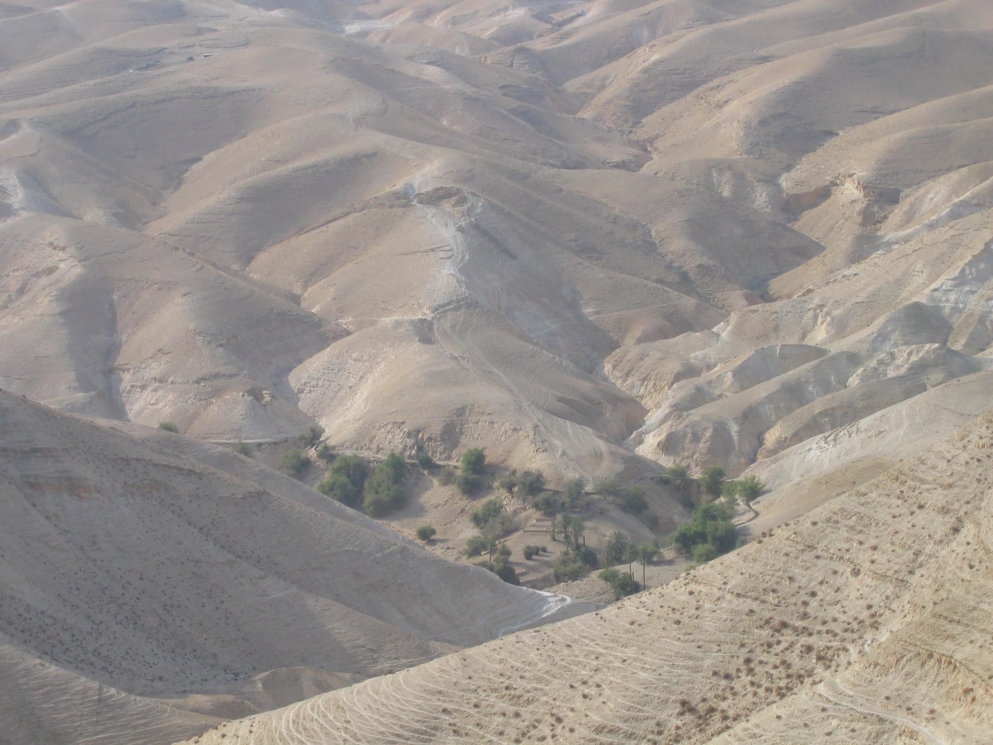
The walking path from the Judean Hills to Jericho.
Notes:
The month of July.

Slide 32
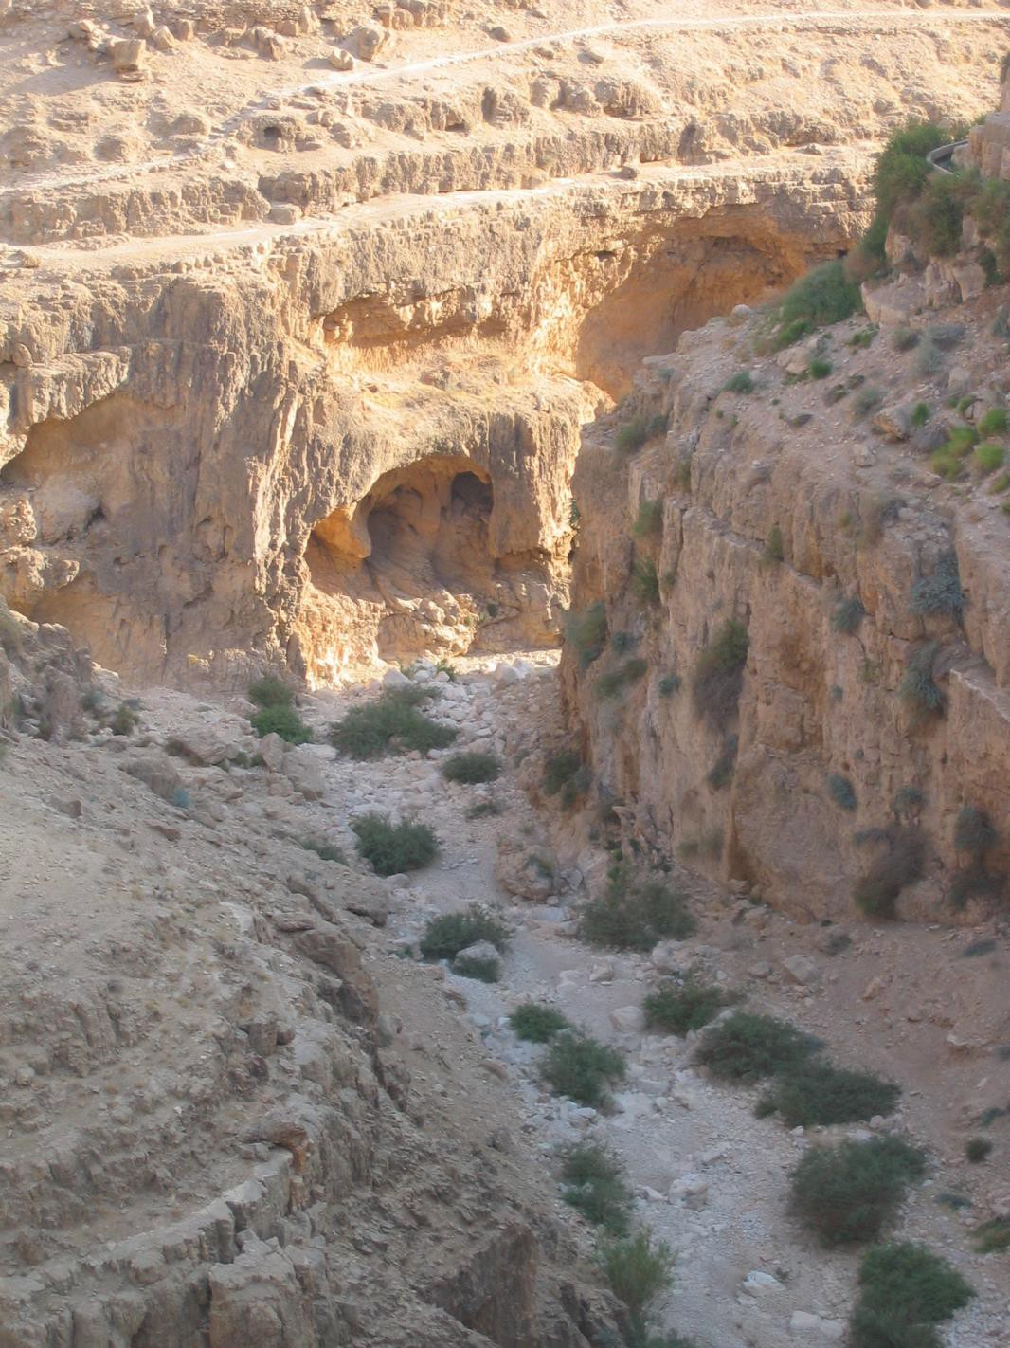
This is a Wadi (a valley). Looking down from the path to where the river would run during the rainy season. This is one path leading to Jericho.

Slide 33
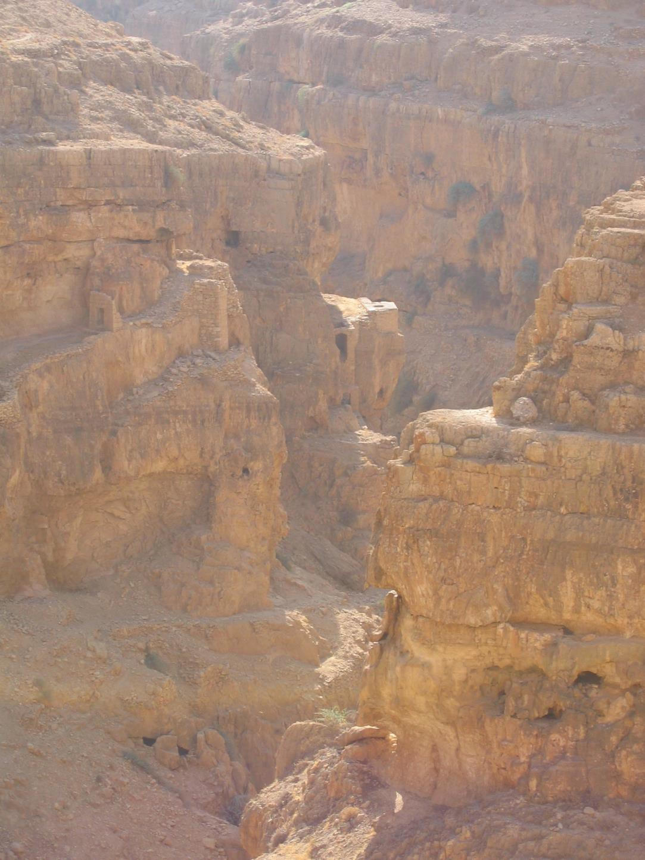
People would build shelters or places to live in the caves and rocks.

Slide 34
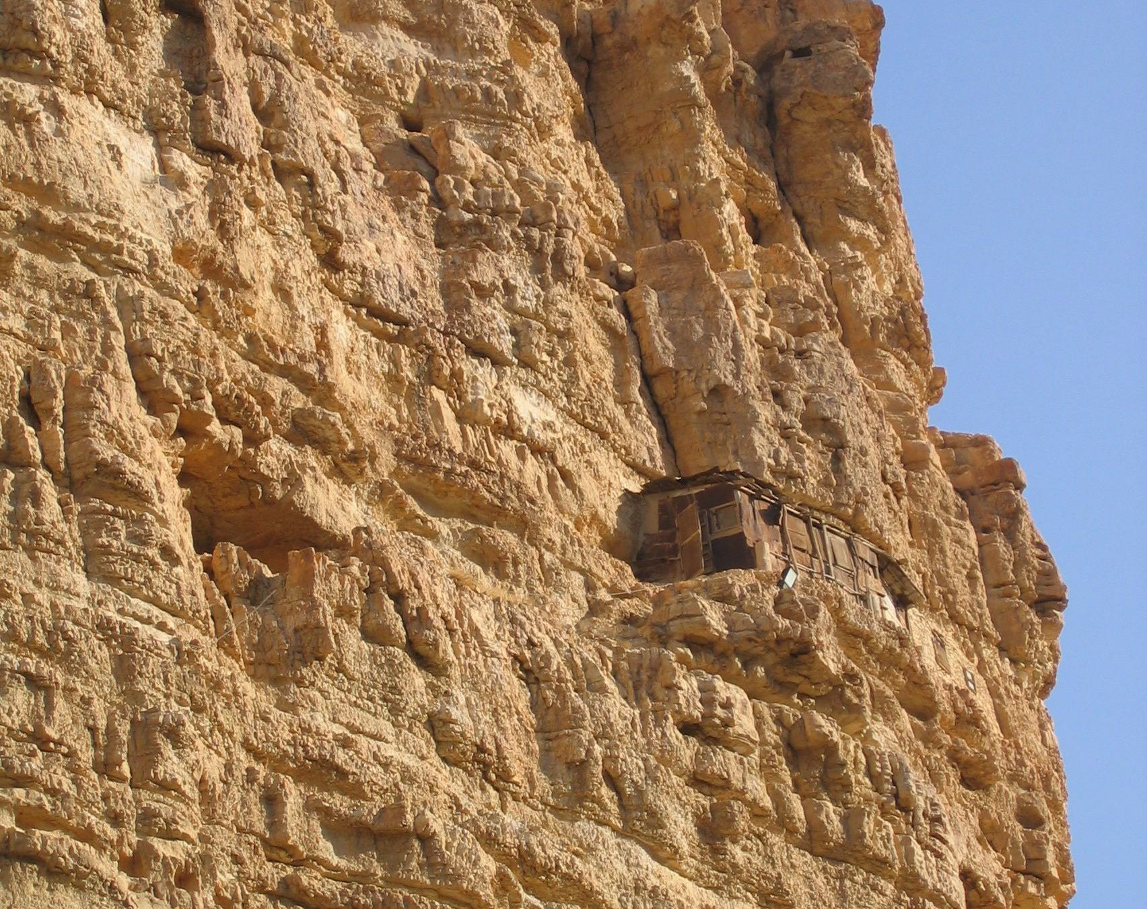
Today, people have built shelters in the mountains.

Slide 35
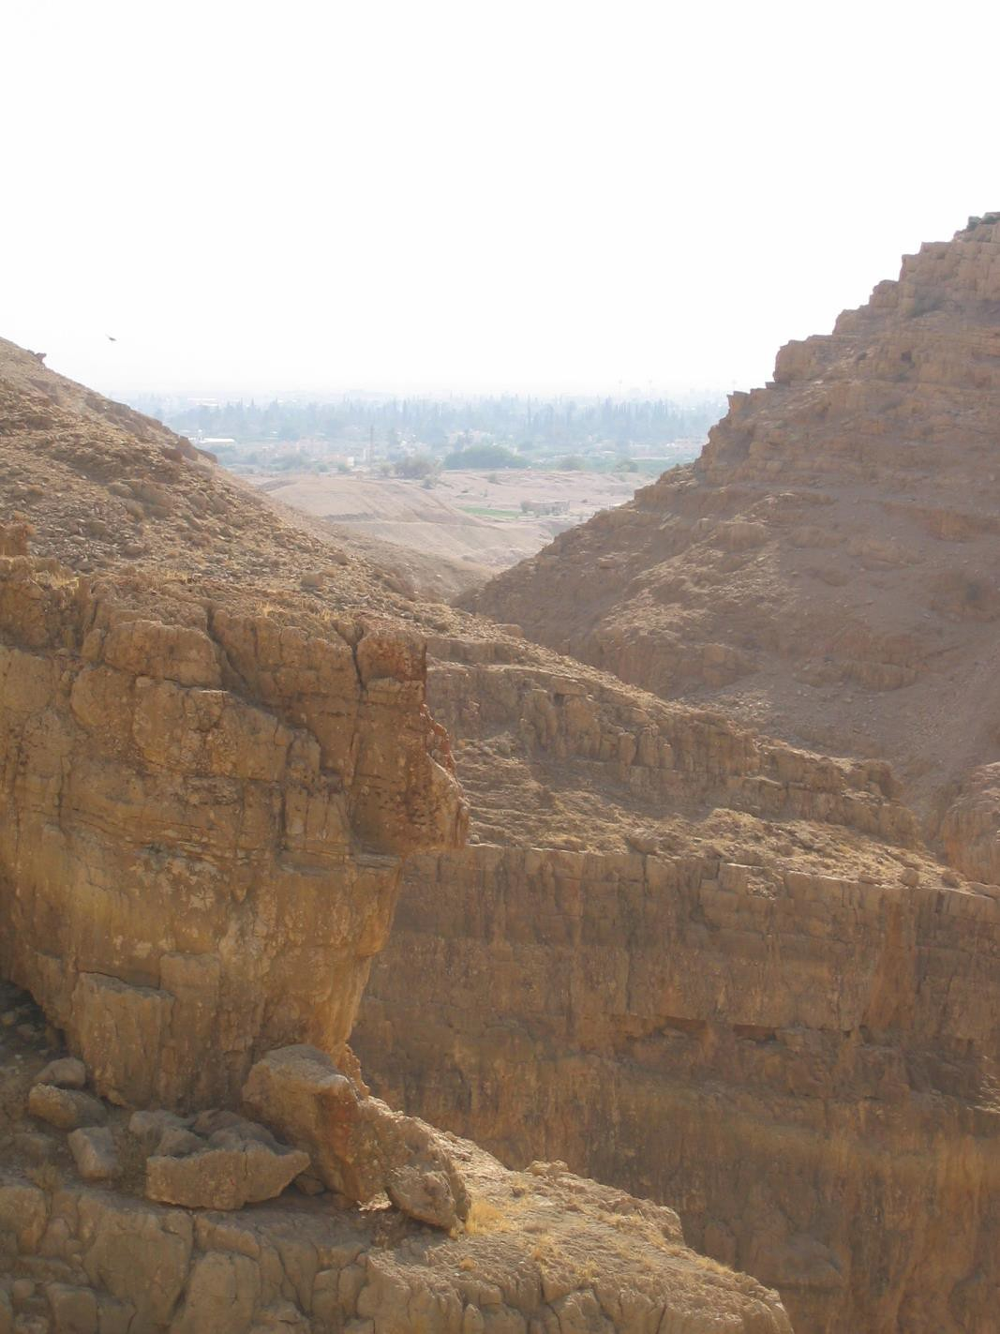
Looking towards the ruins of ancient Jericho.
Modern Jericho in the background.
Notes:
Think about how Joshua and the army would have made their way to Jericho to check it out.

Slide 36
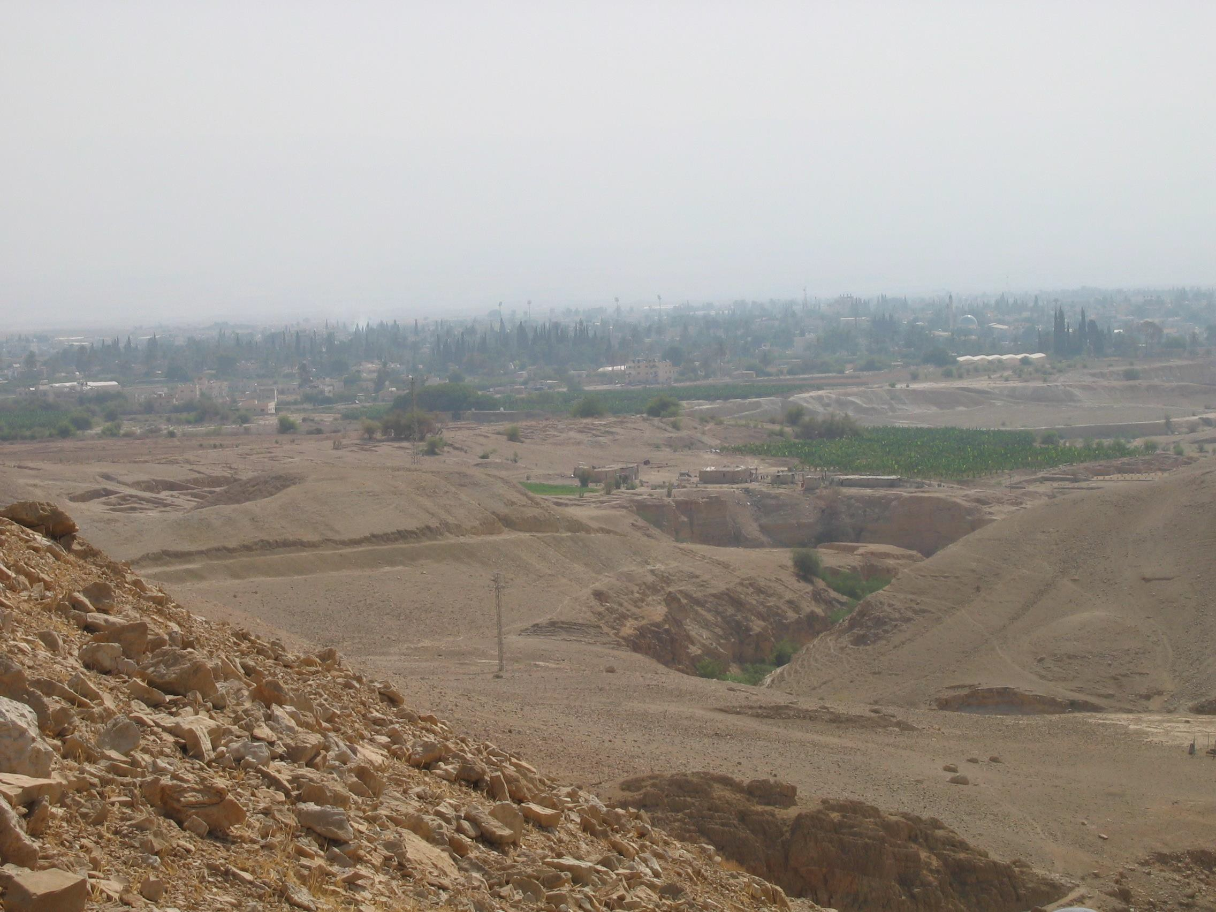
Looking towards the ruins of ancient Jericho in the foreground
and modern Jericho in the background.

Slide 37
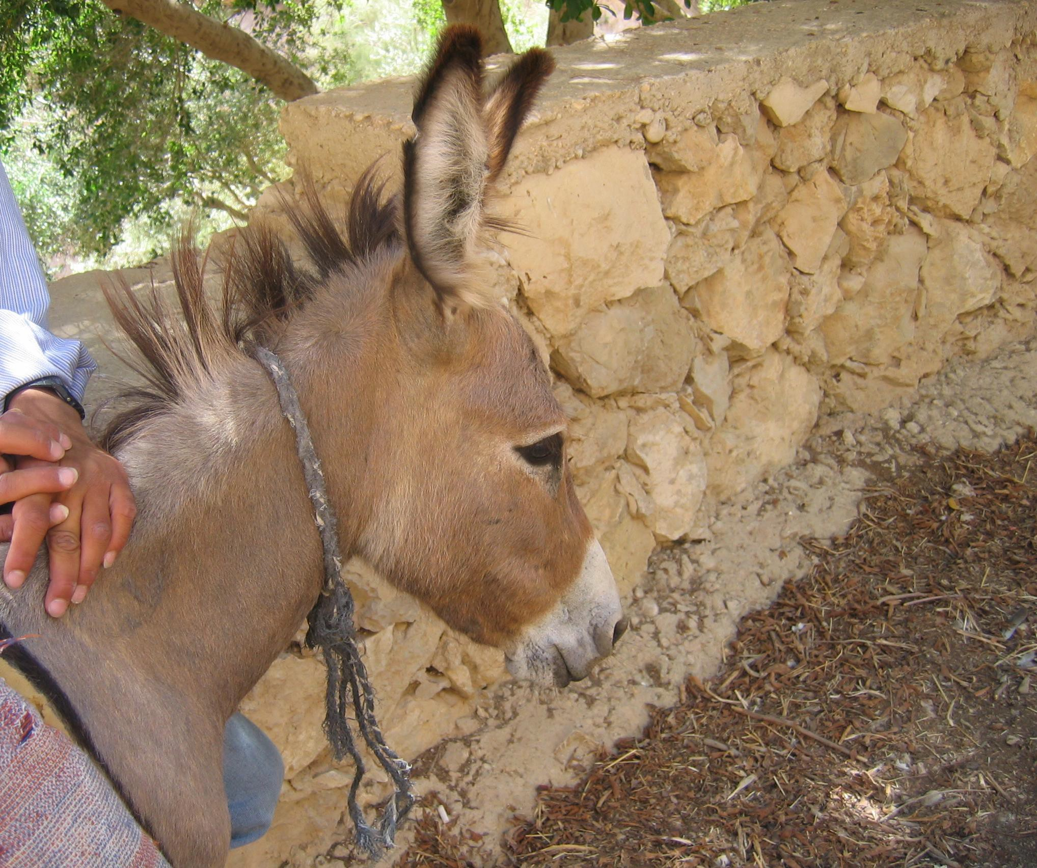
Travel was often by donkey.

Slide 38
Review Bible Memory Verses:
Joshua 1:16 - Then they answered Joshua, “Whatever you have commanded us we will do, and wherever you send us we will go.
Joshua 24:15
“Choose for yourselves this day whom
you will serve…but as for me and my household, we will serve the Lord”

Slide 39
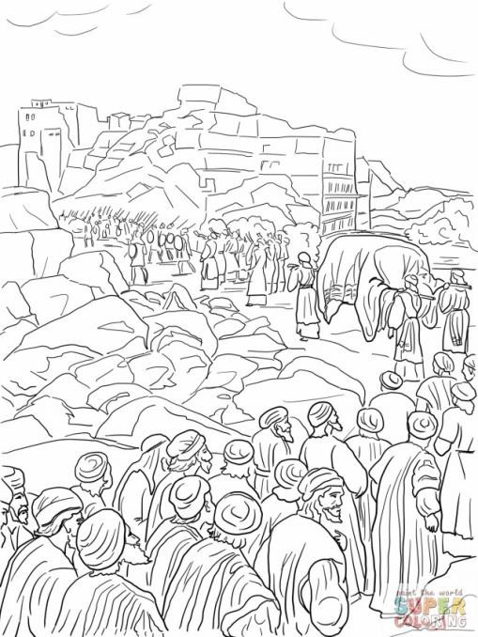
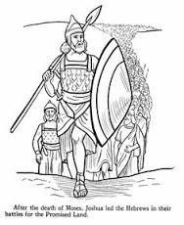
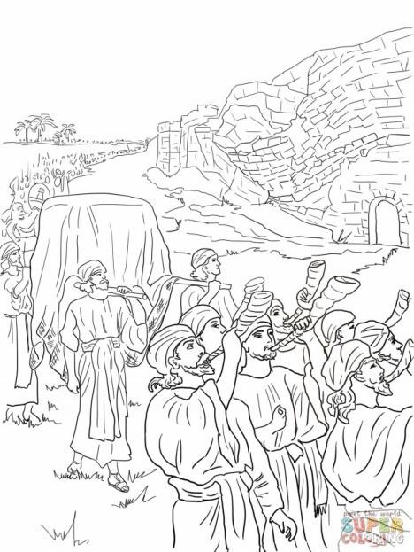
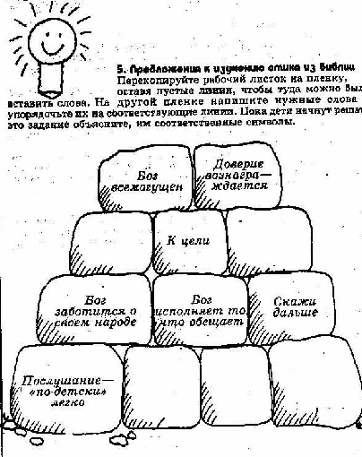

Pictures to paste into your Passport.

Slide 40
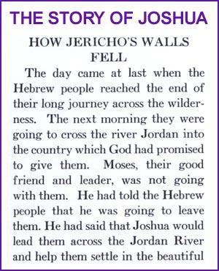
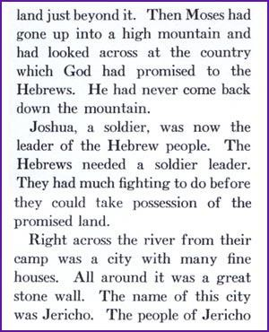
The next few slides provides the story if children want to
read and review the story together.

Slide 41
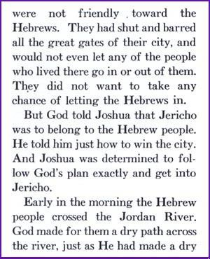
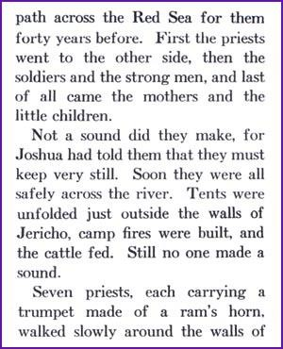

Slide 42
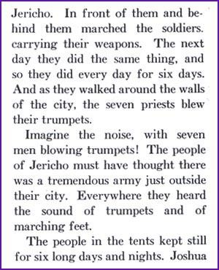
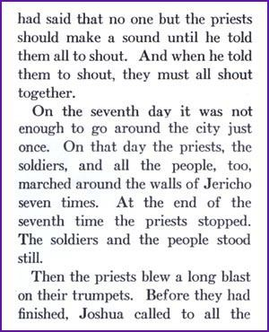

Slide 43
