Slide 1
2 Teaching Strategies
for lessons
“ Jesus Ascension to Heaven” & “Pentecost”
& a TEST
Strategy #1
Imagine you are at the event. Teacher describes the scene, and reads the story when students have closed their eyes and image that they are at the event. Describe in as much detail as possible using all of the senses. Describe with emotion, inner feelings, what is seen or may be seen, what is heard, felt etc. .
Strategy #2.
Reader’s Theatre. Students select or are assigned a character role, or the narrator. This can be preformed as a large class or smaller groups are set up in the class and they read the scene or story in character.
NOTE: Notes to the teacher is in brown text.

Slide 2
Lesson Teaching Strategy # 1 Imagine you are at the scene of the event.
The lesson is set up for students to imagine what is happening and be one of the disciples with Jesus and also in the upper room at Pentecost. The intent is for the student to imagine and feel along with how the disciples may have felt during this time and what was happening to Jesus, their best friend, their guide, their mentor.
Lesson Themes: (This may take several classes to cover.)
The Events of the Ascension of Jesus (Acts 1)
Celebration of Pentecost (Acts 2).
Background Information to the lessons:
At the beginning of each lesson review the following events (with a detailed description of the setting of the following, or watch this shorter section from “The Story of Jesus” movie or a longer version from “Jesus” movie):
Palm Sunday (Day of the Lamb):
Crucifixion of Jesus:
Resurrection of Jesus:

Slide 3
Lesson Strategy #1 continued - Imagine you are at the event.
Learning Activity: Teacher describes and students close eyes and imagine that they are with the people in each of 3 separate events. (Keep sections short so that students don’t fall asleep and ask questions at the end). These scenes take place when Jesus ascends to heaven and when the Holy Spirit descends. Use the scripture from Acts 1 & 2 to describe what the students will experience using all of the senses. Provide a detailed description of where this happens, the feelings, time of day, what one might see, hear, feel, wonder about, etc. . Make it as real to what the Bible says as possible. The scene or event may include information about Jerusalem, where it took place on the Mount of Olives; in the upper room, who was there, etc. Include information you may have about the season, the land, the culture or the people and what the area in Israel where this may have happened. Students may wish to choose which disciple they would like to be in this story.
NOTE: If possible find video clips on YouTube about various parts of Israel that will help the students to feel where they are during an event. Take some of the scenes from the movie “Jesus” www.jesusfilm.org or on YouTube.

Slide 4
Scene #1: 40 Days later after the Resurrection of Jesus - He ascends to Heaven
Acts 1:1-11 As you, the teacher, describes the setting, and reads this section, students imagine they are gathered together on the Mount of Olives with Jesus and again listen carefully to what he says is going to happen to him. (Put feeling into it and what their emotions could have been to be with Jesus again. They have been with him off and on over the 40 days after his resurrection. They are happy to see Jesus again and listen with anticipation etc. Jesus is preparing them for what is going to happen to him and what will follow once he is gone. Then suddenly as they are listening to Jesus, he rises to the sky; a cloud appears and blocks their view of Jesus. Discuss the awe, or how they must have felt?
Then: 2 men dressed in white appear and tell them (read from Acts 1:1- 11)

Slide 5
Scene #2: Acts 1: 12-26. Imagine that you have walked from the Mount of Olives to Jerusalem and are gathered with the disciples and some of the women and are praying in the upstairs room of a house: Peter stands up and explains to those gathered together and speaks that the prediction of the Holy Spirit coming will be fulfilled. He speaks about Judas Iscariot and what happened to him. They then select a disciple to replace Judas Iscariot. (describe the upper room as having hewn stone walls, being lit with oil lamps and possibly being quite dark if there are no windows. It may have been slightly cool or damp as it is in May or June of the year.) Read this section of the story now.
Scene #3: Acts 1: 15 – 26 you are gathered in the room with 120 others when the disciples selected Matthias because Judas Iscariot was dead. Read this section of the story.

Slide 6
Scene #4: Acts 2:1 - 13: Imagine Ten Days later – The receiving of the Holy Spirit. As we read this section, students are in Jerusalem. People are gathered in the house when the Holy Spirit descended. Again describe as much as you might know about the setting in the room. Read the story from the Bible with expression and emotion.
Scene #5: Acts 2:13-36 Peter’s Sermon to people
Again describe as much as you might know about the setting in the room. Read the story from the Bible with expression and emotion.
Scene #6: Acts 2:37-47 Discussion about Baptism
Baptism with holy spirit – Pentecost
Baptism with water – Pentecost
Summary:
Of the scenes that they found themselves in.
Conclusion: The Holy Spirit lives in each of us who has accepted Jesus as our Lord and Saviour.

Slide 7
Lesson Strategy # 2 Reader’s Theatre
Students can read the stories of the Ascension and Pentecost in Acts 1 and 2 like a readers theatre. Readers Theatre is where certain students are select the role of a character in the story and read that portion; the narrator reads his/her specific part when telling the story. For example someone is Peter, someone else reads what Jesus says, etc. (Do a demonstration first for the students.)
Divide the story into scenes like in teaching strategy #1 – Imagine you are at the event. Also provide background information like in imagine the event. This makes it more real to the students.

Slide 8
Acts 1 & 2
Ascension
Pentecost/Shavout
Notes:
Students can read the story like a readers Theatre. Readers Theatre is where certain students are assigned a character in the story and they read that portion; the narrator reads their specific part when telling the story. For example someone is Peter, someone reads what Jesus says, etc.

Slide 9
Acts 1
Jesus Taken Up Into Heaven – The Ascension
1 In my former book, Theophilus, I wrote about all that Jesus began to do and to teach ² until the day he was taken up to heaven, after giving instructions through the Holy Spirit to the apostles he had chosen.
³ After his suffering, he presented himself to them and gave many convincing proofs that he was alive. He appeared to them over a period of forty days and spoke about the kingdom of God.
⁴ On one occasion, while he was eating with them, he gave them this command: “Do not leave Jerusalem, but wait for the gift my Father promised, which you have heard me speak about. ⁵ For John baptized with^{[a]} water, but in a few days you will be baptized with^{[b]} the Holy Spirit.”
Notes:
New International Version (NIV)

Slide 10
⁶ Then they gathered around him and asked him, “Lord, are you at this time going to restore the kingdom to Israel?” ⁷ He said to them: “It is not for you to know the times or dates the Father has set by his own authority. ⁸ But you will receive power when the Holy Spirit comes on you; and you will be my witnesses in Jerusalem, and in all Judea and Samaria, and to the ends of the earth.”
⁹ After he said this, he was taken up before their very eyes, and a cloud hid him from their sight.
¹⁰ They were looking intently up into the sky as he was going, when suddenly two men dressed in white stood beside them. ¹¹ “Men of Galilee,” they said, “why do you stand here looking into the sky? This same Jesus, who has been taken from you into heaven, will come back in the same way you have seen him go into heaven.”
Notes:
Acts 1 continued.

Slide 11
Matthias Chosen to Replace Judas
¹² Then the apostles returned to Jerusalem from the hill called the Mount of Olives, a Sabbath day’s walk^{[c]} from the city.
¹³ When they arrived, they went upstairs to the room where they were staying. Those present were Peter, John, James and Andrew; Philip and Thomas, Bartholomew and Matthew; James son of Alphaeus and Simon the Zealot, and Judas son of James.
¹⁴ They all joined together constantly in prayer, along with the women and Mary the mother of Jesus, and with his brothers.
Notes:
Acts 1 continued.

Slide 12
¹⁵ In those days Peter stood up among the believers (a group numbering about a hundred and twenty) ¹⁶ and said, “Brothers and sisters,^{[d]} the Scripture had to be fulfilled in which the Holy Spirit spoke long ago through David concerning Judas, who served as guide for those who arrested Jesus. ¹⁷ He was one of our number and shared in our ministry.”
¹⁸ (With the payment he received for his wickedness, Judas bought a field; there he fell headlong, his body burst open and all his intestines spilled out. ¹⁹ Everyone in Jerusalem heard about this, so they called that field in their language Akeldama, that is, Field of Blood.)
Notes:
Acts 1 continued.

Slide 13
²⁰ “For,” said Peter, “it is written in the Book of Psalms:
“‘May his place be deserted; let there be no one to dwell in it,’^{[e]}and,
“‘May another take his place of leadership.’^{[f]}
²¹ Therefore it is necessary to choose one of the men who have been with us the whole time the Lord Jesus was living among us, ²² beginning from John’s baptism to the time when Jesus was taken up from us. For one of these must become a witness with us of his resurrection.”
²³ So they nominated two men: Joseph called Barsabbas (also known as Justus) and Matthias. ²⁴ Then they prayed, “Lord, you know everyone’s heart. Show us which of these two you have chosen ²⁵ to take over this apostolic ministry, which Judas left to go where he belongs.” ²⁶ Then they cast lots, and the lot fell to Matthias; so he was added to the eleven apostles.
Notes:
Acts 1 13 to the end..

Slide 14
The Holy Spirit Comes at Pentecost
2 When the day of Pentecost came, they were all together in one place.² Suddenly a sound like the blowing of a violent wind came from heaven and filled the whole house where they were sitting. ³ They saw what seemed to be tongues of fire that separated and came to rest on each of them. ⁴ All of them were filled with the Holy Spirit and began to speak in other tongues^{[a]} as the Spirit enabled them.

Slide 15
⁵ Now there were staying in Jerusalem God-fearing Jews from every nation under heaven. ⁶ When they heard this sound, a crowd came together in bewilderment, because each one heard their own language being spoken. ⁷ Utterly amazed, they asked: “Aren’t all these who are speaking Galileans? ⁸ Then how is it that each of us hears them in our native language? ⁹ Parthians, Medes and Elamites; residents of Mesopotamia, Judea and Cappadocia, Pontus and Asia,^{[b]} ¹⁰ Phrygia and Pamphylia, Egypt and the parts of Libya near Cyrene; visitors from Rome¹¹ (both Jews and converts to Judaism); Cretans and Arabs—we hear them declaring the wonders of God in our own tongues!” ¹² Amazed and perplexed, they asked one another, “What does this mean?”

Slide 16
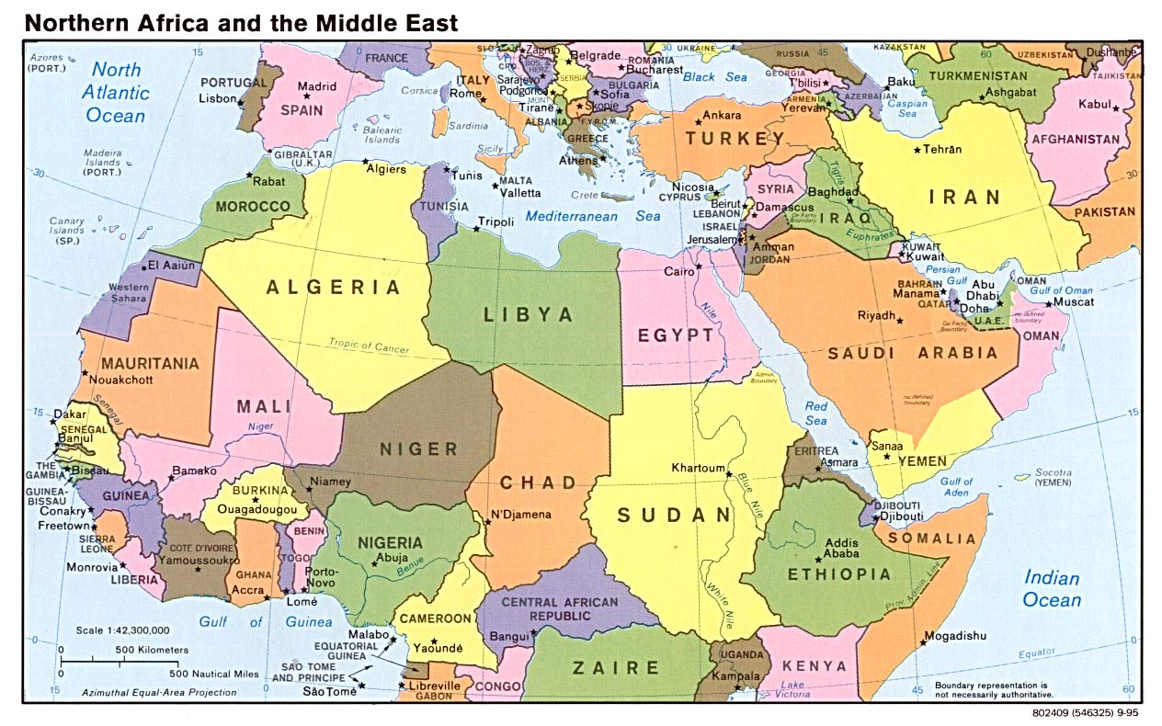

Slide 17
¹³ Some, however, made fun of them and said, “They have had too much wine.”
Peter Addresses the Crowd
¹⁴ Then Peter stood up with the Eleven, raised his voice and addressed the crowd: “Fellow Jews and all of you who live in Jerusalem, let me explain this to you; listen carefully to what I say. ¹⁵ These people are not drunk, as you suppose. It’s only nine in the morning! ¹⁶ No, this is what was spoken by the prophet Joel:

Slide 18
¹⁷ “‘In the last days, God says, I will pour out my Spirit on all people. Your sons and daughters will prophesy, your young men will see visions, your old men will dream dreams. ¹⁸ Even on my servants, both men and women, I will pour out my Spirit in those days, and they will prophesy. ¹⁹ I will show wonders in the heavens above and signs on the earth below, blood and fire and billows of smoke. ²⁰ The sun will be turned to darkness and the moon to blood before the coming of the great and glorious day of the Lord. ²¹ And everyone who calls on the name of the Lord will be saved.’^{[c]}

Slide 19
²² “Fellow Israelites, listen to this: Jesus of Nazareth was a man accredited by God to you by miracles, wonders and signs, which God did among you through him, as you yourselves know. ²³ This man was handed over to you by God’s deliberate plan and foreknowledge; and you, with the help of wicked men,^{[d]} put him to death by nailing him to the cross. ²⁴ But God raised him from the dead, freeing him from the agony of death, because it was impossible for death to keep its hold on him. ²⁵ David said about him:
“‘I saw the Lord always before me. Because he is at my right hand, I will not be shaken. ²⁶ Therefore my heart is glad and my tongue rejoices; my body also will rest in hope, ²⁷ because you will not abandon me to the realm of the dead, you will not let your holy one see decay. ²⁸ You have made known to me the paths of life; you will fill me with joy in your presence.’^{[e]}

Slide 20
²⁹ “Fellow Israelites, I can tell you confidently that the patriarch David died and was buried, and his tomb is here to this day. ³⁰ But he was a prophet and knew that God had promised him on oath that he would place one of his descendants on his throne. ³¹ Seeing what was to come, he spoke of the resurrection of the Messiah, that he was not abandoned to the realm of the dead, nor did his body see decay. ³² God has raised this Jesus to life, and we are all witnesses of it. ³³ Exalted to the right hand of God, he has received from the Father the promised Holy Spirit and has poured out what you now see and hear. ³⁴ For David did not ascend to heaven, and yet he said,
“‘The Lord said to my Lord: “Sit at my right hand ³⁵ until I make your enemies a footstool for your feet.”’^{[f]}
³⁶ “Therefore let all Israel be assured of this: God has made this Jesus, whom you crucified, both Lord and Messiah.”
³⁷ When the people heard this, they were cut to the heart and said to Peter and the other apostles, “Brothers, what shall we do?”

Slide 21
³⁸ Peter replied, “Repent and be baptized, every one of you, in the name of Jesus Christ for the forgiveness of your sins. And you will receive the gift of the Holy Spirit. ³⁹ The promise is for you and your children and for all who are far off—for all whom the Lord our God will call.”
⁴⁰ With many other words he warned them; and he pleaded with them, “Save yourselves from this corrupt generation.” ⁴¹ Those who accepted his message were baptized, and about three thousand were added to their number that day.

Slide 22
The Fellowship of the Believers
⁴² They devoted themselves to the apostles’ teaching and to fellowship, to the breaking of bread and to prayer. ⁴³ Everyone was filled with awe at the many wonders and signs performed by the apostles. ⁴⁴ All the believers were together and had everything in common. ⁴⁵ They sold property and possessions to give to anyone who had need. ⁴⁶ Every day they continued to meet together in the temple courts. They broke bread in their homes and ate together with glad and sincere hearts, ⁴⁷ praising God and enjoying the favor of all the people. And the Lord added to their number daily those who were being saved.

Slide 23
The Next Section is a Test for Students
it is also in a Word Document named:
“Acts 1 and 2 Ascension Holy Spirit”

Slide 24
TEST
The Events of the Ascension of Jesus and Celebration of Pentecost
(Acts 1 & 2)
1. Background information: Describe 3 events that happened when Jesus came into Jerusalem for the Passover Festival:
On ____________________ Jesus came into ______________ riding on a ______________.
On ____________________ Jesus was crucified outside of Jerusalem at Golgotha. He was the Passover lamb that was slain for the sins of the world John 3:16.
On ____________________ Jesus was resurrected from the dead.

Slide 25
2. Events that happened 40 and 50 days after the resurrection of Jesus.
When studying Acts chapter 1 and 2 we have described 6 scenes about what happened to Jesus, to the disciples and others gathered with them during the time of the ascension of Jesus and believers in Jesus receiving of the Holy Spirit. You are to describe what happened in each scene.
a) Describe what you would have seen, heard, felt and learned during this scene if you had been there.
Scene #1: 40 Days later after the Resurrection of Jesus you imagine that you are with the disciples. Describe what happens, what you see, hear, feel and learned. Give details about the event. Acts 1:1-11
Then: what do the 2 men dressed in white who appear and tell those who were there?

Slide 26
b) Scene #2: Acts 1: 12-14 You have walked from the Mount of Olives, where Jesus ascended to heaven, to Jerusalem and are gathered with the disciples and some of the women. What were they doing here?
c) Scene #3: Acts 1: 15 – 26 you were gathered in the room with 120 others what happens here? What does Peter talk about and explain?
Describe what you would have seen, heard, felt and learned during this scene if you had been there.

Slide 27
d) Scene #4: Acts 2:1 - 13: Imagine Ten Days later – The receiving of the Holy Spirit. As we read Acts 2:1 – 13 Describe what you would have seen, heard, felt and learned during this scene if you had been there.
e) Scene #5: Acts 2:13-36 Peter’s Sermon to people. Explain what you would have heard, felt and learned during this scene if you had been there.

Slide 28
f) Scene #6: Acts 2:37-47 Baptism with holy spirit, Baptism with water at Pentecost
Describe in detail what you would have seen, heard, felt and learned during this scene if you had been there.

