Slide 1
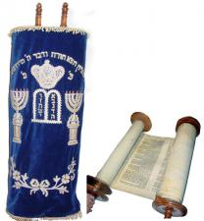
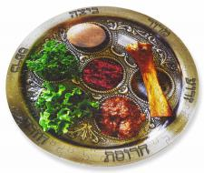
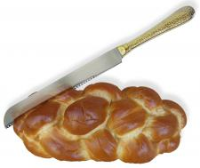
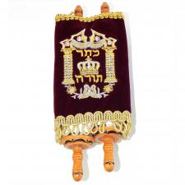
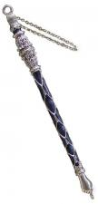
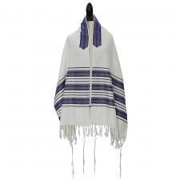
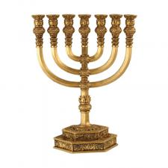
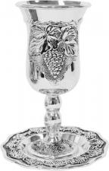
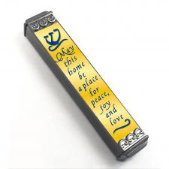
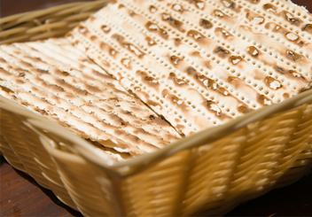
Symbols of Judaism
1.
2.
3.
4.
5.
6.
8.
9.
7.

Slide 2
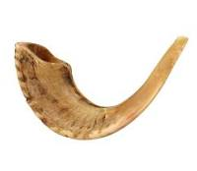
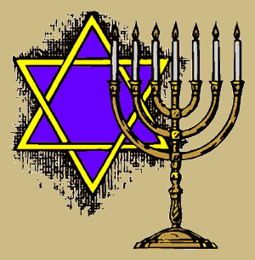
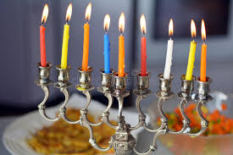
Four Traditoinal Jewish Shofar Calls or Blasts –
https://www.youtube.com/watch?v=7JuJ1funexc YouTube
http://www.shofarot-israel.com/index.php/the-shofar/biblicaltime/
10.
11.
12.
Notes:
The Shofar is mentioned seventy two times in the bible in various contexts and functions.
In the revelation of Sinai the very strong sound of a Shofar, which shocked (made people tremble) the people, was heard among the sounds and bolts. Here is the description in the book of Exodus (29, 16-19): 16…”And it came to pass on the third day in the morning, that there were thunders and lightning, and a thick cloud upon the mount, and the voice of the trumpet exceeding loud; so that all the people that was in the camp trembled.
17…”And Moses brought forth the people out of the camp to meet with God; and they stood at the nether part of the mount.”
18…”And Mount Sinai was altogether on a smoke, because the LORD descended upon it in fire: and the smoke thereof ascended as the smoke of a furnace, and the whole mount quaked greatly.”
19…”And when the voice of the trumpet sounded long, and waxed louder and louder, Moses spoke, and God answered him by a voice.”
The role of the Shofar in the description of receiving the Torah at Mount Sinai may be the strongest expression of the magic, supernatural, enchanted nature of the Shofar, which had such an impact on the imagination of people through the ages.
In the description of the conquests of Joshua and the People of Israel, the walls of Jericho came tumbling down after blowing the Shofars. And so it is written in the book of Joshua (6, 1-20) about the conquest of Jericho and falling of its walls:
“1 Now Jericho was tightly shut up because of the Israelites. No one went out and no one came in. 2 Then the LORD said to Joshua, “See, I have delivered Jericho into your hands, along with its king and its fighting men. 3 March around the city once with all the armed men. Do this for six days. 4 Have seven priests carry trumpets of rams’ horns* in front of the ark. On the seventh day, march around the city seven times, with the priests blowing the trumpets. 5 When you hear them sound a long blast on the trumpets, have all the people give a loud shout; then the wall of the city will collapse…”
In various places in the Bible the Shofar is conceived as an instrument, used by God himself:
“Then the LORD will appear over them; his arrow will flash like lightning. The Sovereign LORD will sound the trumpet…” (Zechariah 9:14).
The sign is given with the Shofar, it is the symbol of God, it is God’s voice.
The Shofar is mentioned in the Bible also in other events and images connected with might, awe and fear.
The Shofar was used, usually, for the following military purposes:
Signaling and alerting: Ehud and Nehemiah use it to summon their men (Judges 3:27; Nehemiah 4:12-14).
Weapon for frightening the enemy (Judges 7:22)
Announcing victory (Samuel A 13:3)
Announcing rebellion (Samuel B 20:1)
Cease fighting (Samuel B 20:22)
Warning sign about approaching enemy (Jeremiah 4:21; Hosea 5:8; and other)
The prophet is likened to a scout blowing the Shofar to warn the people (Ezekiel 33:1-6).
The scout’s Shofar and the army’s Shofar are joined together in the description of the day of the Lord (Zephaniah 1:16).
It is also written: “And it shall come to pass in that day, that a great horn shall be blown;” (Isaiah 27:13).
It was customary to blow the Shofar on coronations, like in the story of Absalom (2 Samuel 15:10) and of Jehu (2 Kings 9:13), as well as upon the coronation of God on the entire universe (Psalms 47:6; 68:6)
The Shofar is mentioned on occasions of festivals and worship, like on the occasion of bringing up the Holy Ark (2 Samuel 6:15) and in the repentance of Asa and The People (Chronicles B 15:14).
Tekiah and Teruah
The shofar is frequently mentioned along with the trumpets on events of festivals and worship. E.g. when the Holy Ark was taken by king David to Jerusalem: “So all Israel brought up the ark of the covenant of the LORD with shouts, with the sounding of rams’ horns and trumpets, and of cymbals, and the playing of lyres and harps” (1 Chronicles 15:28) or in the hints given by Ba’al Tehilim (Psalms 98:6) “With trumpets and sound of cornet make a joyful noise before the LORD, the King”.
That proximity, between the trumpet and the Shofar is also expressed in the common verbs and gerunds: the word Tekiah and the word Teruah are used both for the trumpet and Shofar.
After the Destruction of the Second Temple
After the destruction of the Second Temple and in the Diaspora the Shofar lost its public and strategic meaning, but retained its ritual role, particularly on Rosh Hashanah and Yom Kippur.
From the days that preceded the Destruction of the Second Temple we still have the testimony of Philo of Alexandria ** about the use of the Shofar in Rosh Hashanah and the meanings attributed to it. The testimony given by that philosopher is of great importance to nowadays researchers. The use of the Shofar on Rosh Hashanah and Yom Kippur is influenced by the principles of using the Shofar in biblical times.
(= rams) sometimes the word Shofar is adjacent to the word Yovel (jubilee) or the word combination Keren Hayovel (Horn of Jubilee) (Joshua 6:4, 5, 6, 8). Sometimes the word Yovel is synonymous to the word Shofar (Exodus 19:13). (Yovel or Yevel in Canaanite = ram)** About the Commandments, Book B, Translation from: Yom Tov Levinsky – bbbbbb Book of the Holidays A, p. 52.
http://www.shofarot-israel.com/index.php/the-shofar/biblicaltime/
11. The Hanukkiah has 8 branches and the middle candle is the servant candle. It is lit first and used to light the other candles.
12. Star of David and Menorah – Symbols of Judaism

Slide 3
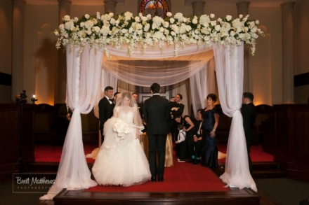
13.
14.
15.

Slide 4
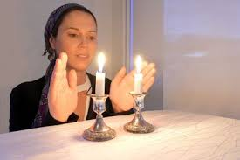
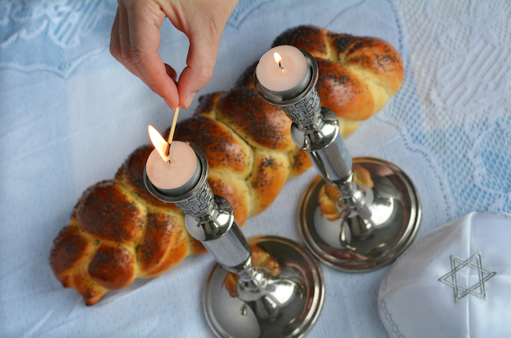
Celebrations:
Passover (Seder Meal) Celebration is a family celebration.
Erv Shabbat Celebration is a family celebration and begins every Friday evening at sundown. It is a special time of blessing, the food God provided, the mother, the father, the children.
Challah served at Erv Shabbat

Slide 5
Seder Plate used at Passover

Slide 6
Wedding. Getting married under the Huppah – God’s covering and blessing in the marriage.

Slide 7
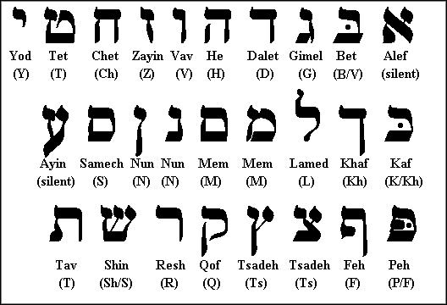
Begin to read from right to left. Reading a book, you begin from the back and read to the front.

Slide 8
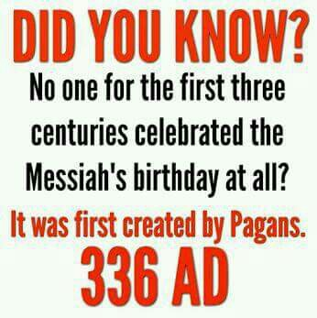
https://www.pinterest.com/pin/520025088200211222/
https://www.pinterest.com/pin/362680576227826647/

Slide 9
Explanation of Shavout/Pentecost
https://www.pinterest.com/pin/448882287836252443/

Slide 10
Letter of the Law given at Mount Sinai – death
Notes:
Also known as Shavout or Pentecost
https://www.pinterest.com/pin/434175220316781804/

Slide 11
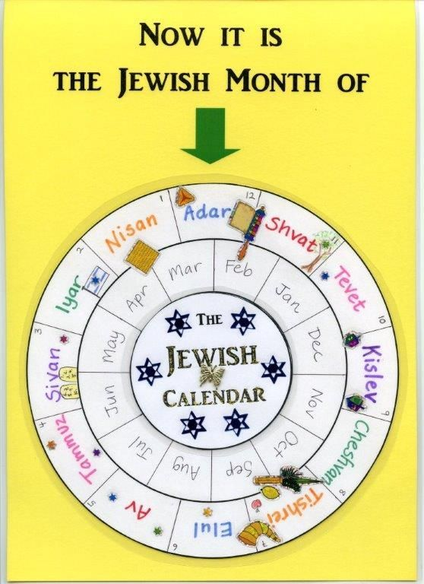
Notes:
https://i.pinimg.com/564x/f9/e3/eb/f9e3eb333b25bf0cfadbbb5bc64f0650.jpg

Slide 12
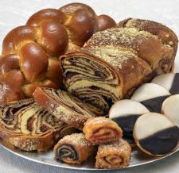
Special foods served during the Holy Days.
The foods relate to each particular agricultural season.
Matza – Passover –remembering the Manna in the wilderness.
Pastries made with honey and Wheat - Shavout
Potato Latkes – Hanukkah remembering the oil that burned for 8 days

Slide 13
Take the Test
Write your answers on a sheet or paper. Numbered 1 to 12
Identify the symbol
Identify when it is used
Identify where it is used
Identify why it is used
If all of your answers are correct add 6 points to your score to make 50 marks.

Slide 14
Symbols of Judaism
Nebuchadnezzar
1.
2.
3.
4.
5.
6.
8.
9.
7.

Slide 15
Symbols of Judaism
1. Passover Seder plate, what does each represent? Shank bone represents lamb that was sacrificed; hameatz (mortar for bricks); lettuce bitterness of slavery; parsley dipped in salt water - tears shed in slavery; egg – new life; horse radish root - bitterness of slavery
2. Challah – braided bread served at Erv Shabbat
3.Scriptures: Torah and Half Torah (Prophets and Writings)
4. Yad – Torah Pointer
8. Mezuzah – attached to the door post of the home with a verse.
5. Prayer Shawl
8. Matzah – unleavened bread used at Passover.
6. Menorah used on Holy Days
7. Kiddish Cup used on Erv Shabbat.

Slide 16
Four Traditoinal Jewish Shofar Calls or Blasts –
https://www.youtube.com/watch?v=7JuJ1funexc YouTube
http://www.shofarot-israel.com/index.php/the-shofar/biblicaltime/
10. Shofar
11. Hanukkiah
12. Symbols of Israel - star of David and Menorah.
Notes:
The Shofar is mentioned seventy two times in the bible in various contexts and functions.
In the revelation of Sinai the very strong sound of a Shofar, which shocked (made people tremble) the people, was heard among the sounds and bolts. Here is the description in the book of Exodus (29, 16-19): 16…”And it came to pass on the third day in the morning, that there were thunders and lightning, and a thick cloud upon the mount, and the voice of the trumpet exceeding loud; so that all the people that was in the camp trembled.
17…”And Moses brought forth the people out of the camp to meet with God; and they stood at the nether part of the mount.”
18…”And Mount Sinai was altogether on a smoke, because the LORD descended upon it in fire: and the smoke thereof ascended as the smoke of a furnace, and the whole mount quaked greatly.”
19…”And when the voice of the trumpet sounded long, and waxed louder and louder, Moses spoke, and God answered him by a voice.”
The role of the Shofar in the description of receiving the Torah at Mount Sinai may be the strongest expression of the magic, supernatural, enchanted nature of the Shofar, which had such an impact on the imagination of people through the ages.
In the description of the conquests of Joshua and the People of Israel, the walls of Jericho came tumbling down after blowing the Shofars. And so it is written in the book of Joshua (6, 1-20) about the conquest of Jericho and falling of its walls:
“1 Now Jericho was tightly shut up because of the Israelites. No one went out and no one came in. 2 Then the LORD said to Joshua, “See, I have delivered Jericho into your hands, along with its king and its fighting men. 3 March around the city once with all the armed men. Do this for six days. 4 Have seven priests carry trumpets of rams’ horns* in front of the ark. On the seventh day, march around the city seven times, with the priests blowing the trumpets. 5 When you hear them sound a long blast on the trumpets, have all the people give a loud shout; then the wall of the city will collapse…”
In various places in the Bible the Shofar is conceived as an instrument, used by God himself:
“Then the LORD will appear over them; his arrow will flash like lightning. The Sovereign LORD will sound the trumpet…” (Zechariah 9:14).
The sign is given with the Shofar, it is the symbol of God, it is God’s voice.
The Shofar is mentioned in the Bible also in other events and images connected with might, awe and fear.
The Shofar was used, usually, for the following military purposes:
Signaling and alerting: Ehud and Nehemiah use it to summon their men (Judges 3:27; Nehemiah 4:12-14).
Weapon for frightening the enemy (Judges 7:22)
Announcing victory (Samuel A 13:3)
Announcing rebellion (Samuel B 20:1)
Cease fighting (Samuel B 20:22)
Warning sign about approaching enemy (Jeremiah 4:21; Hosea 5:8; and other)
The prophet is likened to a scout blowing the Shofar to warn the people (Ezekiel 33:1-6).
The scout’s Shofar and the army’s Shofar are joined together in the description of the day of the Lord (Zephaniah 1:16).
It is also written: “And it shall come to pass in that day, that a great horn shall be blown;” (Isaiah 27:13).
It was customary to blow the Shofar on coronations, like in the story of Absalom (2 Samuel 15:10) and of Jehu (2 Kings 9:13), as well as upon the coronation of God on the entire universe (Psalms 47:6; 68:6)
The Shofar is mentioned on occasions of festivals and worship, like on the occasion of bringing up the Holy Ark (2 Samuel 6:15) and in the repentance of Asa and The People (Chronicles B 15:14).
Tekiah and Teruah
The shofar is frequently mentioned along with the trumpets on events of festivals and worship. E.g. when the Holy Ark was taken by king David to Jerusalem: “So all Israel brought up the ark of the covenant of the LORD with shouts, with the sounding of rams’ horns and trumpets, and of cymbals, and the playing of lyres and harps” (1 Chronicles 15:28) or in the hints given by Ba’al Tehilim (Psalms 98:6) “With trumpets and sound of cornet make a joyful noise before the LORD, the King”.
That proximity, between the trumpet and the Shofar is also expressed in the common verbs and gerunds: the word Tekiah and the word Teruah are used both for the trumpet and Shofar.
After the Destruction of the Second Temple
After the destruction of the Second Temple and in the Diaspora the Shofar lost its public and strategic meaning, but retained its ritual role, particularly on Rosh Hashanah and Yom Kippur.
From the days that preceded the Destruction of the Second Temple we still have the testimony of Philo of Alexandria ** about the use of the Shofar in Rosh Hashanah and the meanings attributed to it. The testimony given by that philosopher is of great importance to nowadays researchers. The use of the Shofar on Rosh Hashanah and Yom Kippur is influenced by the principles of using the Shofar in biblical times.
(= rams) sometimes the word Shofar is adjacent to the word Yovel (jubilee) or the word combination Keren Hayovel (Horn of Jubilee) (Joshua 6:4, 5, 6, 8). Sometimes the word Yovel is synonymous to the word Shofar (Exodus 19:13). (Yovel or Yevel in Canaanite = ram)** About the Commandments, Book B, Translation from: Yom Tov Levinsky – bbbbbb Book of the Holidays A, p. 52.
http://www.shofarot-israel.com/index.php/the-shofar/biblicaltime/
11. The Hanukkiah has 8 branches and the middle candle is the servant candle. It is lit first and used to light the other candles.
12. Star of David and Menorah – Symbols of Judaism

Slide 17
14. Getting married under the Huppah and Tallit (God’s covering for the marriage)
13. Passover Celebration
15. Kippah

Slide 18
This is Just a Beginning …
of all there is to learn.
It benefits students ... which is all of us…
be inspired …
Enjoy it,
Edit it,
Add to it ☺
Helen Wall, Spiritual Fruit Ministries, February 2018
Nassau, Bahamas

