Slide 1

Notes:
Welcome and Introduction
Neil: Hi everyone! We want to welcome all of the parents, youth and kids to today’s special – it’s a Family Fun and Blessing Day.
Annette: This is a special service designed for families – we are going to facilitate a time for you parents (and grandparents) to bless your children. Let’s start with this fun song… I’m sure you all know it…. (show video)

Slide 2

Notes:
Worship: (Suggested Songs- feel free to choose 2 or 3 worship songs geared to the family)
Jesus you’re my Superhero: https://www.youtube.com/watch?v=1FY4C930M2Y
Deep Cries Out: written by William Matthews, Christiann Koepke © 2010 Bethel Music Publishing

Slide 3
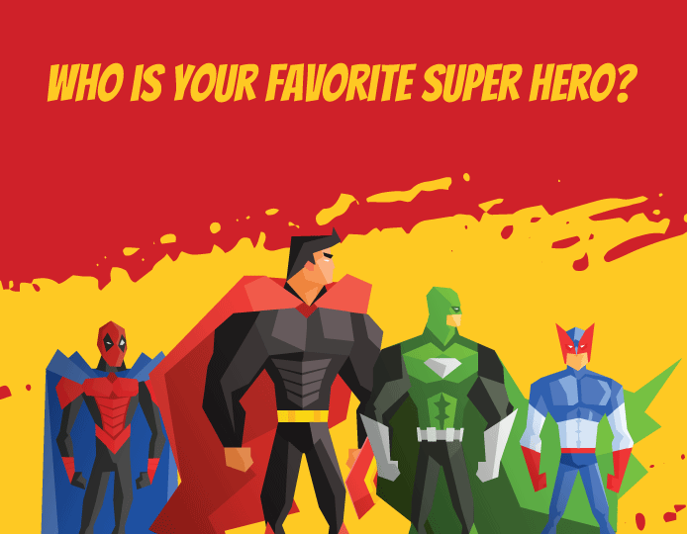
Notes:
Crowd Breaker:
Activity name: Share your ‘Super Hero’ Stories
Annette: WHO IS YOUR FAVORITE SUPER HERO?

Slide 4

Notes:
Neil: Superheros have come a long way from the comic books I use to read as a kid. I loved the old Batman TV show in the 60’s. Batman and his sidekick Robin would fight evil villains like the Joker, the Riddler, Cat Woman and the Penguin. The fight scenes had great cartoon captions like kapow, bam, zap… Almost every episode Batman and Robin would be in some impossible situation and the announcer would say something like, “Has Batman struck out? Is Robin cool for good? Can no one save out noble pair of human popsicles? Tune in next week! Same bat time same bat channel… Na na na na na Batman!

Slide 5

Notes:
Neil: Super Hero movies are big business now. Audiences assembled worldwide as Disney and Marvel's Avengers: Infinity War broke both the domestic opening weekend box office record and worldwide opening record with a massive $250 million domestically and $630 million worldwide. No matter if you are young are old you probably have a favourite super hero.

Slide 6

Notes:
Message: Launching Superheroes
Neil: Today we want to talk about launching superhero kids and youth
Neil: We sang earlier about Jesus being our super hero. What is the difference between Jesus and all of these other super heroes? (Again get audience feedback)

Slide 7
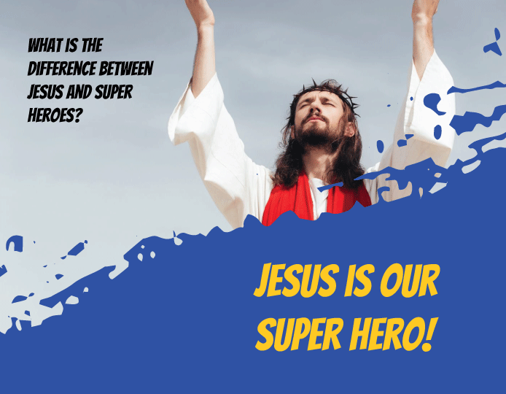
Notes:
Annette: One thing that is different about Jesus and the other superheroes is that most of them don’t have a father and they are orphans. Superman parents sent him on a rocket ship from Krypton before dying when their planet exploded.
Neil: That’s right… and… Batman aka Bruce Wayne’s parents died in a robbery when his parents were killed by a criminal. Even Spiderman, Peter Parker’s parents died when he was young and he lived with his aunt May and uncle Ben. All of these super heroes had everyday secret identities and did extraordinary things to help make their city and the world a safer place to live.
Annette: Jesus on the other hand was not an orphan. Jesus came to introduce us to his Heavenly Father.
Jesus said in John 14:6, “I am the way, the truth, and the life. No one can come to the Father except through me. ABC
And in John 14:18 he also said… If you had really known me, you would know who my Father is… I will not abandon you and leave you as orphans… I will come to you.

Slide 8
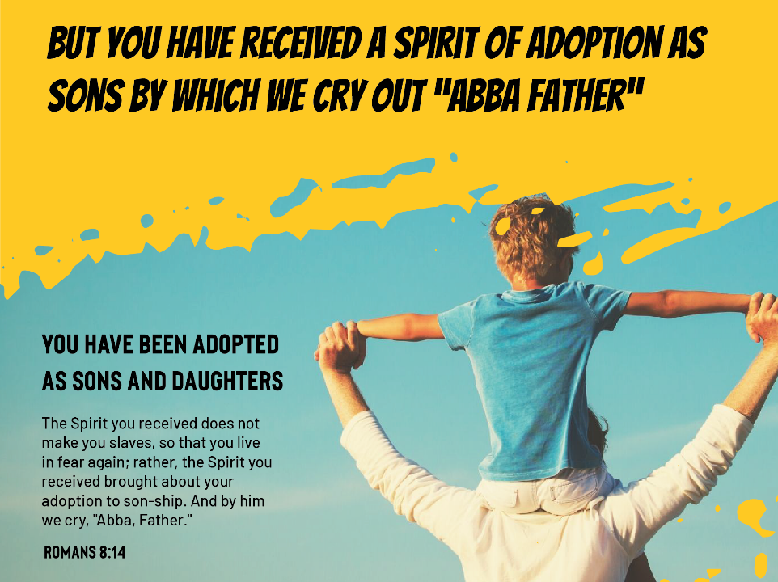
Notes:
Neil:
You have been Adopted as Sons and Daughters
When we become followers of Jesus and invite him to come and dwell in our hearts. He promised to send us the Holy Spirit.
The Spirit you received does not make you slaves, so that you live in fear again; rather, the Spirit you received brought about your adoption to son-ship. And by him we cry, "Abba, Father." Romans 8:14
You and I have been adopted into God’s family and we can call him Abba or daddy!

Slide 9
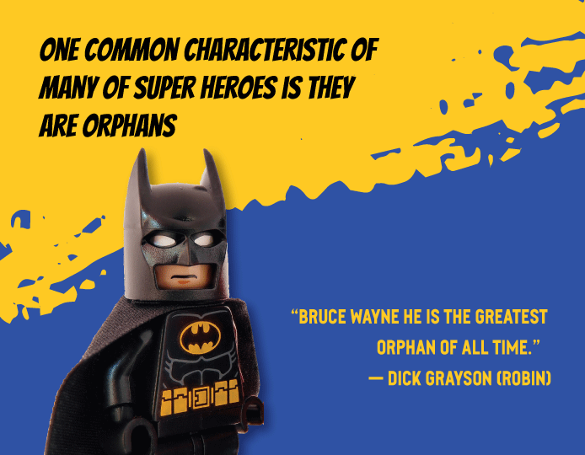
Notes:
Neil. There is something that is in all of us that longs for a father’s blessing. In the Batman Lego movie there is a scene where Bruce Wayne is attending an orphanage fundraiser. One of the orphans in the choir is Dick Grayson (who becomes Robin) blurts out “ look it is Bruce Wayne … the greatest orphan of all time.” Why? Because he is the self made millionaire he has done great things and done great things without having parents. Batman is always looking for a family in the movie but he has put up this shell of protection around his heart that he is the only one who can save Gotham from the bad guys.
Dick goes down to meet Bruce Wayne and ask him advice to get adopted… Bruce ignores the little orphan brushing him off and walks away. Sadly he looks up and says, “All I want to be is adopted so that I never have to be alone.”
(SHOW VIDEO)

Slide 10

Notes:
Annette:
Each one of us – that’s you and me - has immense incredible value and worth.
Look at the birds of the air: they neither sow nor reap nor gather into barns, and yet your heavenly Father feeds them. Are you not of more value than they? Matthew 6:26
Everyone has immense, incredible value and worth.
Who knows what 'immense' means?
I looked that word up in a thesaurus… it means….
Huge - massive - enormous - gigantic - jumbo - cosmic - whopping, humongous, giant....
Do you it's the same for everyone - it doesn't matter where you were born, what colour you are, what language you speak.
Everyone is born with the same amount and it never changes no matter how old you get or what someone else tells you... You were born with it and it will remain with them all the days of your life.
Neil: Illustration- Pull out a $20 bill from my pocket…wave it in the air…
Like this $20 bill – for example – how much is this $20.00 worth? $20.00 you say?? Well what if I take the $20, crumple it into a ball, throw it on the ground, stomp on it a few times, and say something silly along the lines of “This is a dumb, good for nothing, worthless $20 bill!” How much is it worth now?
A $20 bill is a $20 bill, and no matter how dirty it is or what you say about it, it’s still worth $20.
Put the $20 bill in your pocket…
Annette: What if I take that $20 out of your pocket and put it in this guy’s pocket… How much is it worth now?
Neil: Still $20.00… A $20 bill is made with a certain value. It is always worth $20, no matter how many times it is stepped on, crumpled up, or thrown on the floor – or whose pocket it ends up in. No matter what anyone says about it or does to it, it is always worth $20 because it was MADE with that value. And the same thing is true about you.”
Annette: That’s right Neil – each of us was born with immense, incredible value and worth!

Slide 11
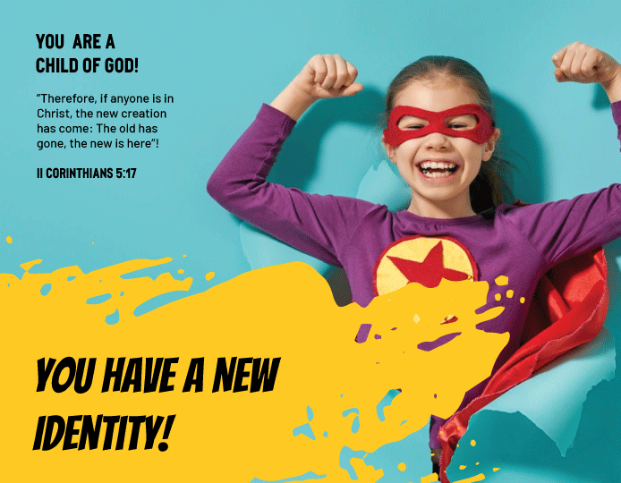
Notes:
You have a New Identity
”Therefore, if anyone is in Christ, the new creation has come: The old has gone, the new is here”! II Corinthians 5:17
Identity, very simply stated, is my perception of me. How I see me?
The primary issue at stake in dealing with identity is value: “What am I worth?”
Your TRUE identity in JESUS doesn't depend on your hair colour, body type, or which lunch table you sit at. Have you allowed other people to define you? To tell you who you are and who you aren't? God has already defined you in His perfect Son, Jesus Christ

Slide 12
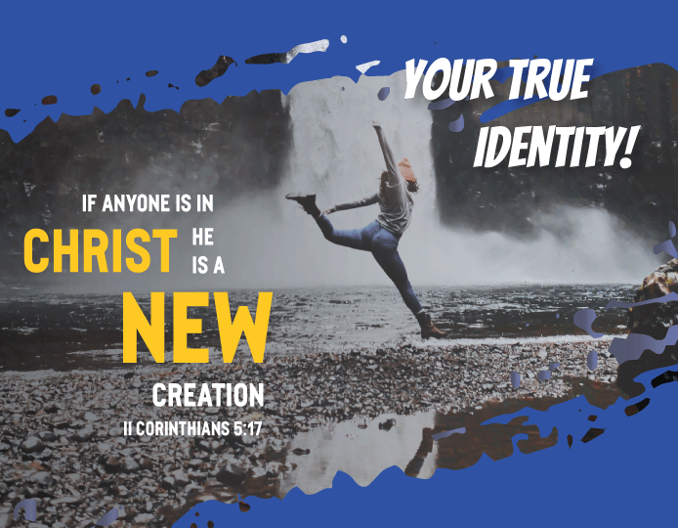
Notes:
You are a new creation In Christ and you have the Nature of Jesus living in you. You have a new power to live a different life that loves God and serves others.
In some ways you could say that we are like superheroes because they always seem to make the right decisions, often saving the world from evil. We aim to be like them, in the sense that they have strong morals and values; which we look to carry into everyday life.

Slide 13
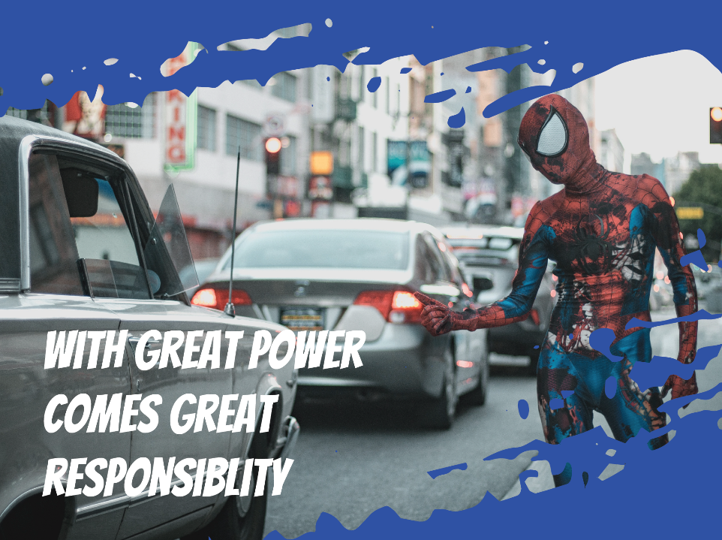
Notes:
Neil:
There is a great line in the original Spider-man movie where Peter Parker is sitting with his uncle Ben and he is telling Peter “just because you can doesn't make it right.” He goes on to say, “With Great Power comes great responsibility”.
Likewise, we all have a great responsibility to tell others about God and that they don’t have to be orphans they to can come to know him as their father if they will ask Jesus to come into their lives.

Slide 14

Notes:
Annette:
God’s design is for parents to bless their identity and their destiny.
God's plan to get the message of our value and worth to us.... is from His Heart through parents towards us...
We have found no matter where we travel in the world... we have found this to be true? How many here come from parents? (Have people lift up their hands…)
I call heaven and earth to witness that I have set before you a choice. Life or death. The blessing or the curse. So choose life. You and your descendants.” Deut. 30:19

Slide 15
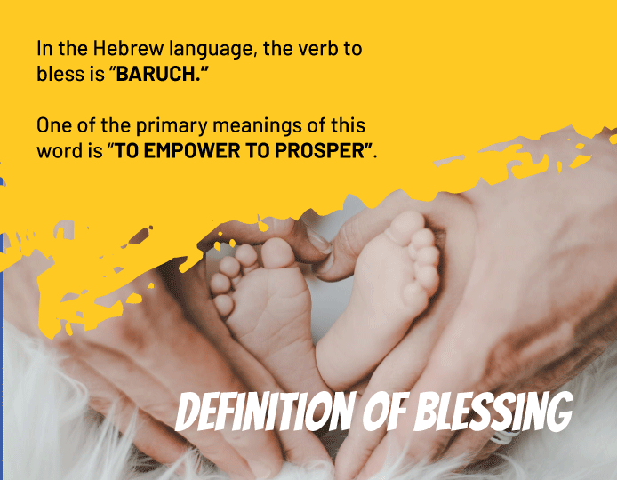
Notes:
Parents you have a choice today to bless your sons and daughters with words of blessing and affirmation. The word blessing comes from the Hebrew word “Baruch” which means to empower them to prosper. This empowerment to prosper answers two questions - ‘Who Am I?’ and ‘Why Am I here?’

Slide 16
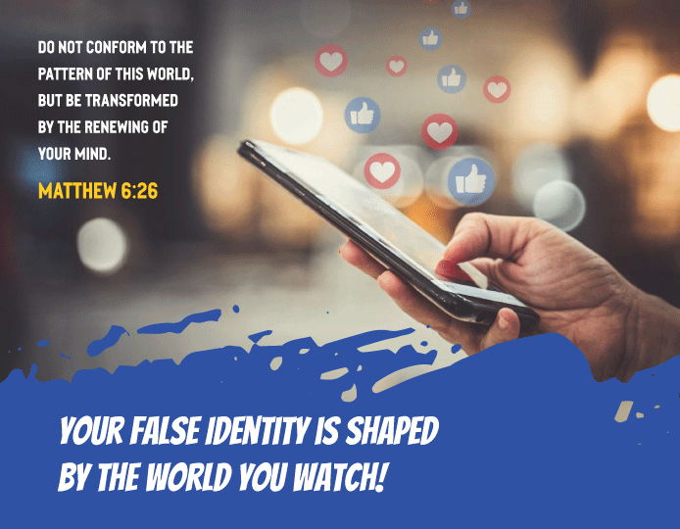
Notes:
It has been said that the average young person by the time they reach the age of 12 have had 25 million memes of information sent to them through various forms of media, education, video games and other people in their lives. Satan, the enemy of our hearts will try to give you a false Identity- Tell you that you are not pretty enough, smart enough or good enough... that I'm too short or too tall or too fat or too skinny or too....
The bad guy - like the Joker... or Lex Luther - will use good things in the world... like media, computers, music emails, pictures, even other people - like friends... to plant lies in our heart.

Slide 17
Notes:
God Uses Parents and Teachers to Speak Your True Identity.
We have found that when you don’t bless the identity, gender and destiny of your children that you actually have disempowered them and cursed their identity and destiny. Tonight we have the opportunity to reverse those lies or curses to their identity by affirming and blessing who they really are!

Slide 18

Notes:
Look into camera…. This concludes our message… what is going to happen next boys and girls – you parents have prepared a blessing for each of you… they are going to look you right in the eyes and speak those words (directly from God Heart…that He has already placed in your parent’s hearts for you)…and we get this opportunity to hear those words out loud.
Parents this is your opportunity to bless their children. Before you bless your son or daughter, take a moment to ask the Lord if you have been used as an agent of the devil to send a relational message that they are not valuable or important in your life. If the Lord shows you an incident take a moment to look your child in the eye and repent for making them feel that way. Once you have done that then take a moment to look each of your children in the eye (the window of their souls) and share from your heart to their heart the blessing that you have prepared.

Slide 19

Notes:
Benediction: (Once all of the families have finished blessing their children gather their attention and give them instructions about an ice cream social following the service - then give a benediction).
“May the Lord bless you and keep you;
May the Lord make his face shine on you and be gracious to you and your family;
May the Lord turn his face toward you and give you and your household his peace.”’
Based on Numbers 6:24-26 New International Version (NIV)

